Slide 1
BEAUFORT
The solution after storm

Slide 2


Slide 3
Contents
Why Beaufort?
User requirements
How does it work?
Visualisation
Future improvements

Slide 4
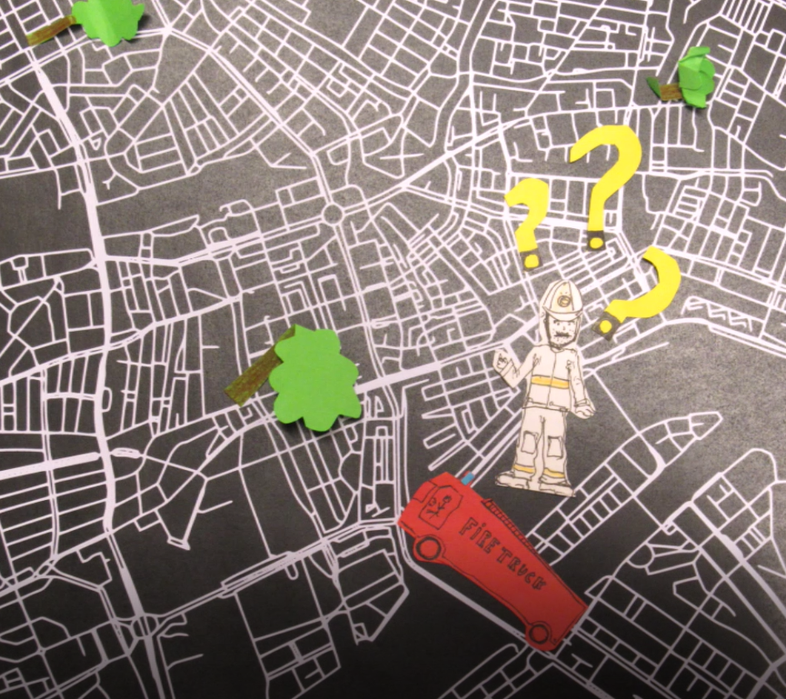
Why Beaufort?
1. Why Beaufort?
2. User requirements
3. How does it work?
4. Visualisation
5. Future improvements
In what order to solve which incidents with which trucks?
How to combine different priorities in one decision?

Slide 5
User Requirements
1. Why Beaufort?
2. User requirements
3. How does it work?
4. Visualisation
5. Future improvements
Prioritise blockages
Multiple users > login & connected via GPS
Routing takes into account blockages
Minimalistic, fast and easy to use
Feedback on why a route is chosen
Reporting function

Slide 6


Slide 7


Slide 8
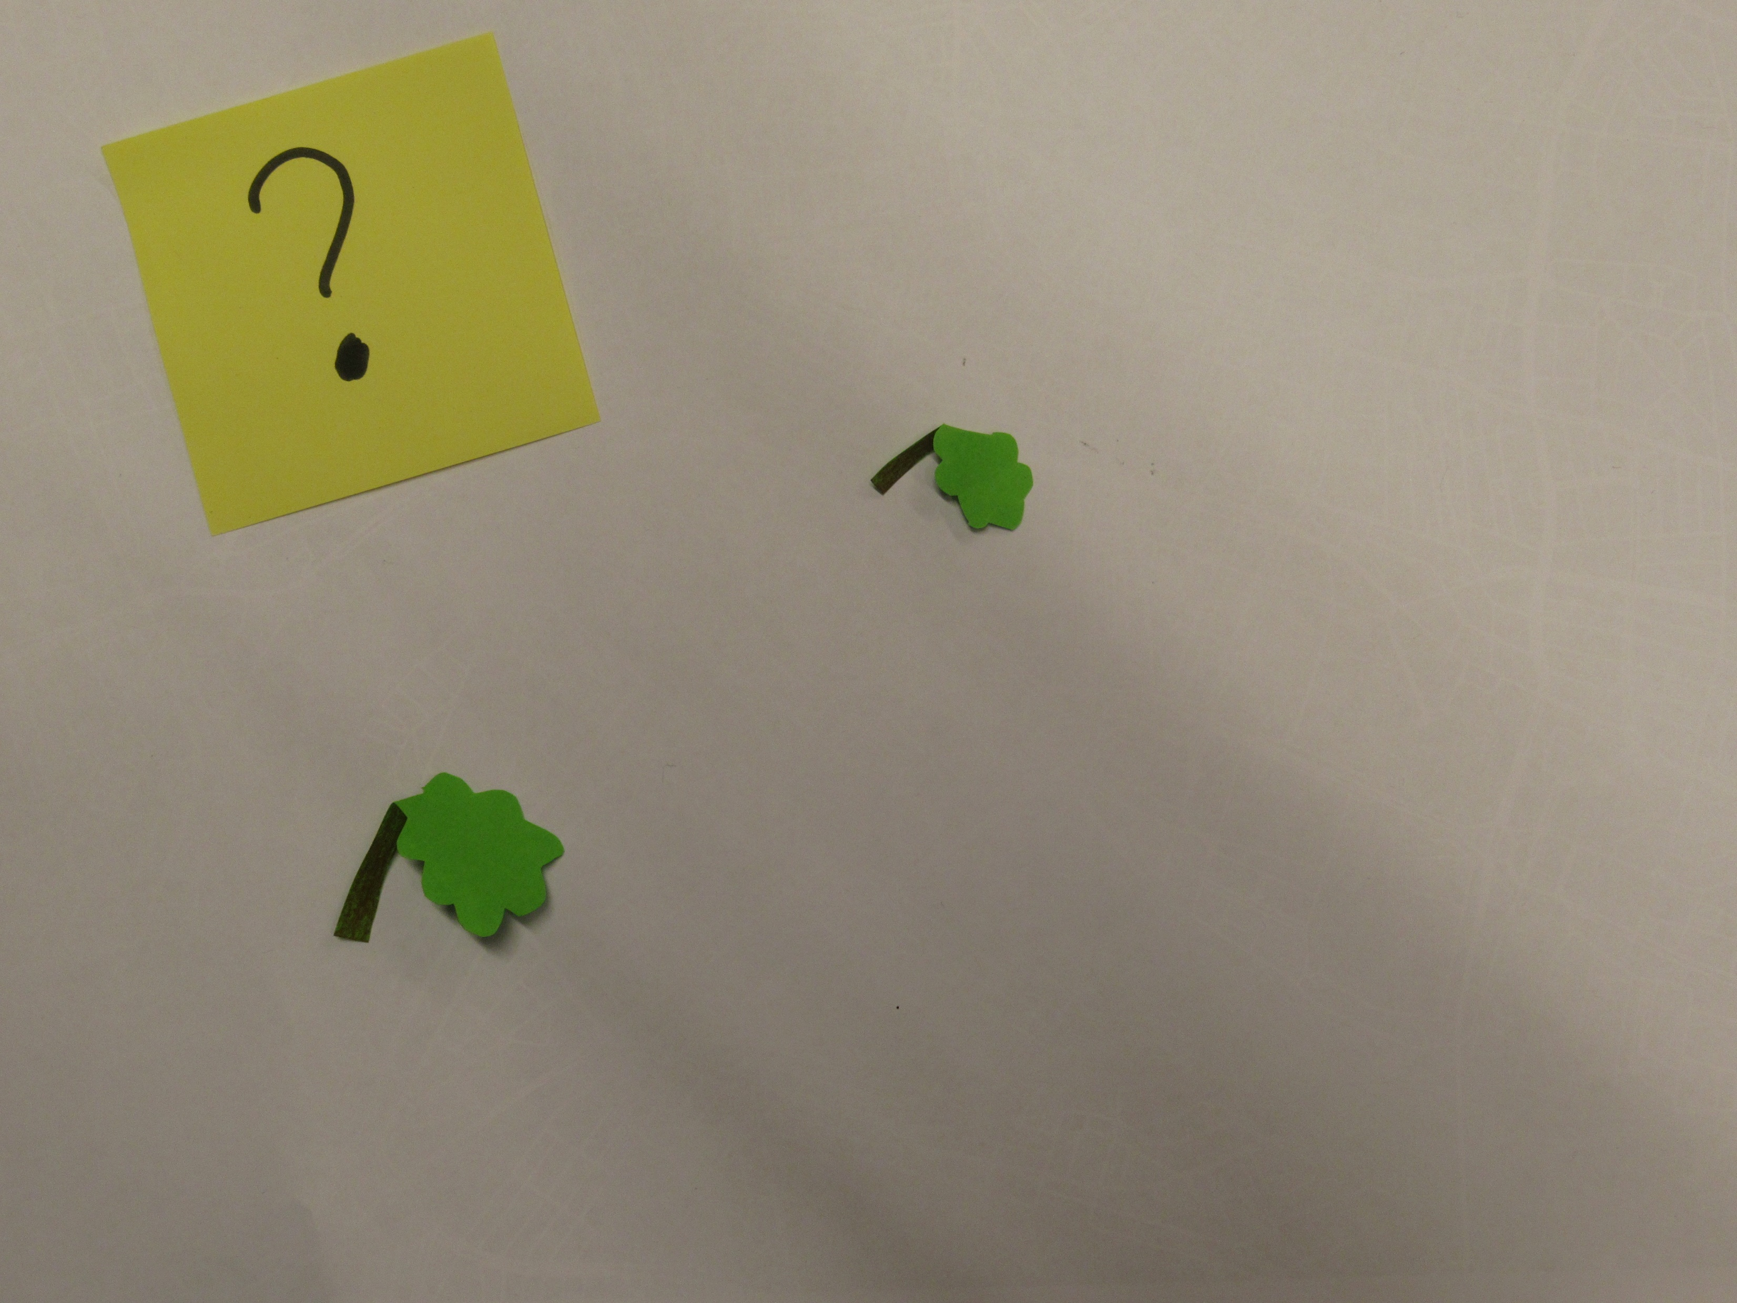

Slide 9
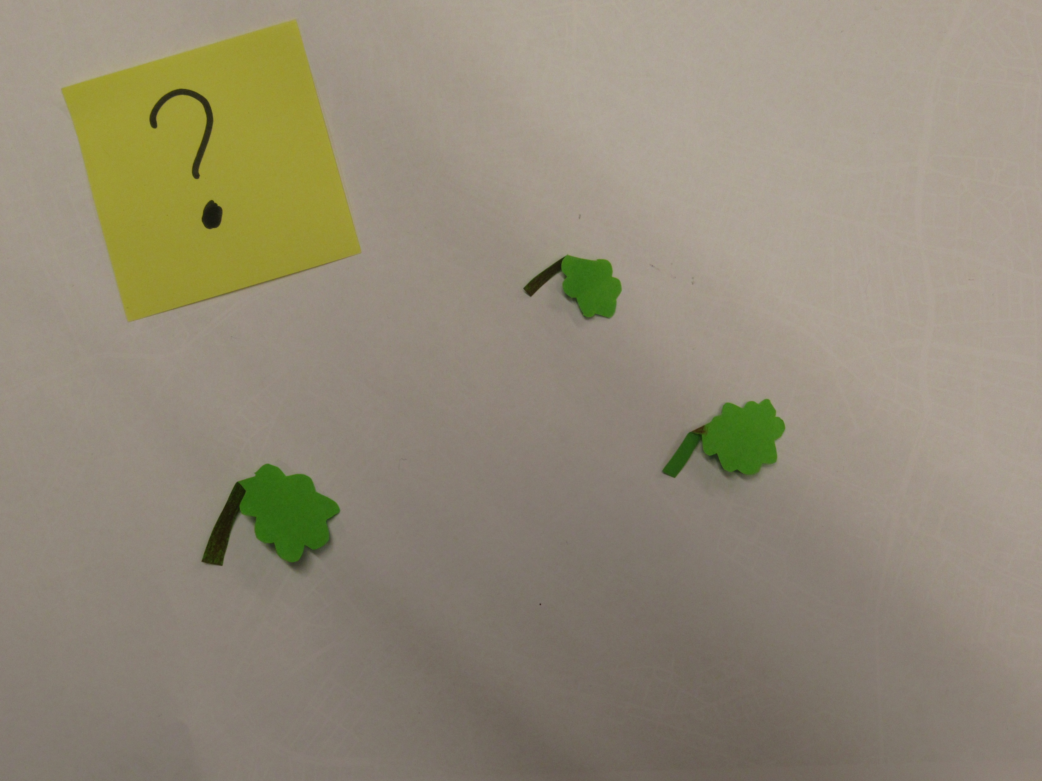

Slide 10


Slide 11
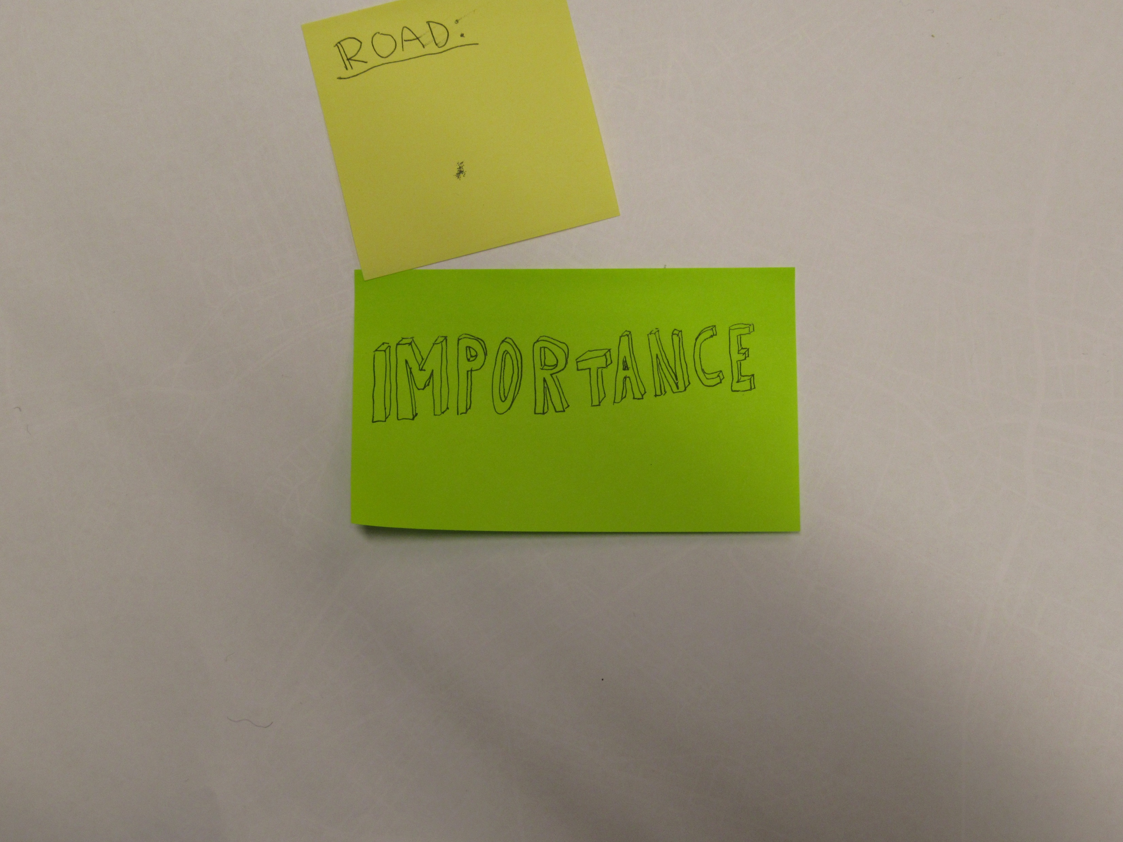

Slide 12
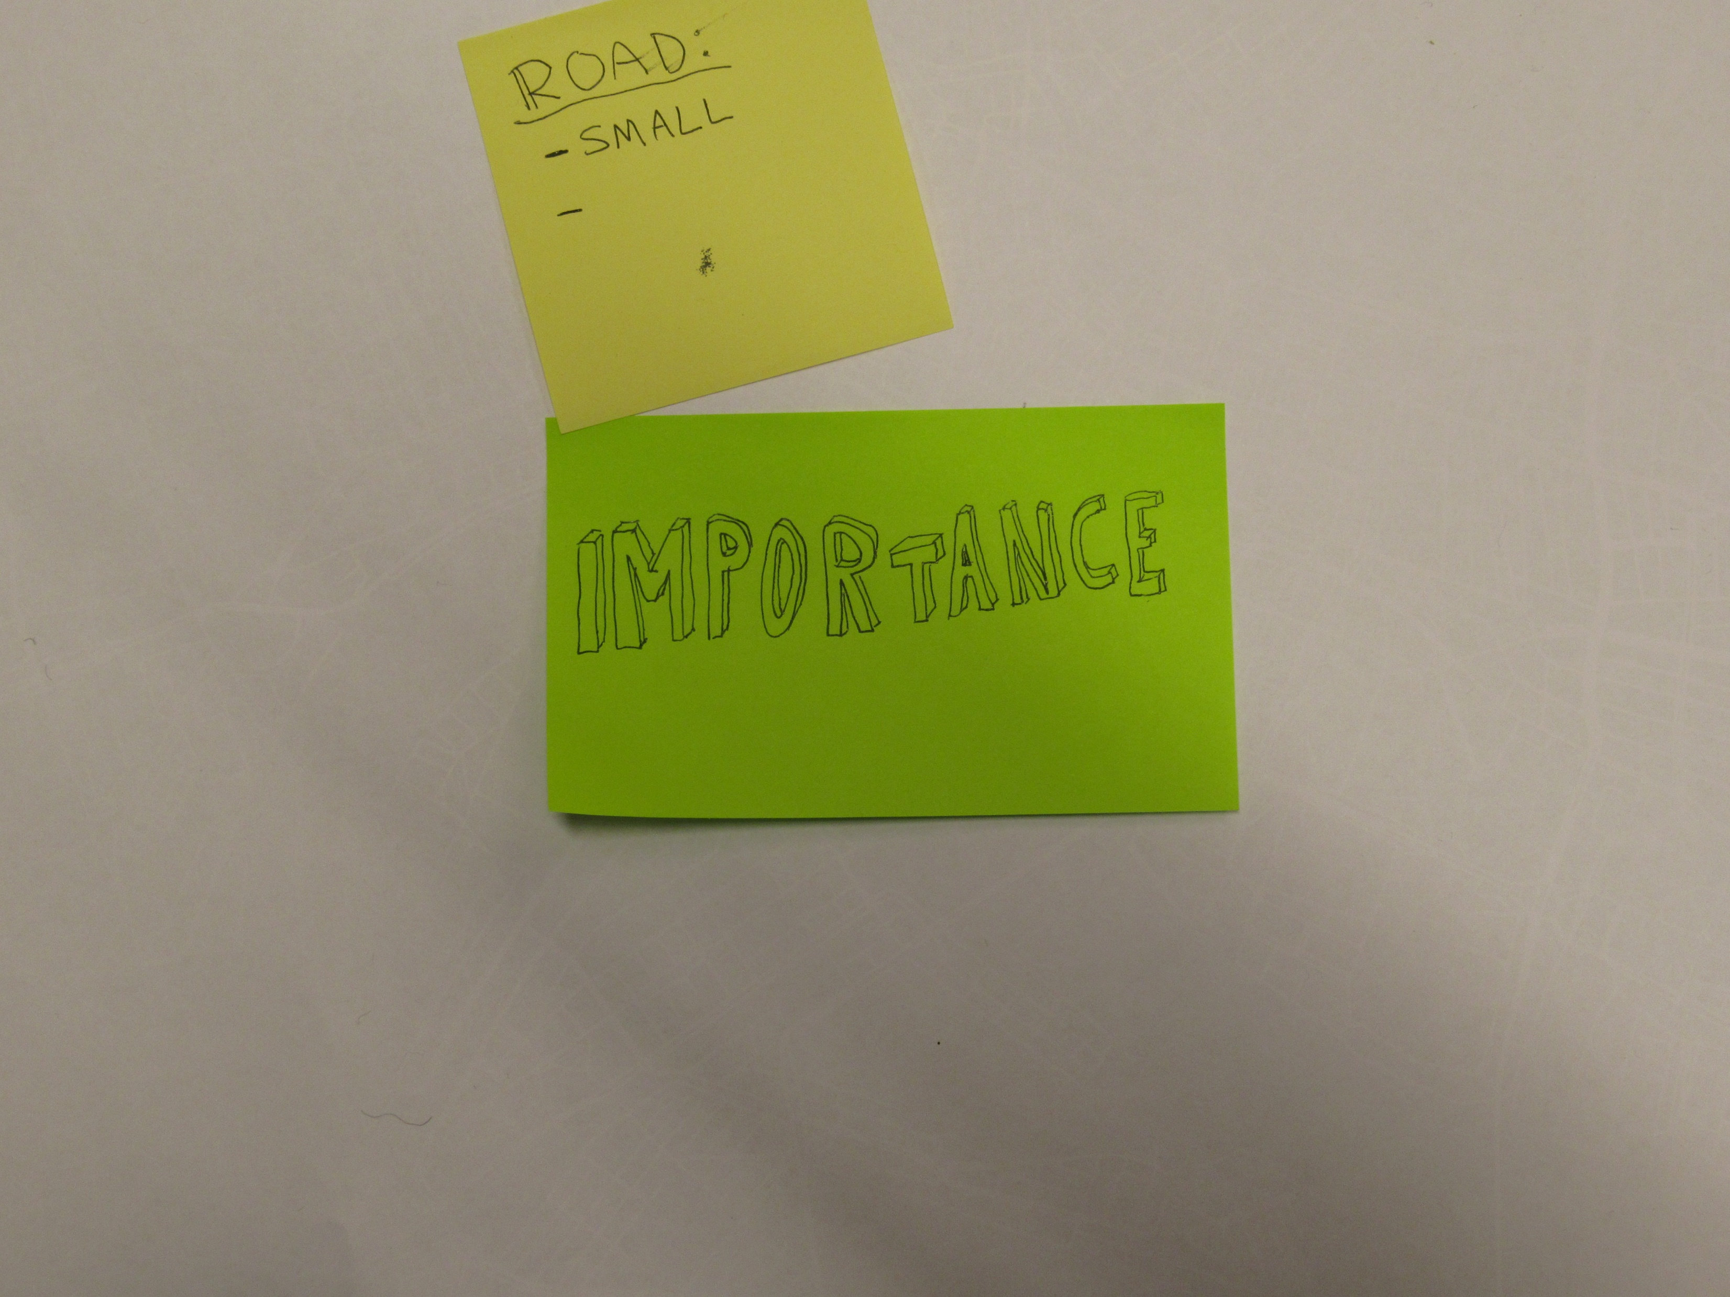

Slide 13
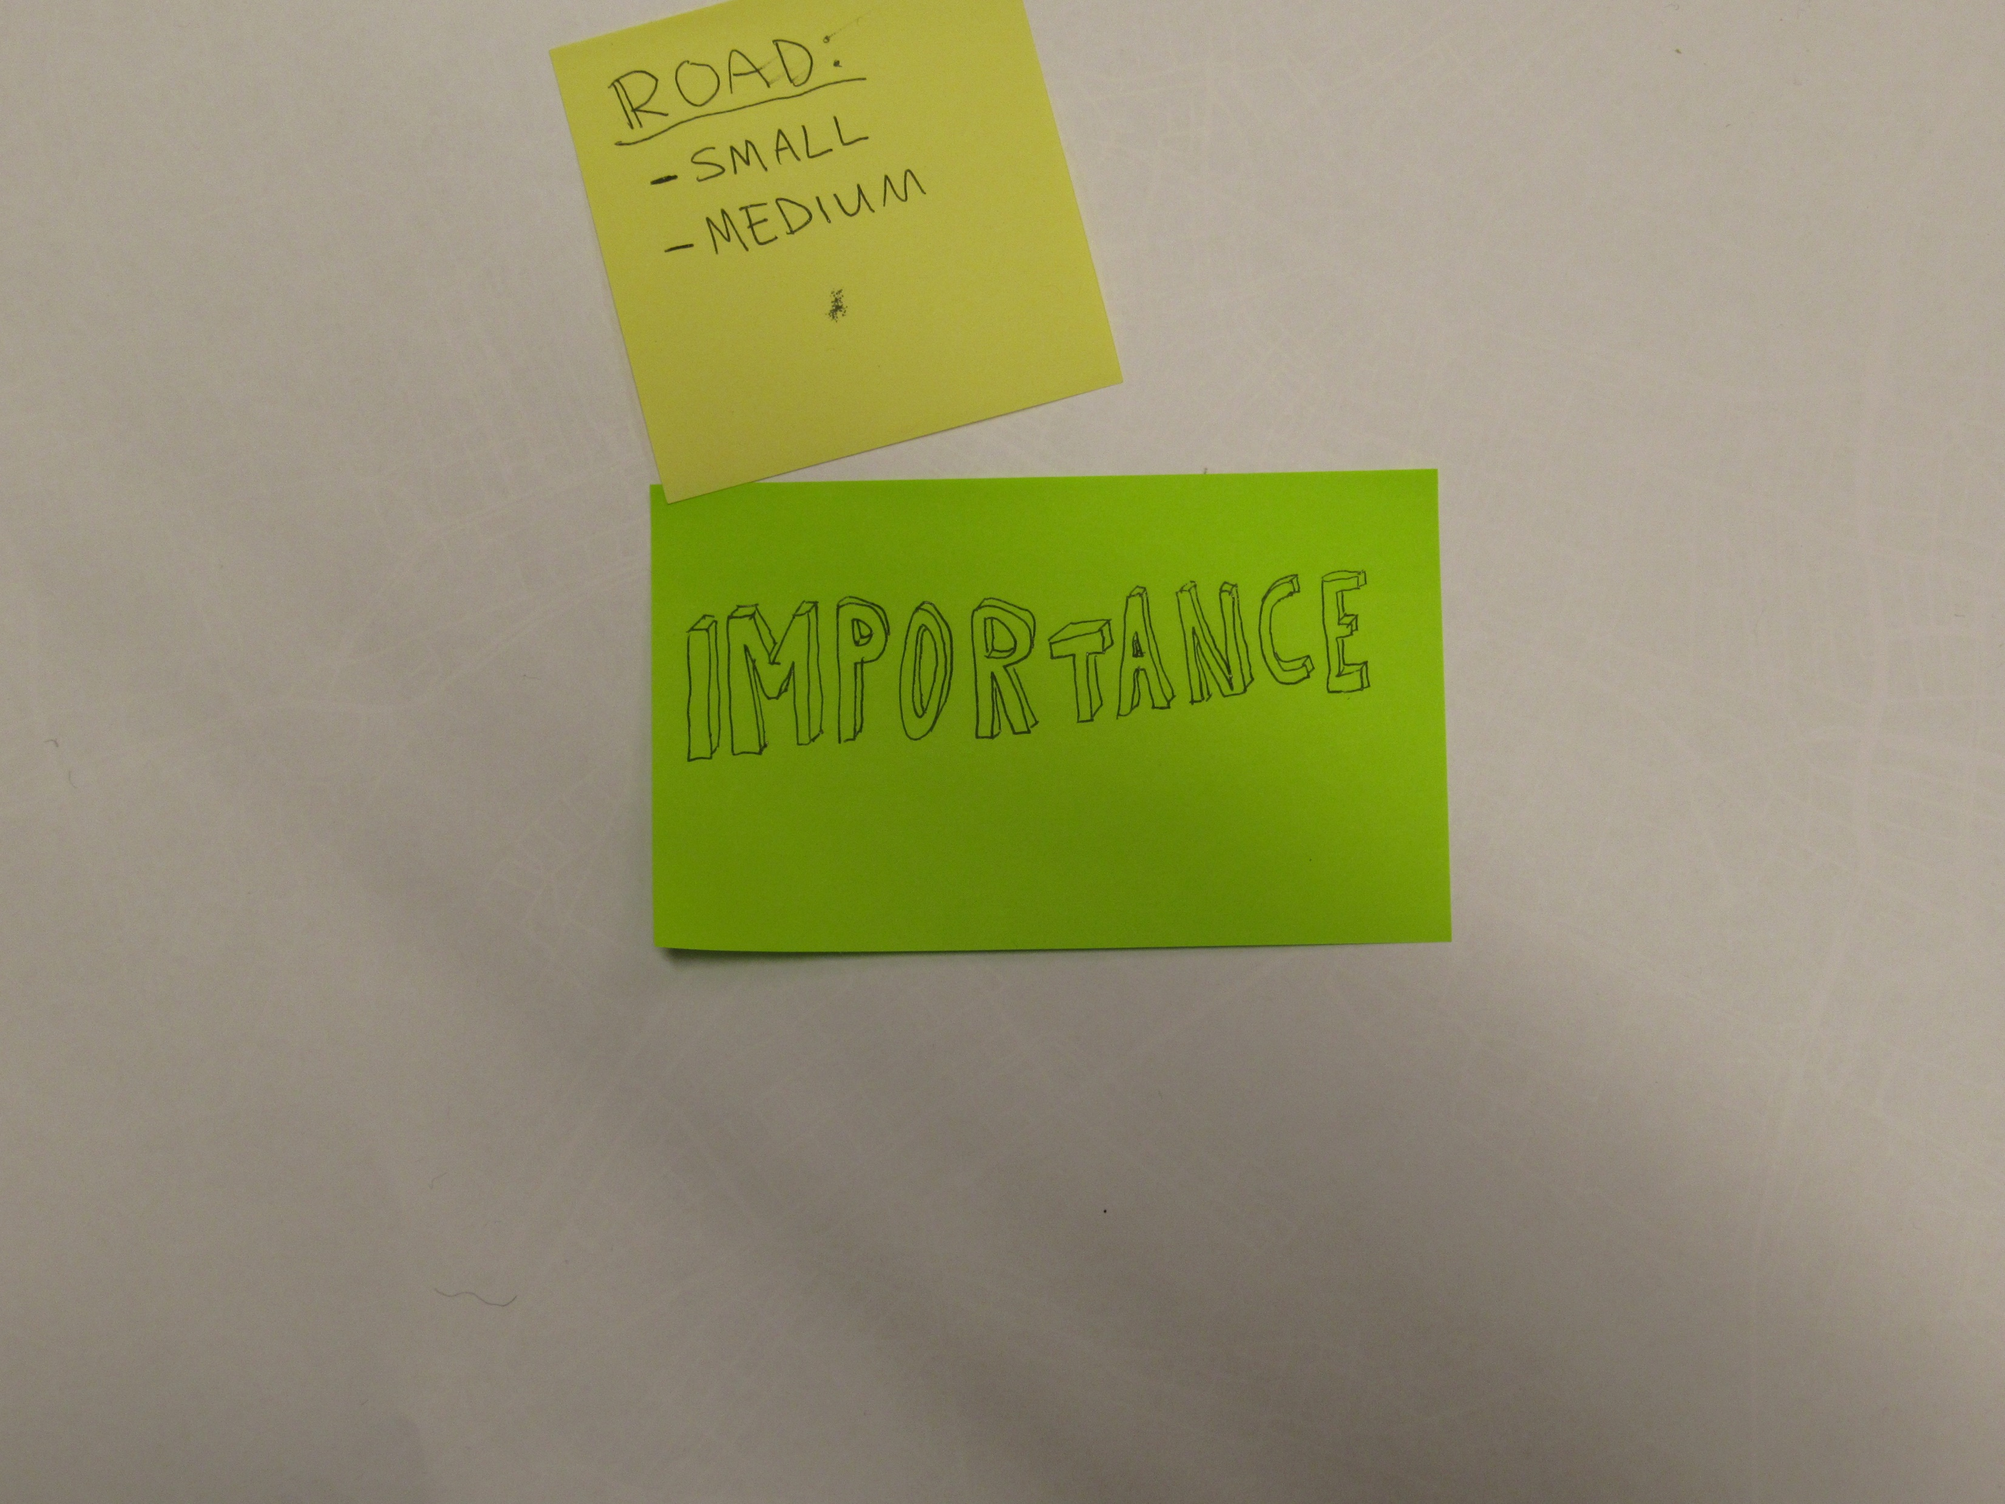

Slide 14
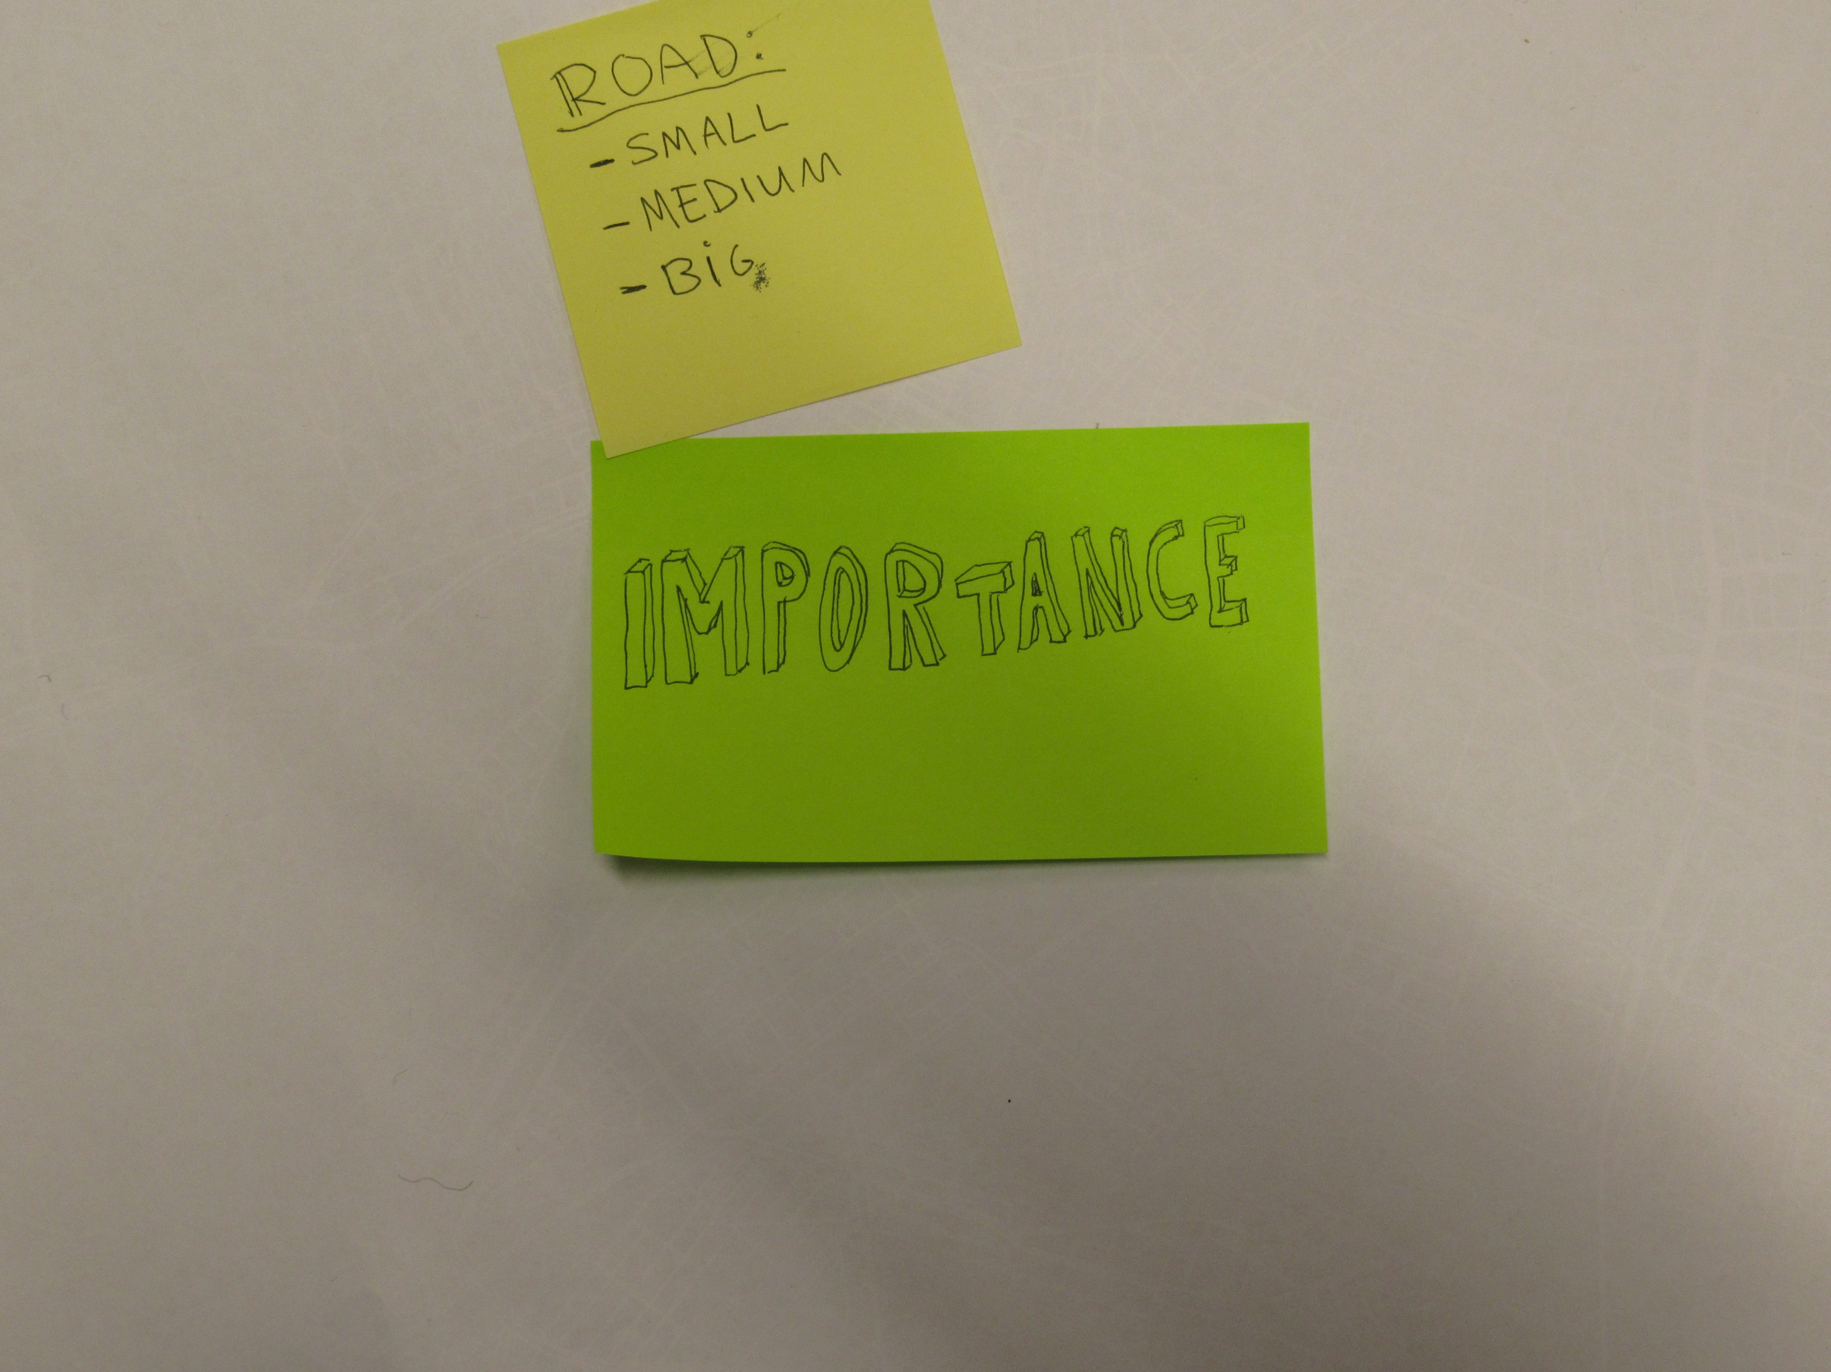

Slide 16
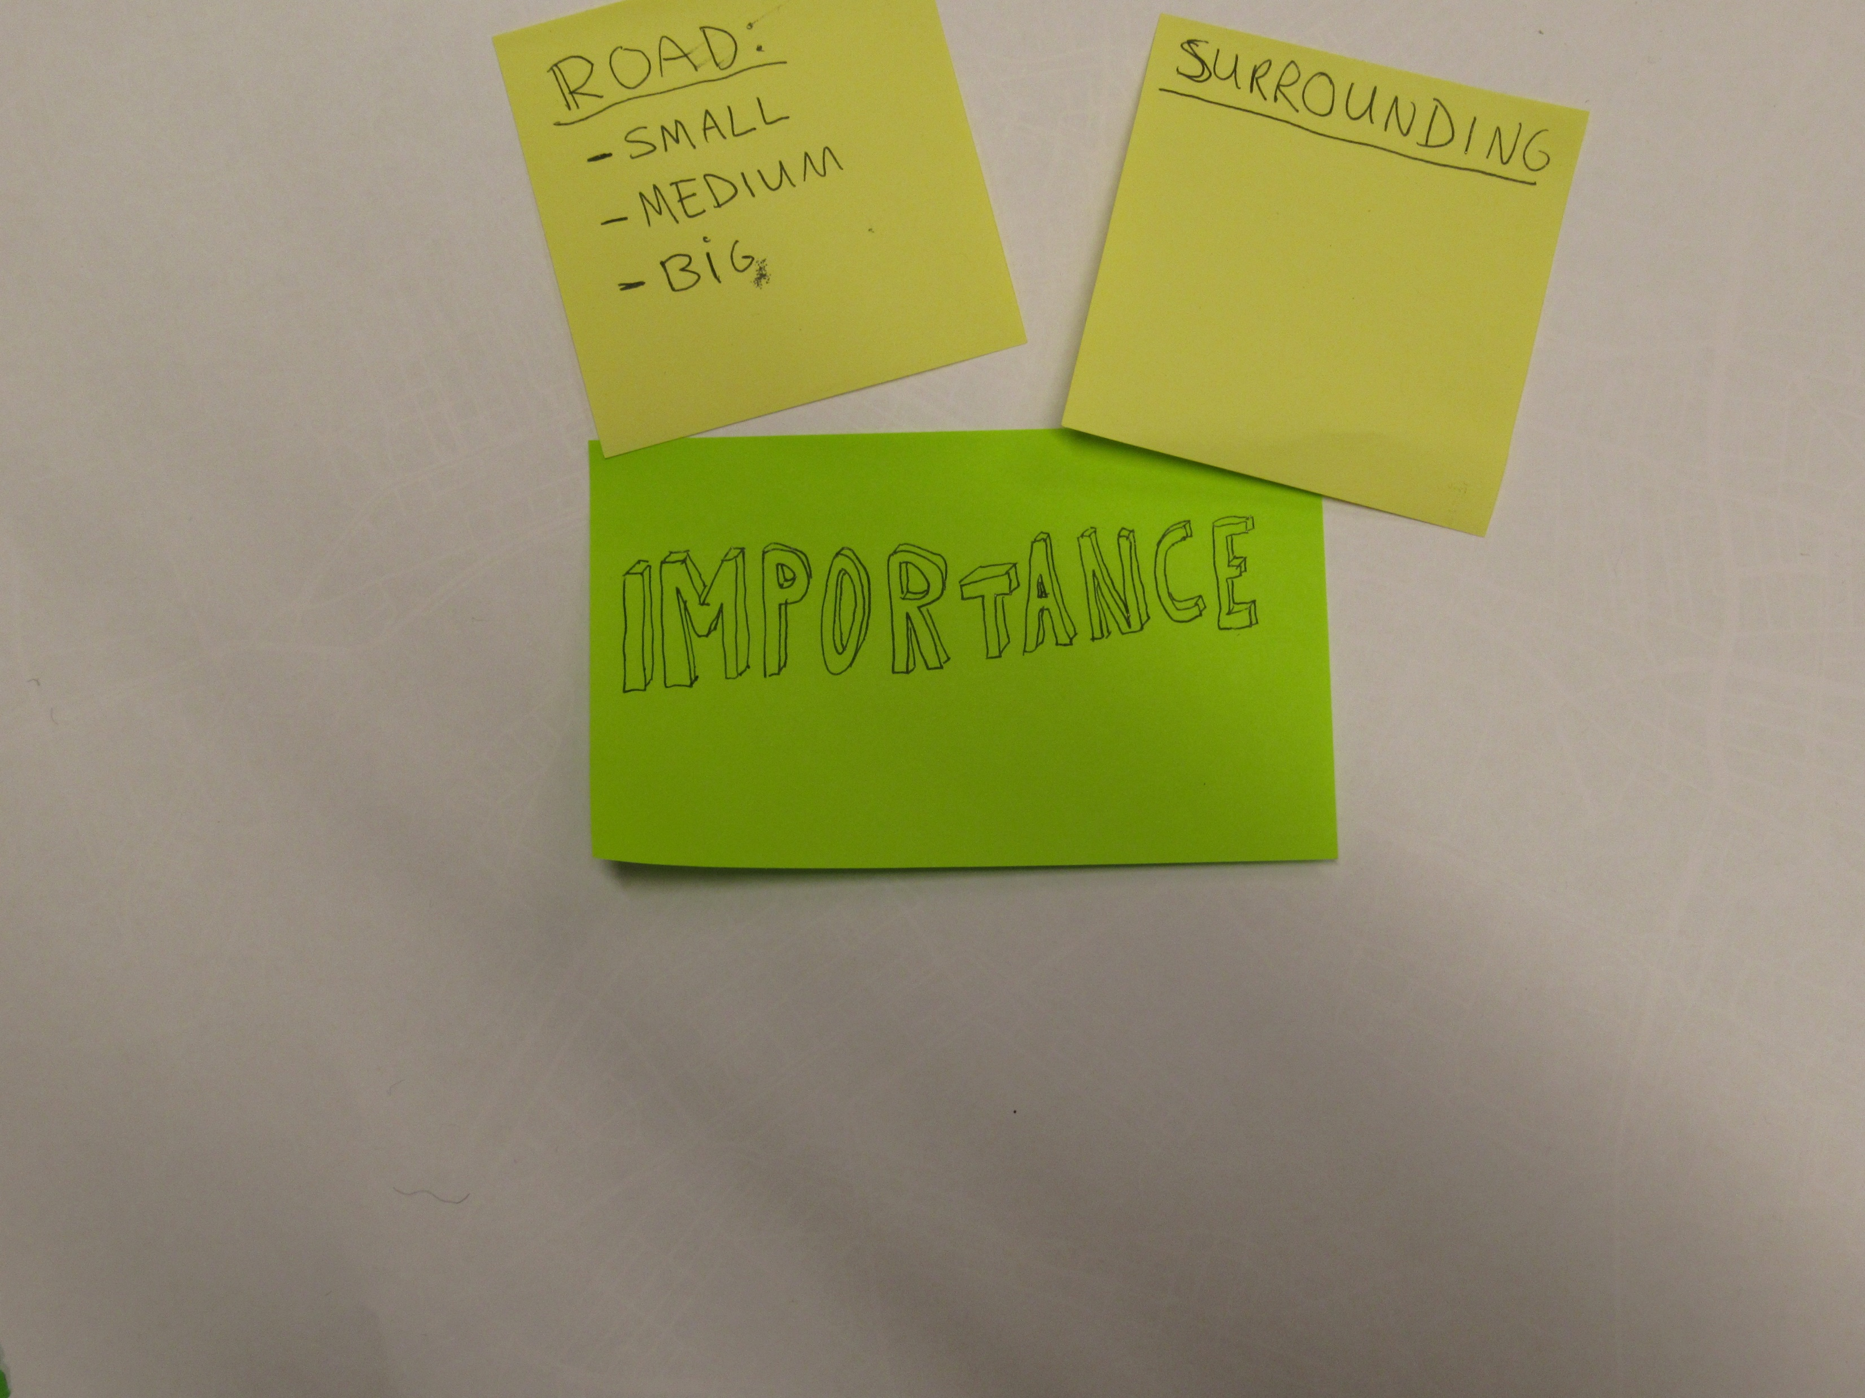

Slide 17
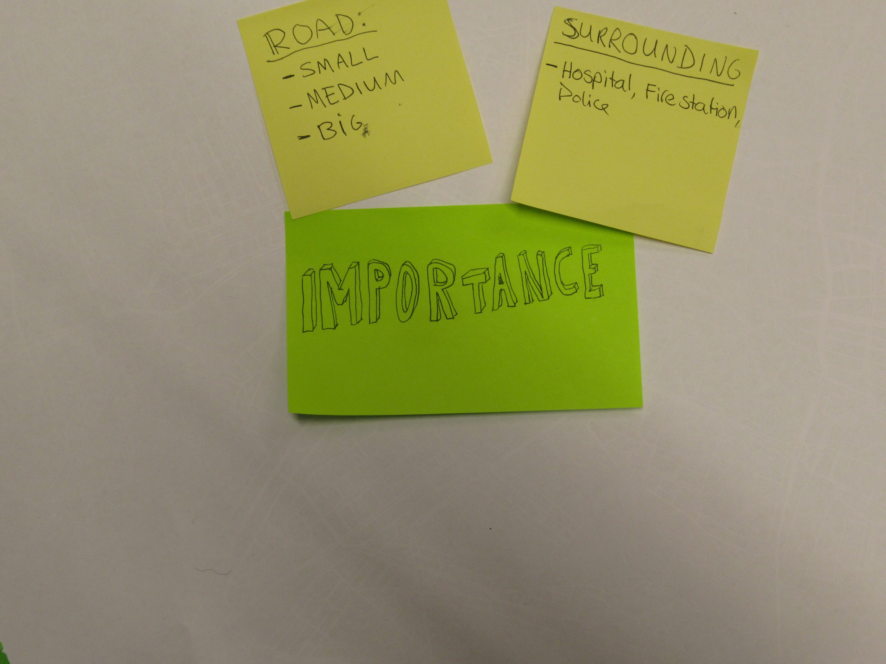

Slide 18
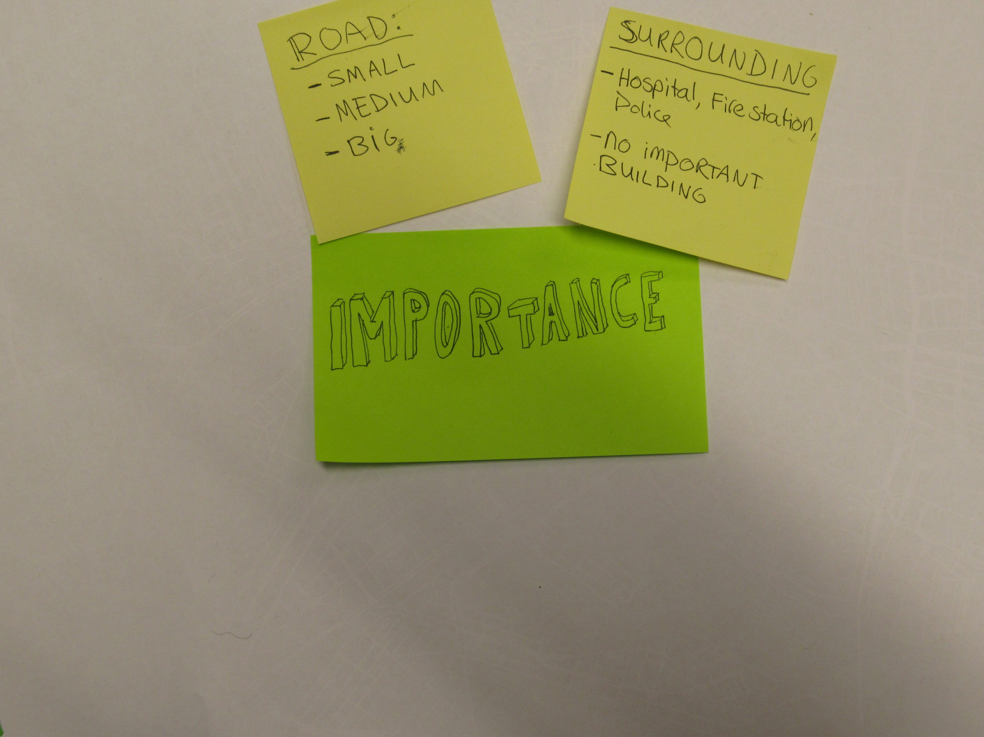

Slide 19
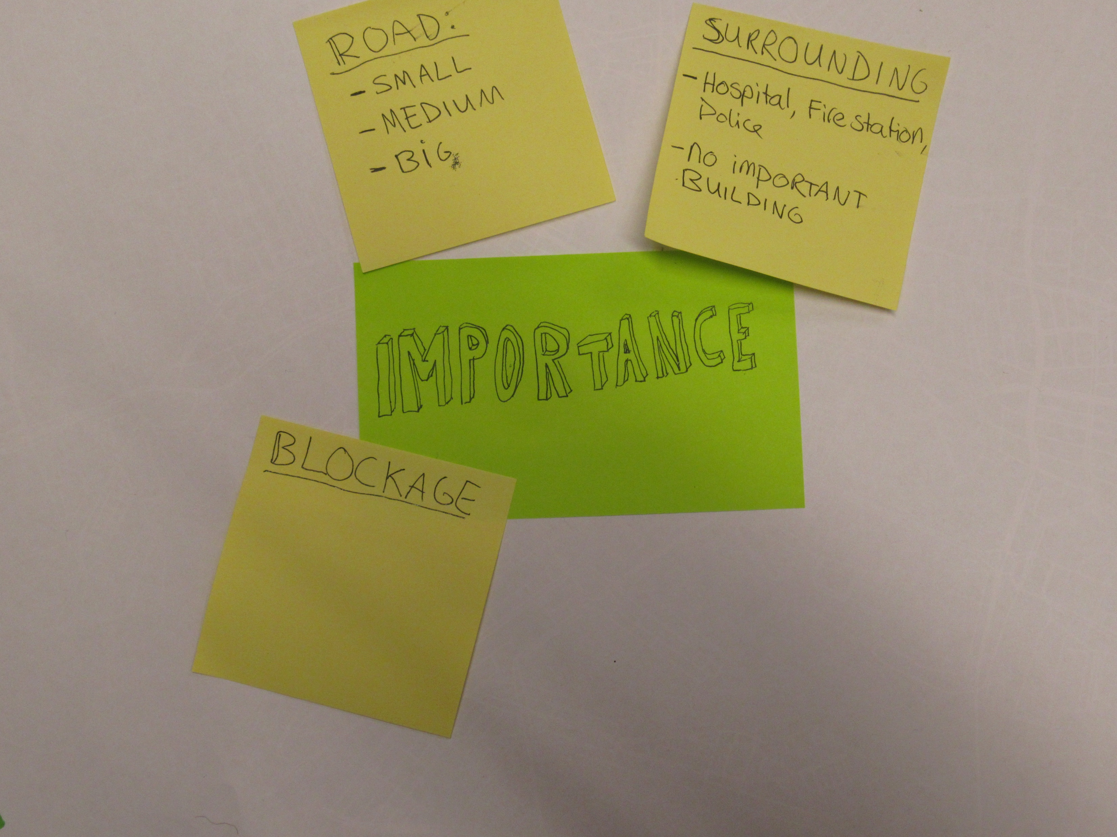

Slide 20
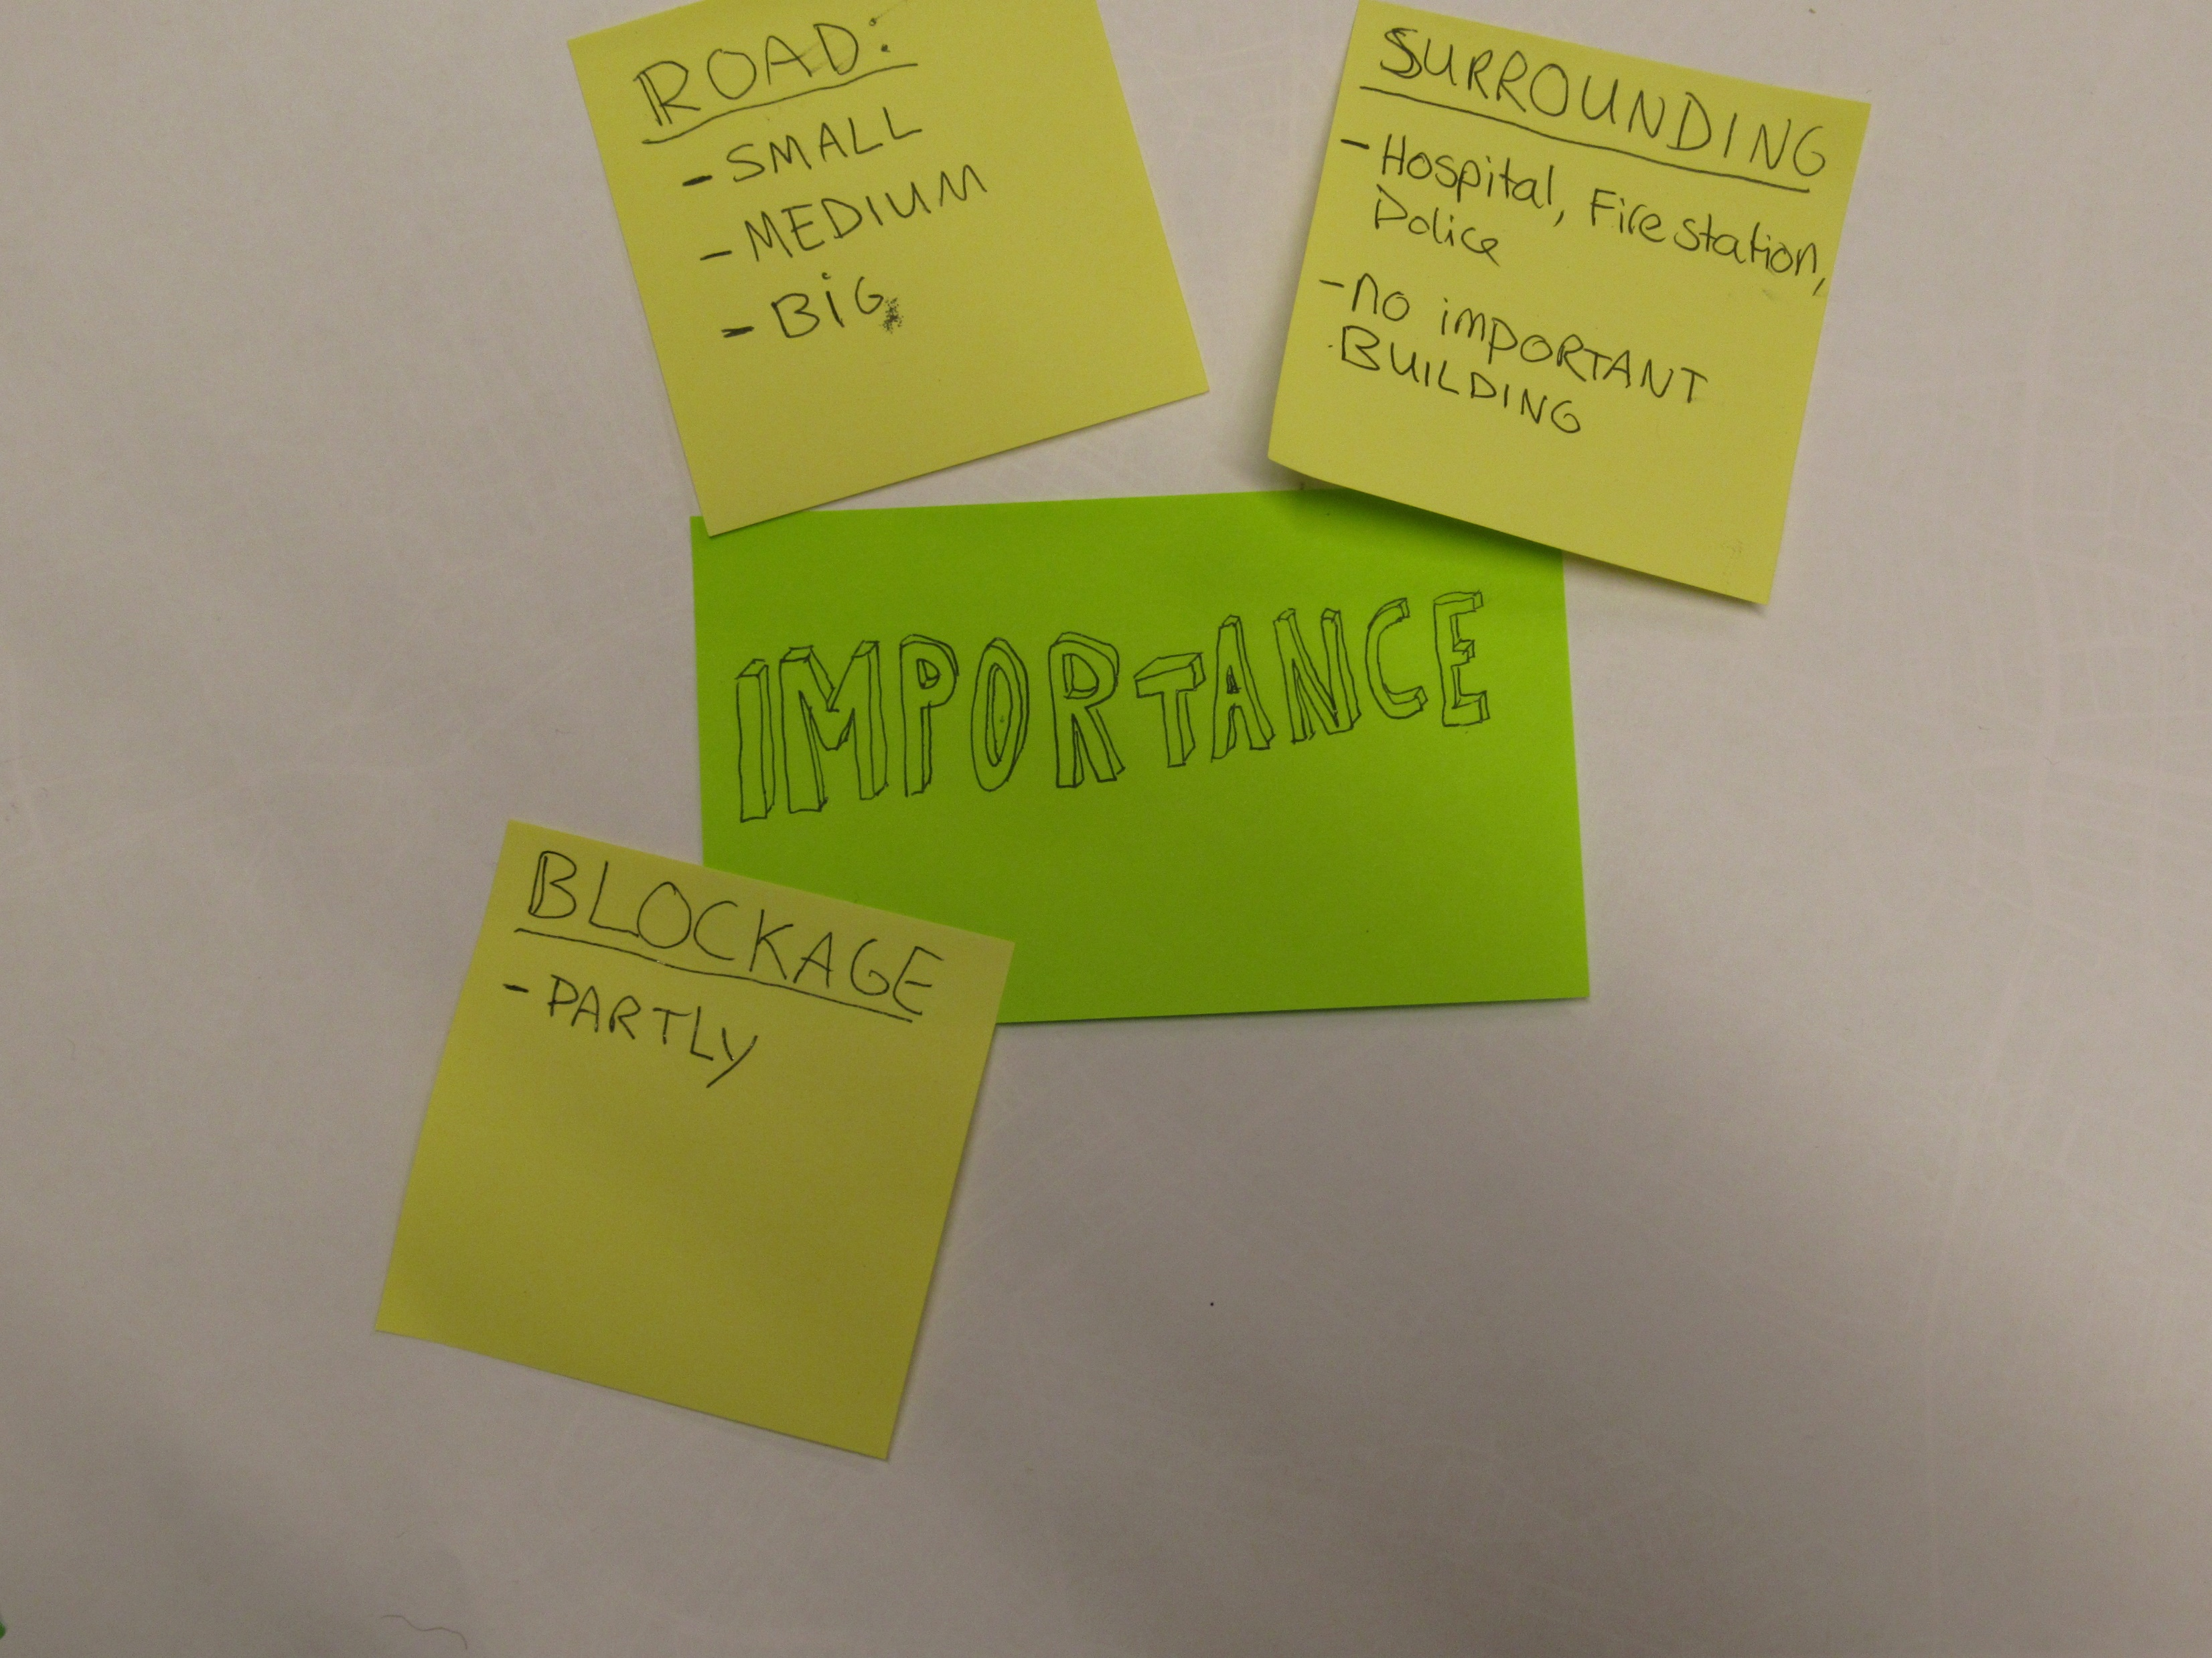

Slide 21
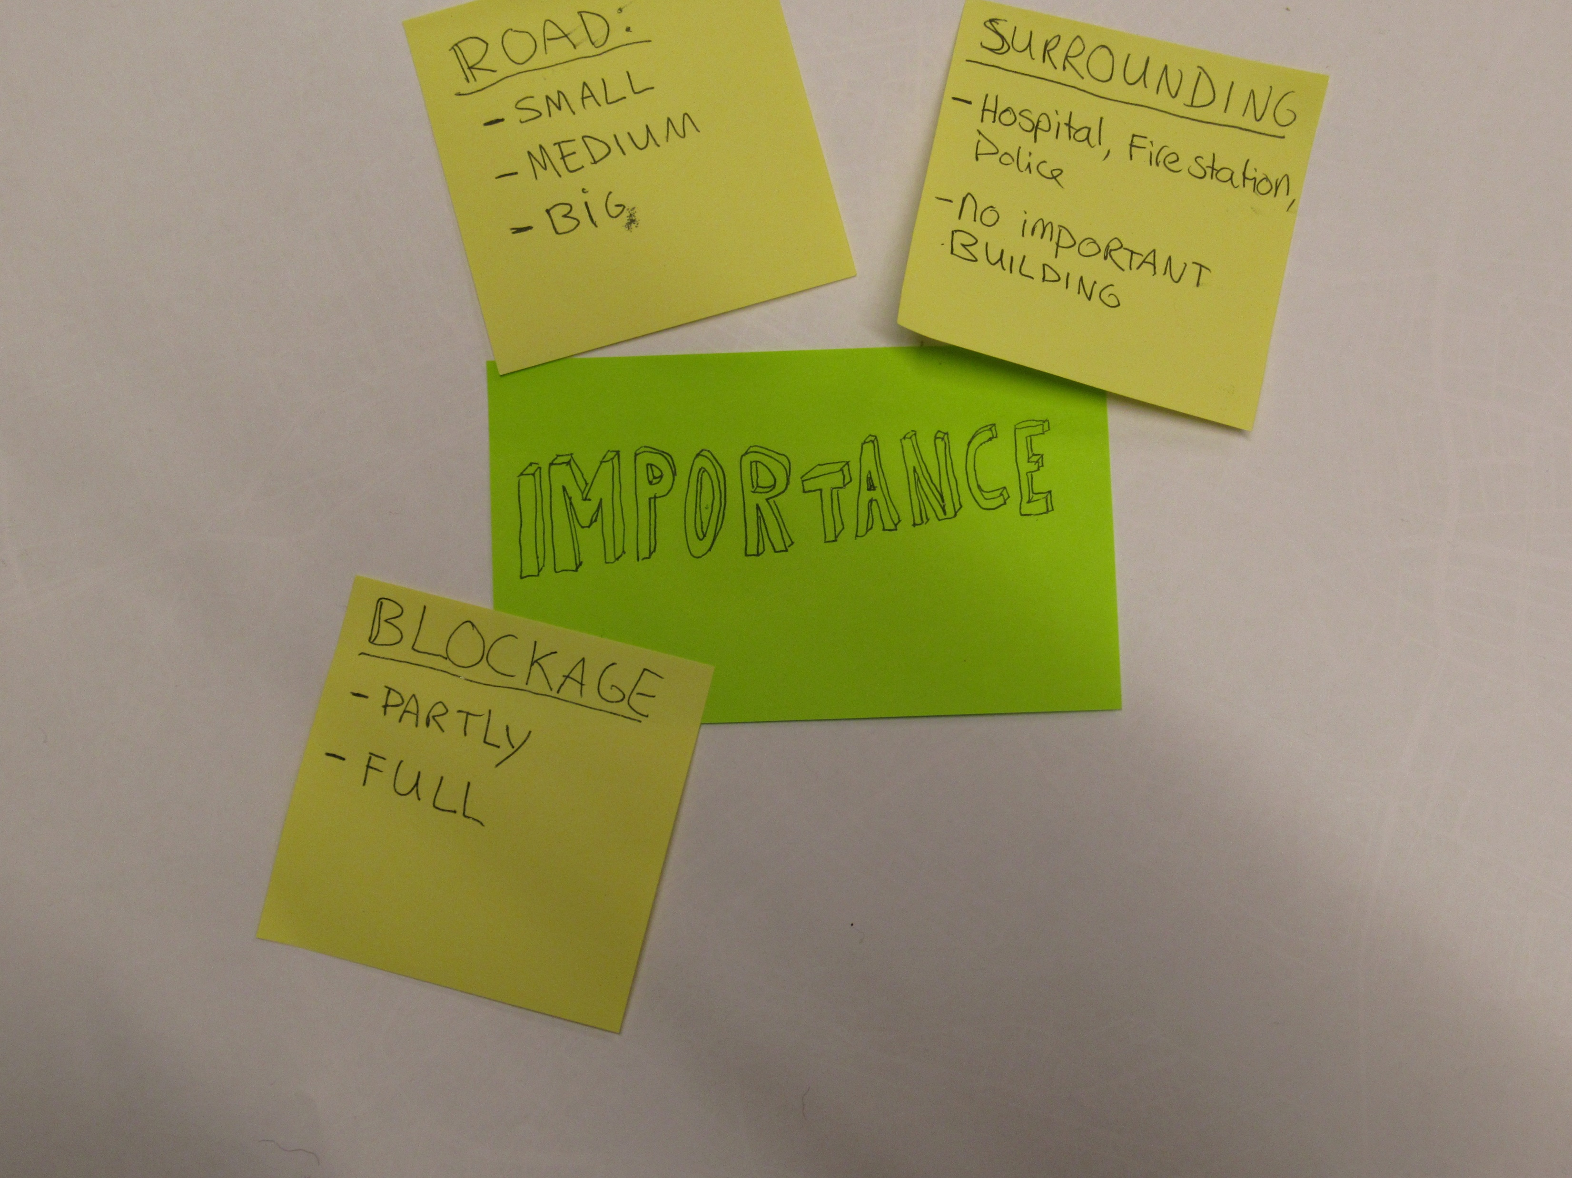

Slide 22
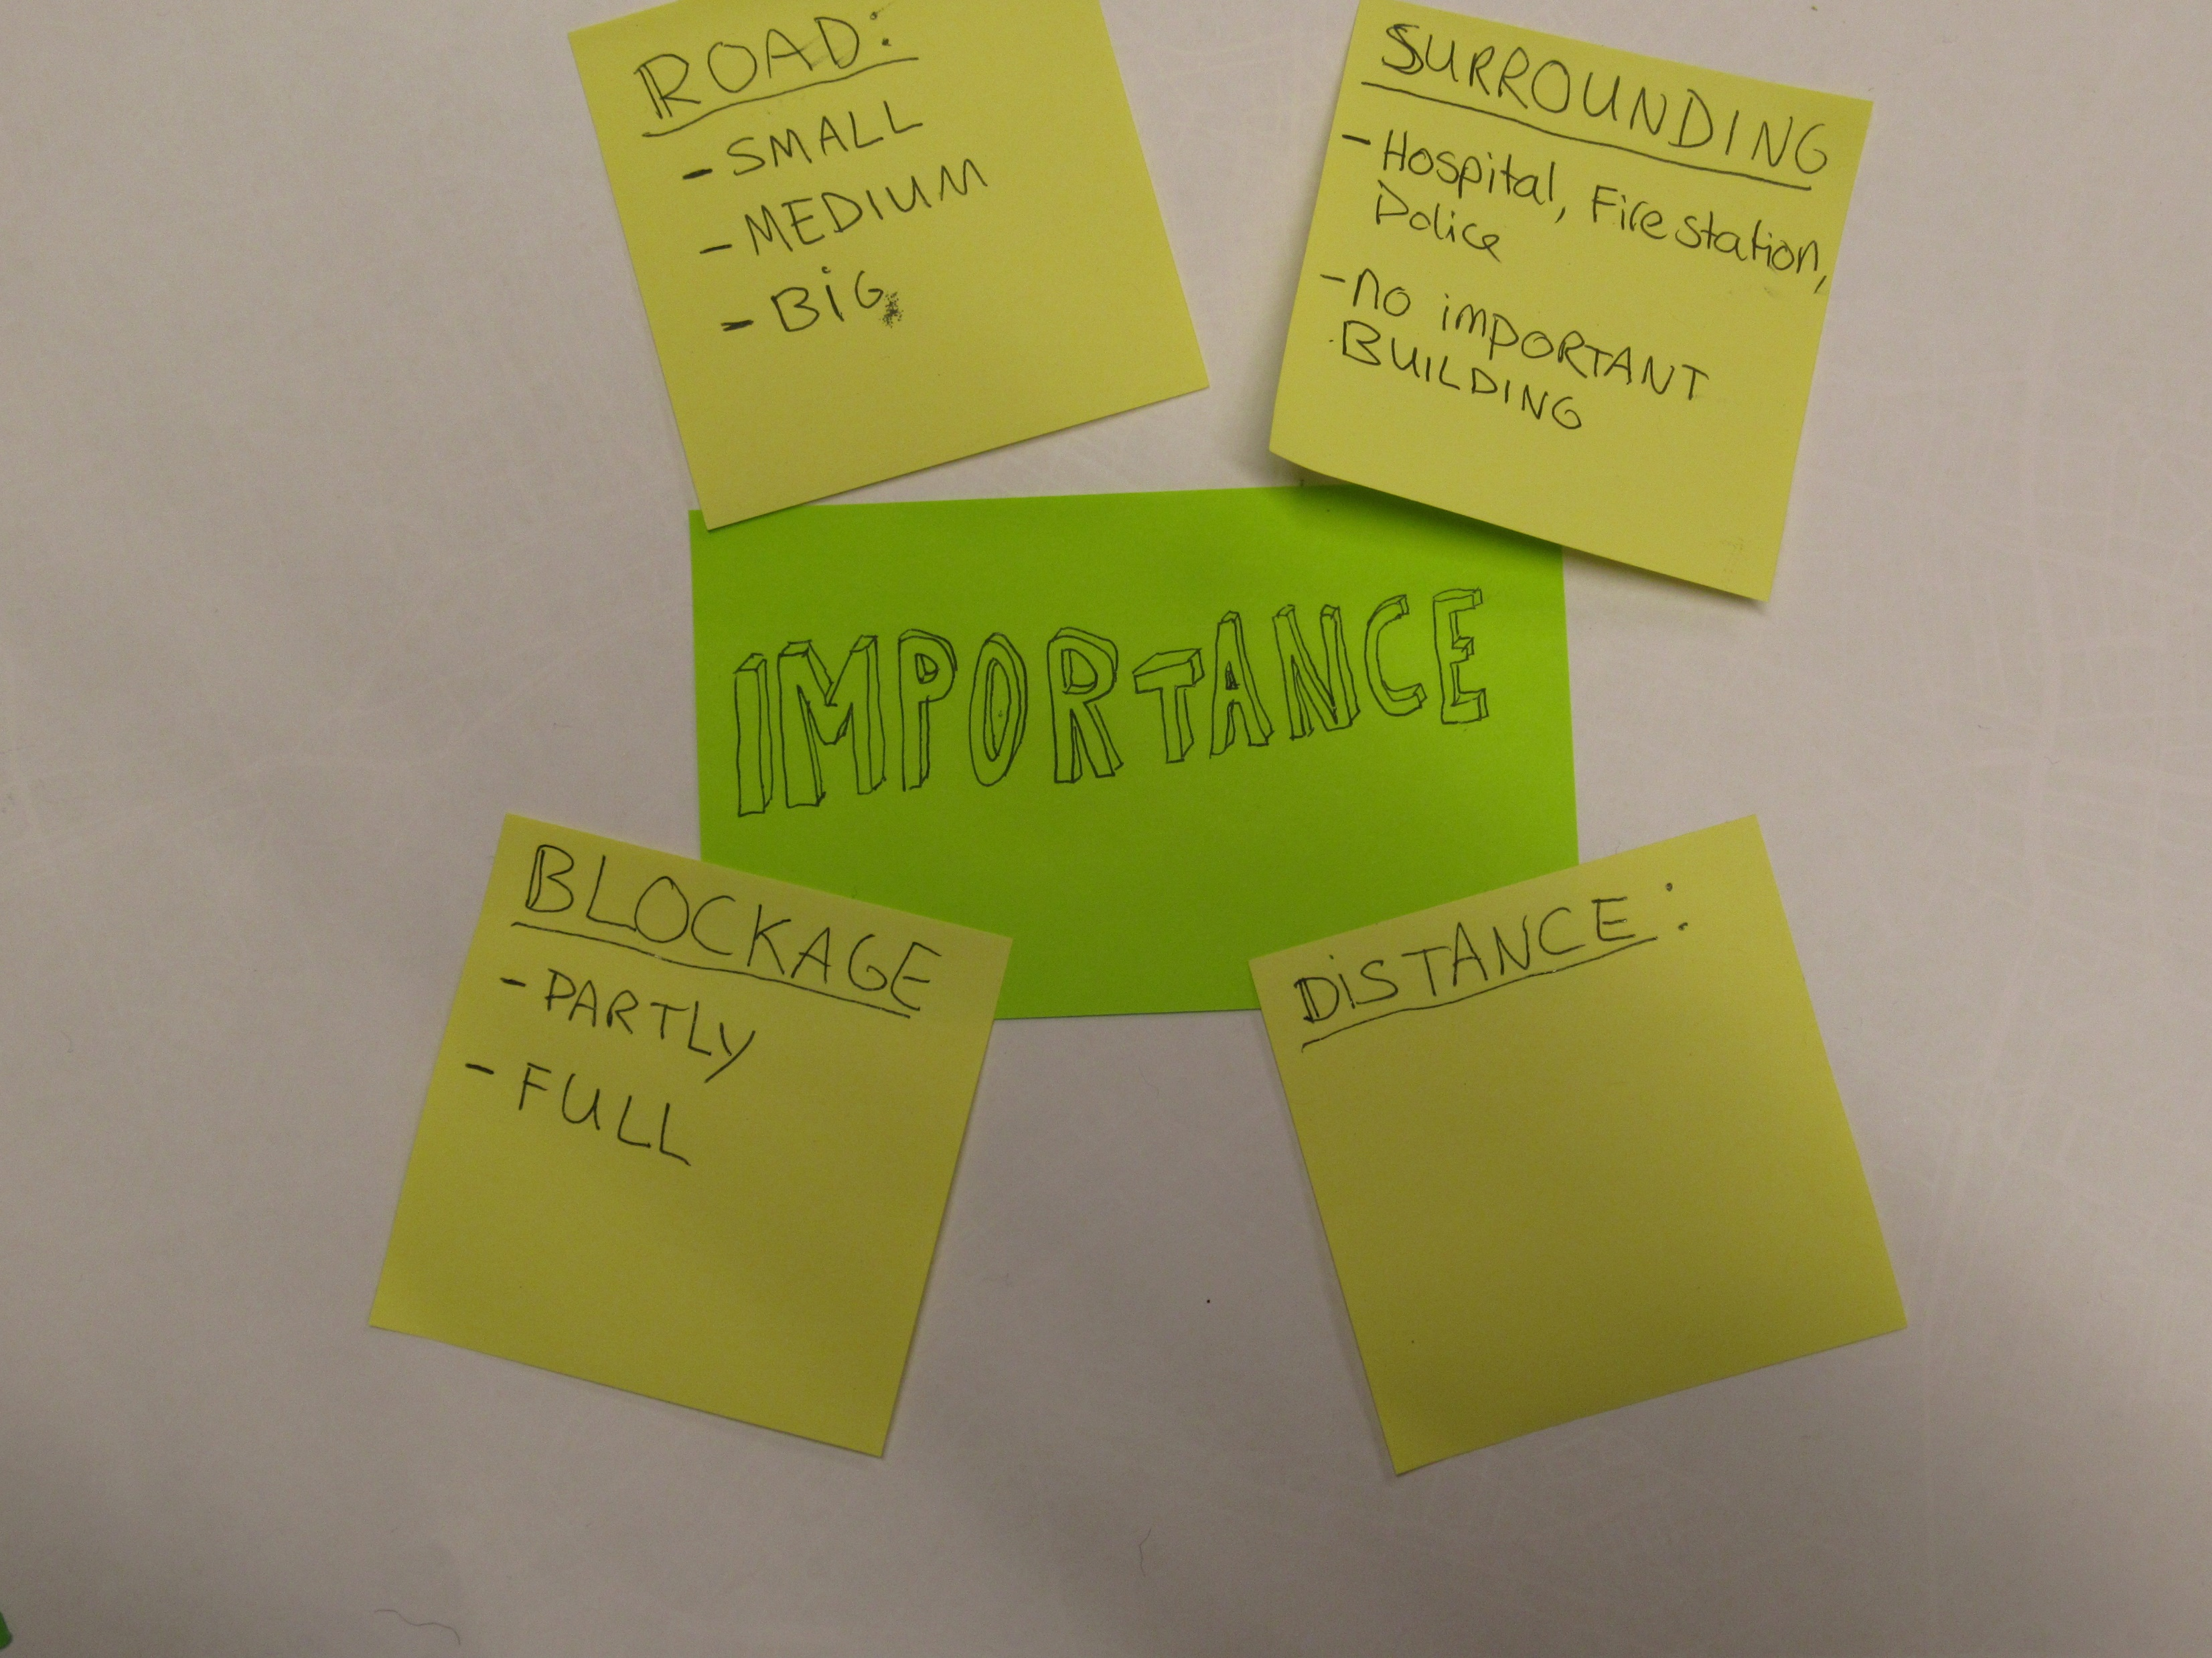

Slide 23
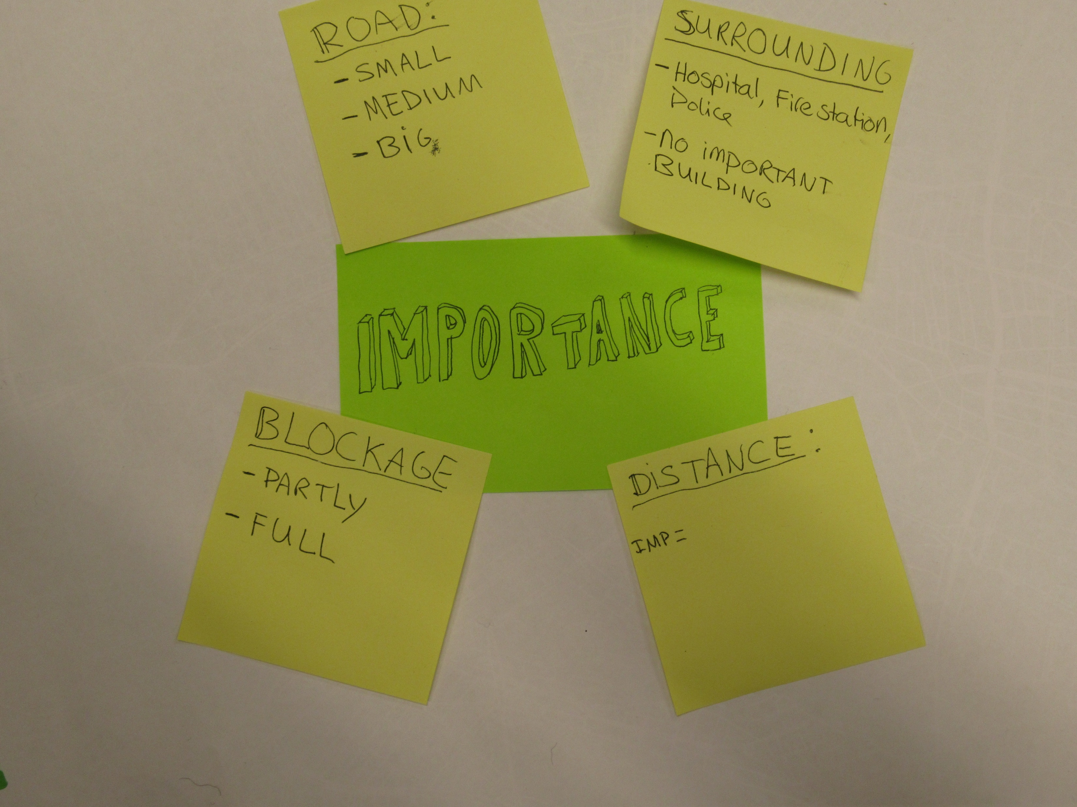

Slide 24
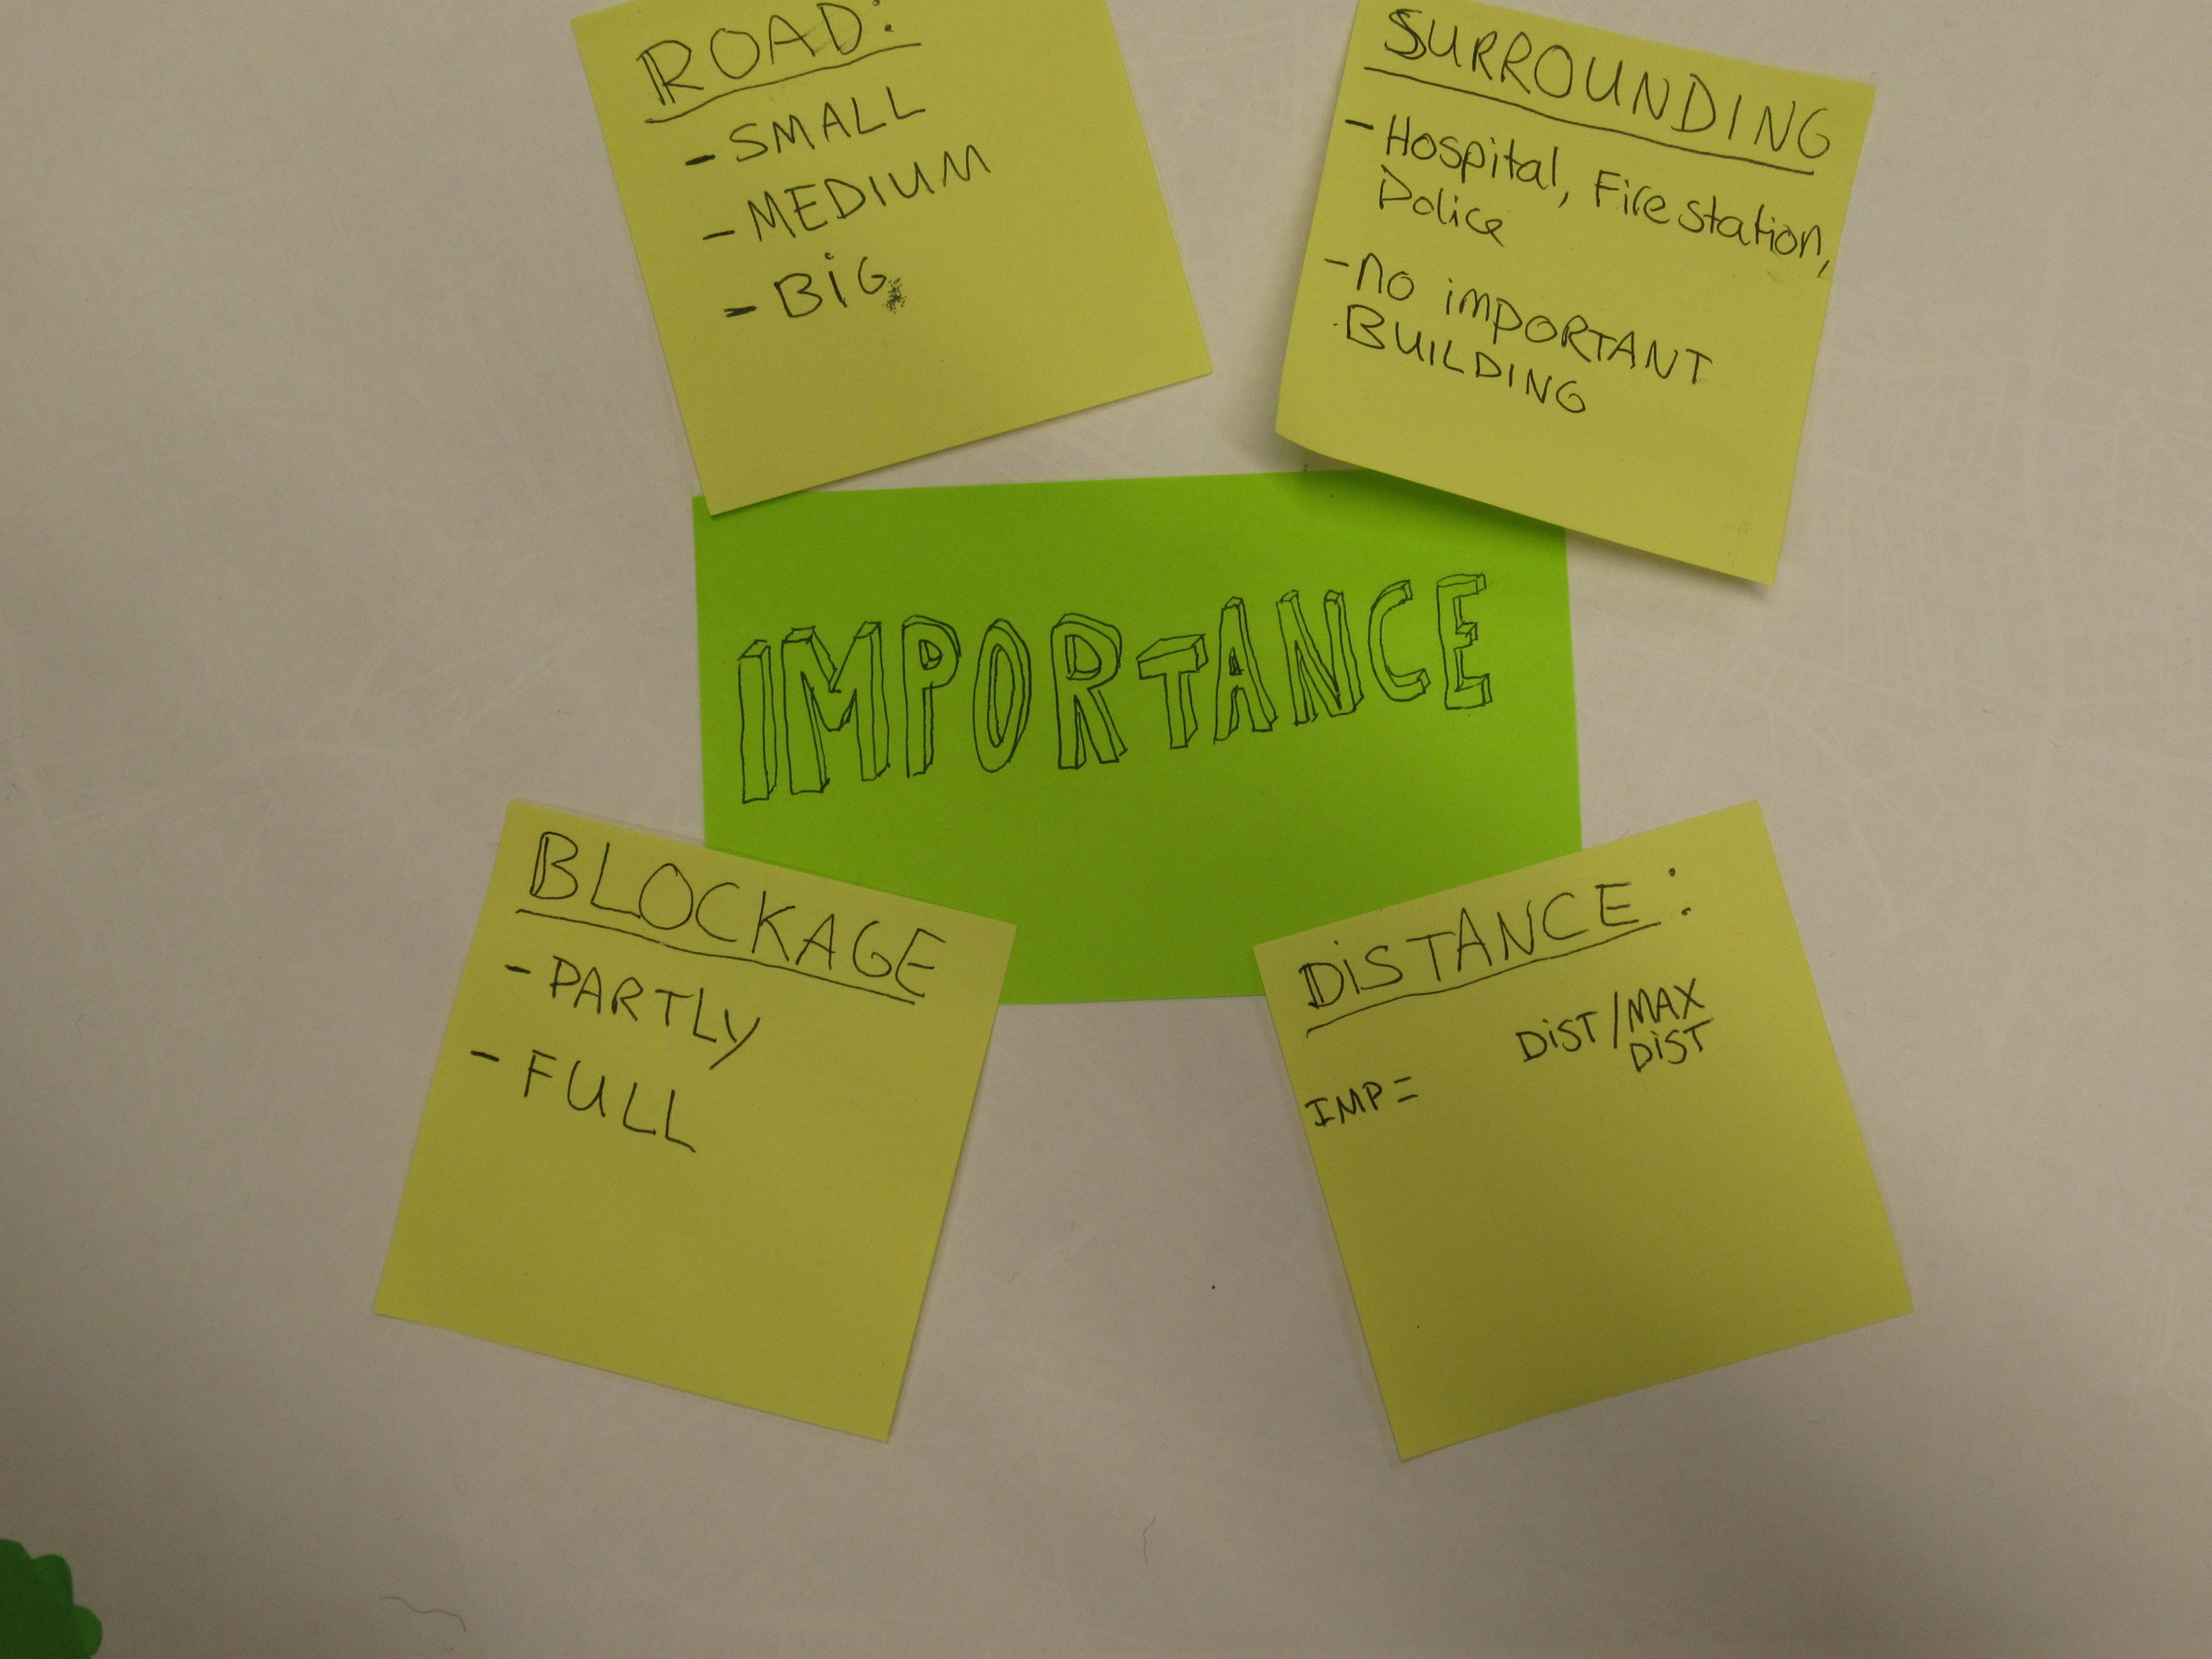

Slide 25


Slide 26
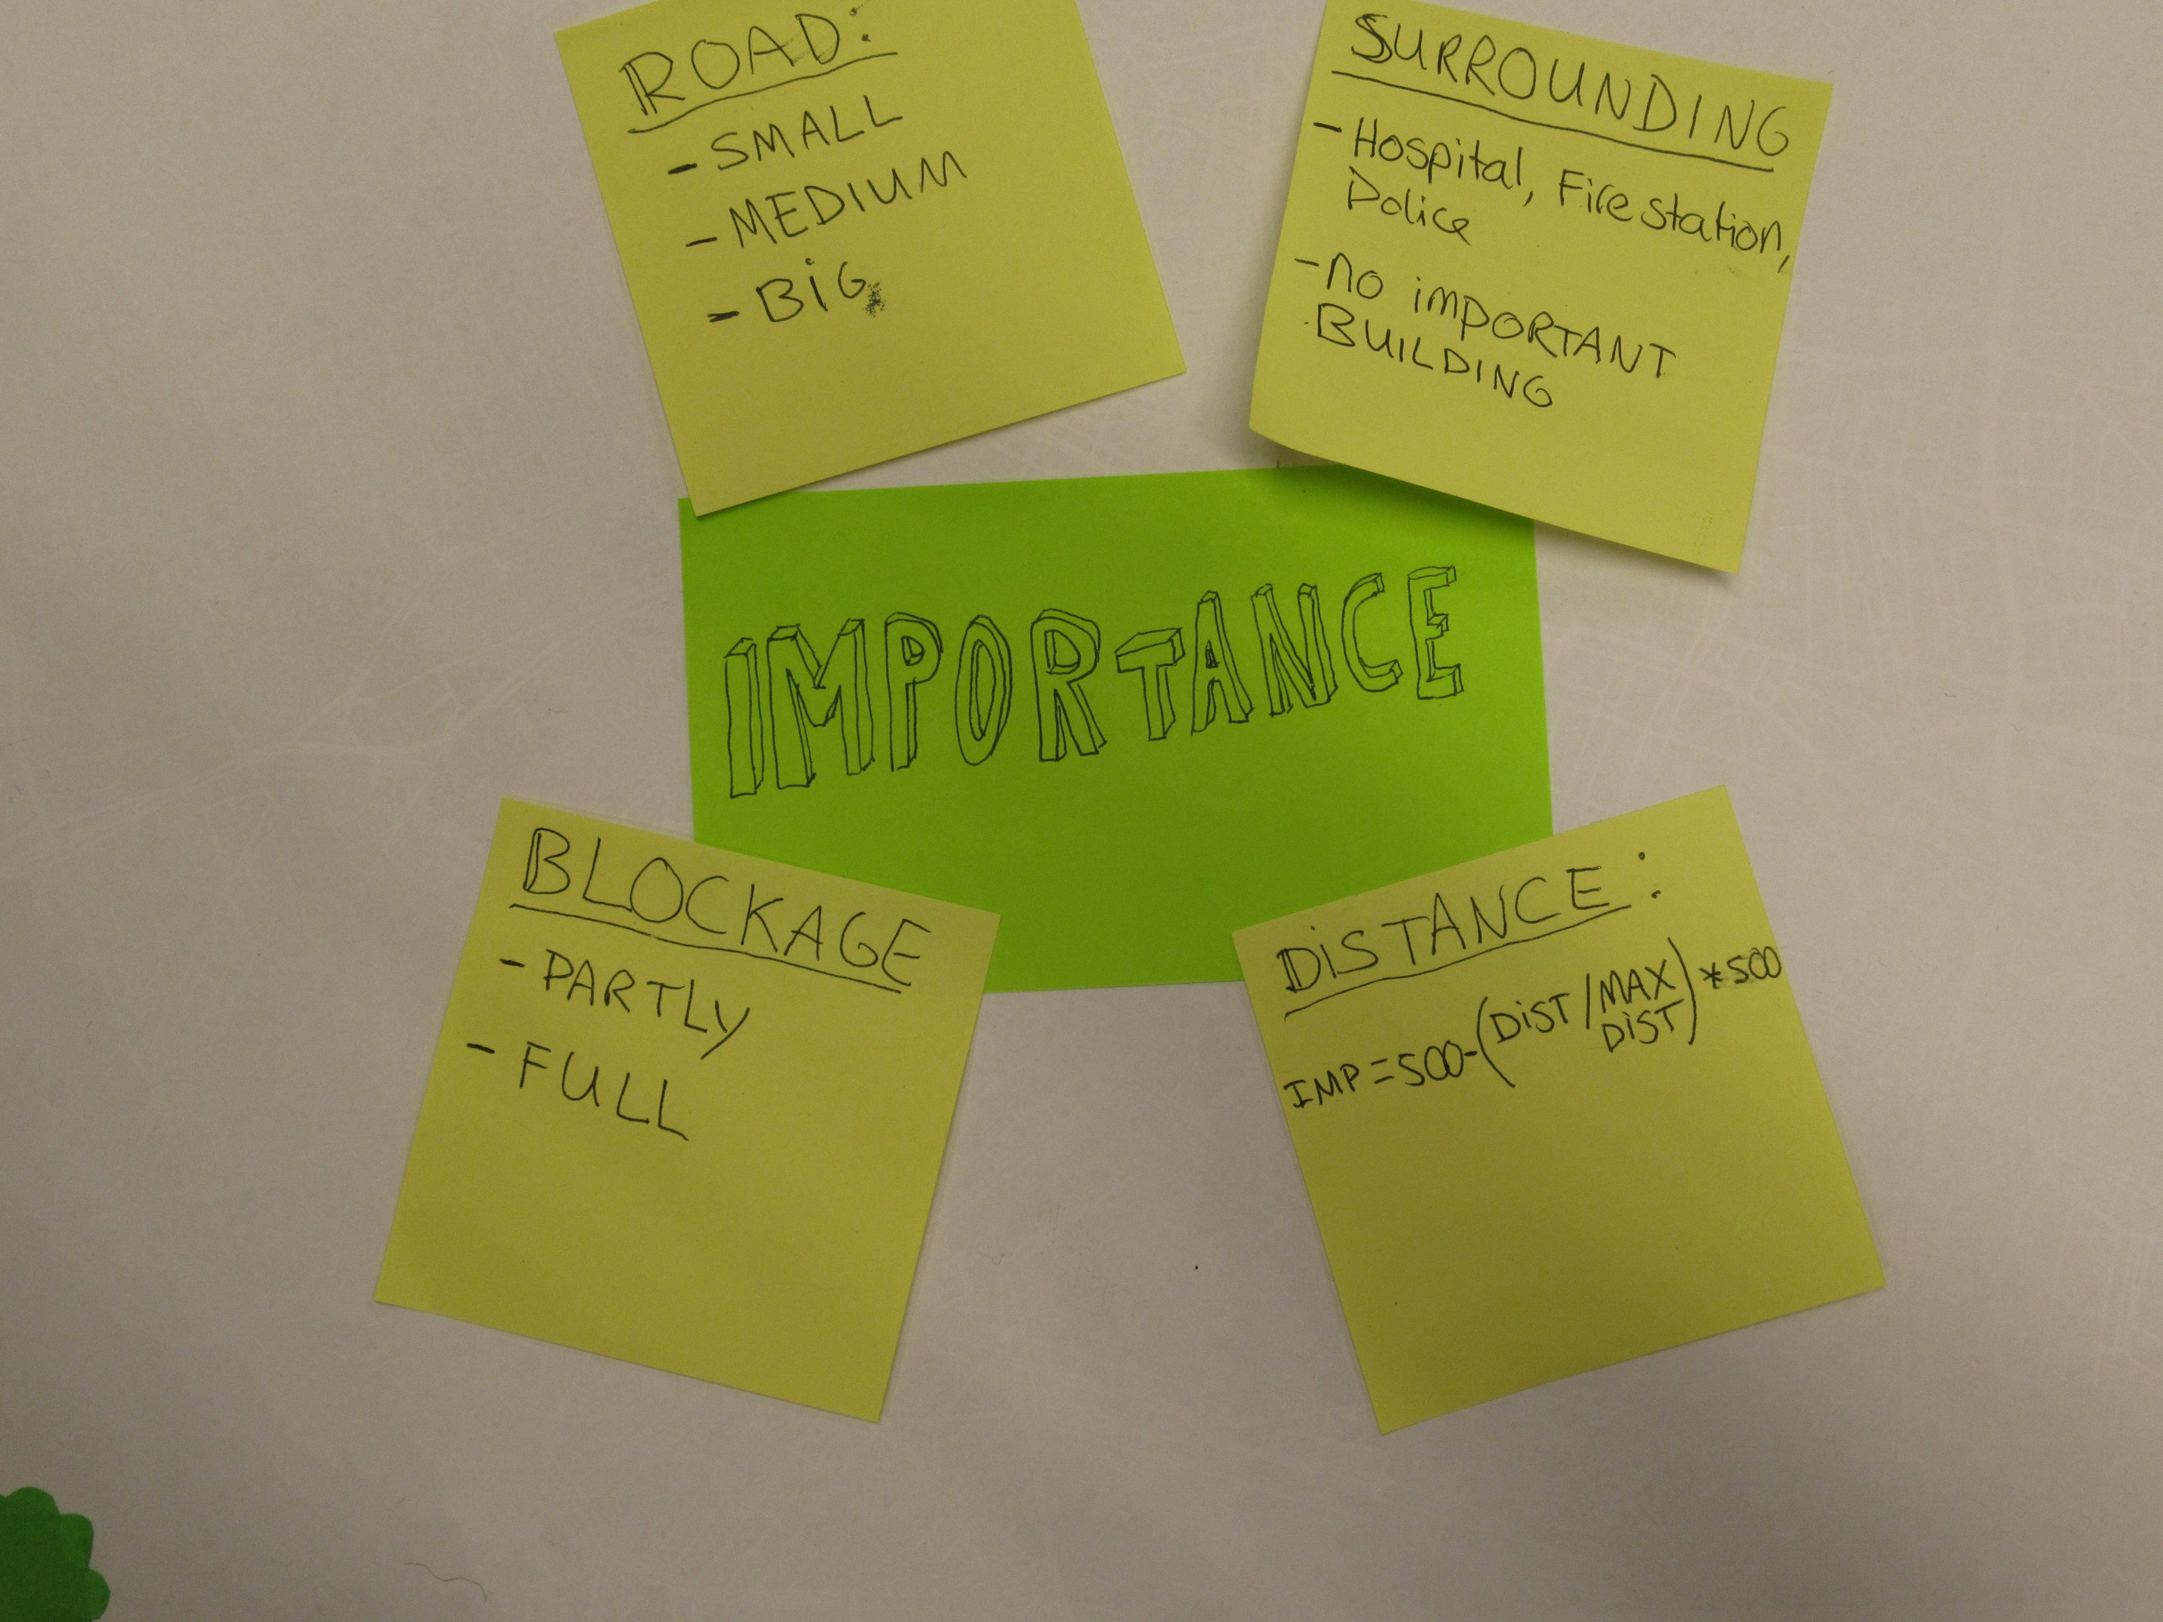

Slide 27
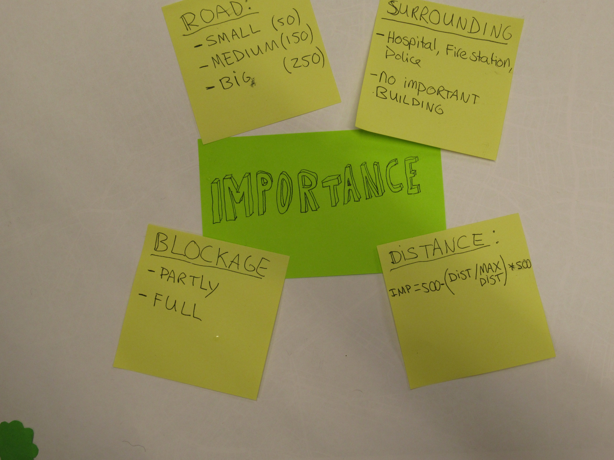

Slide 28
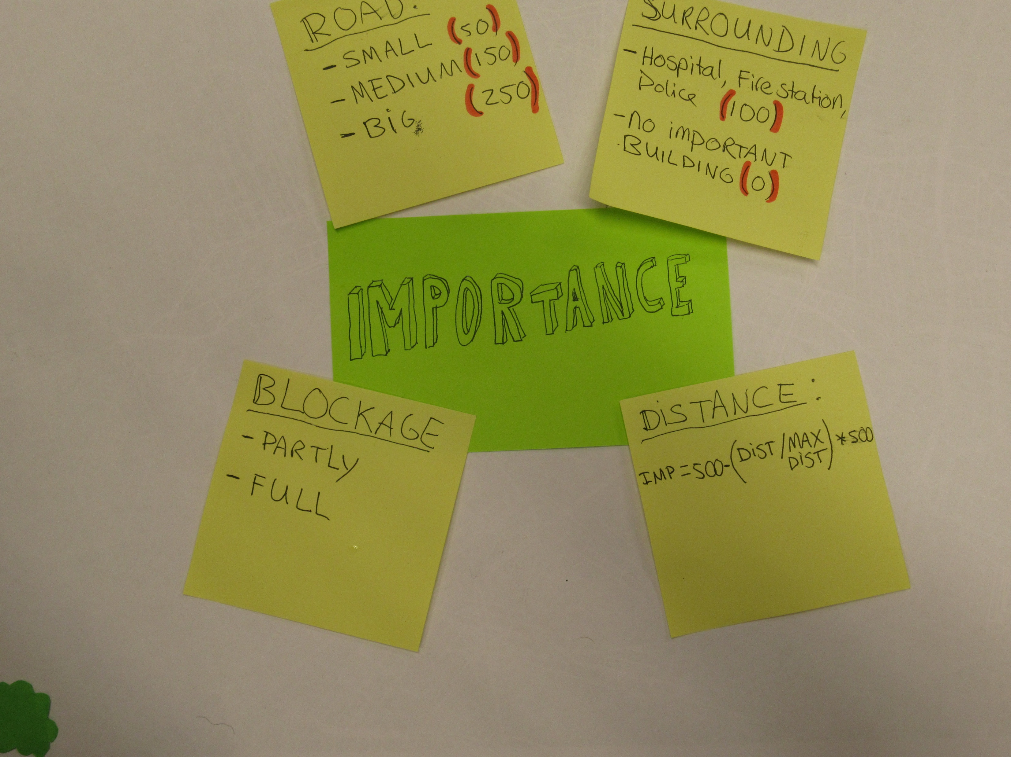

Slide 29
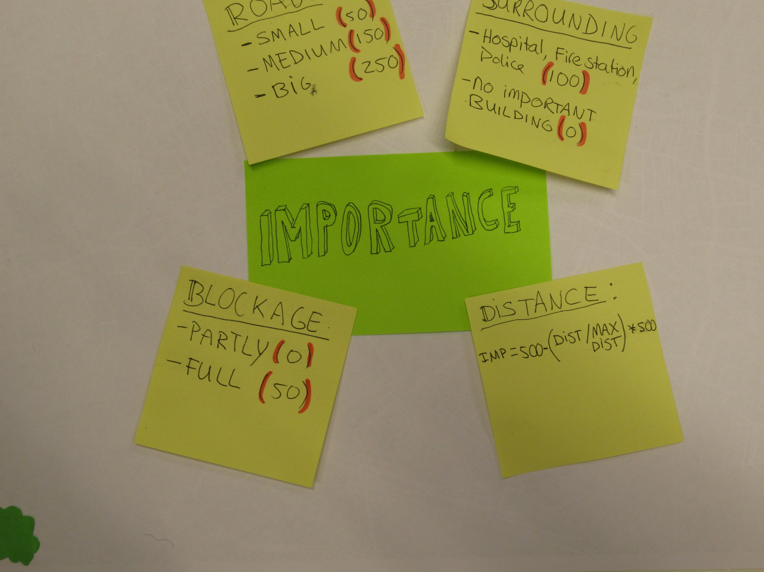

Slide 30
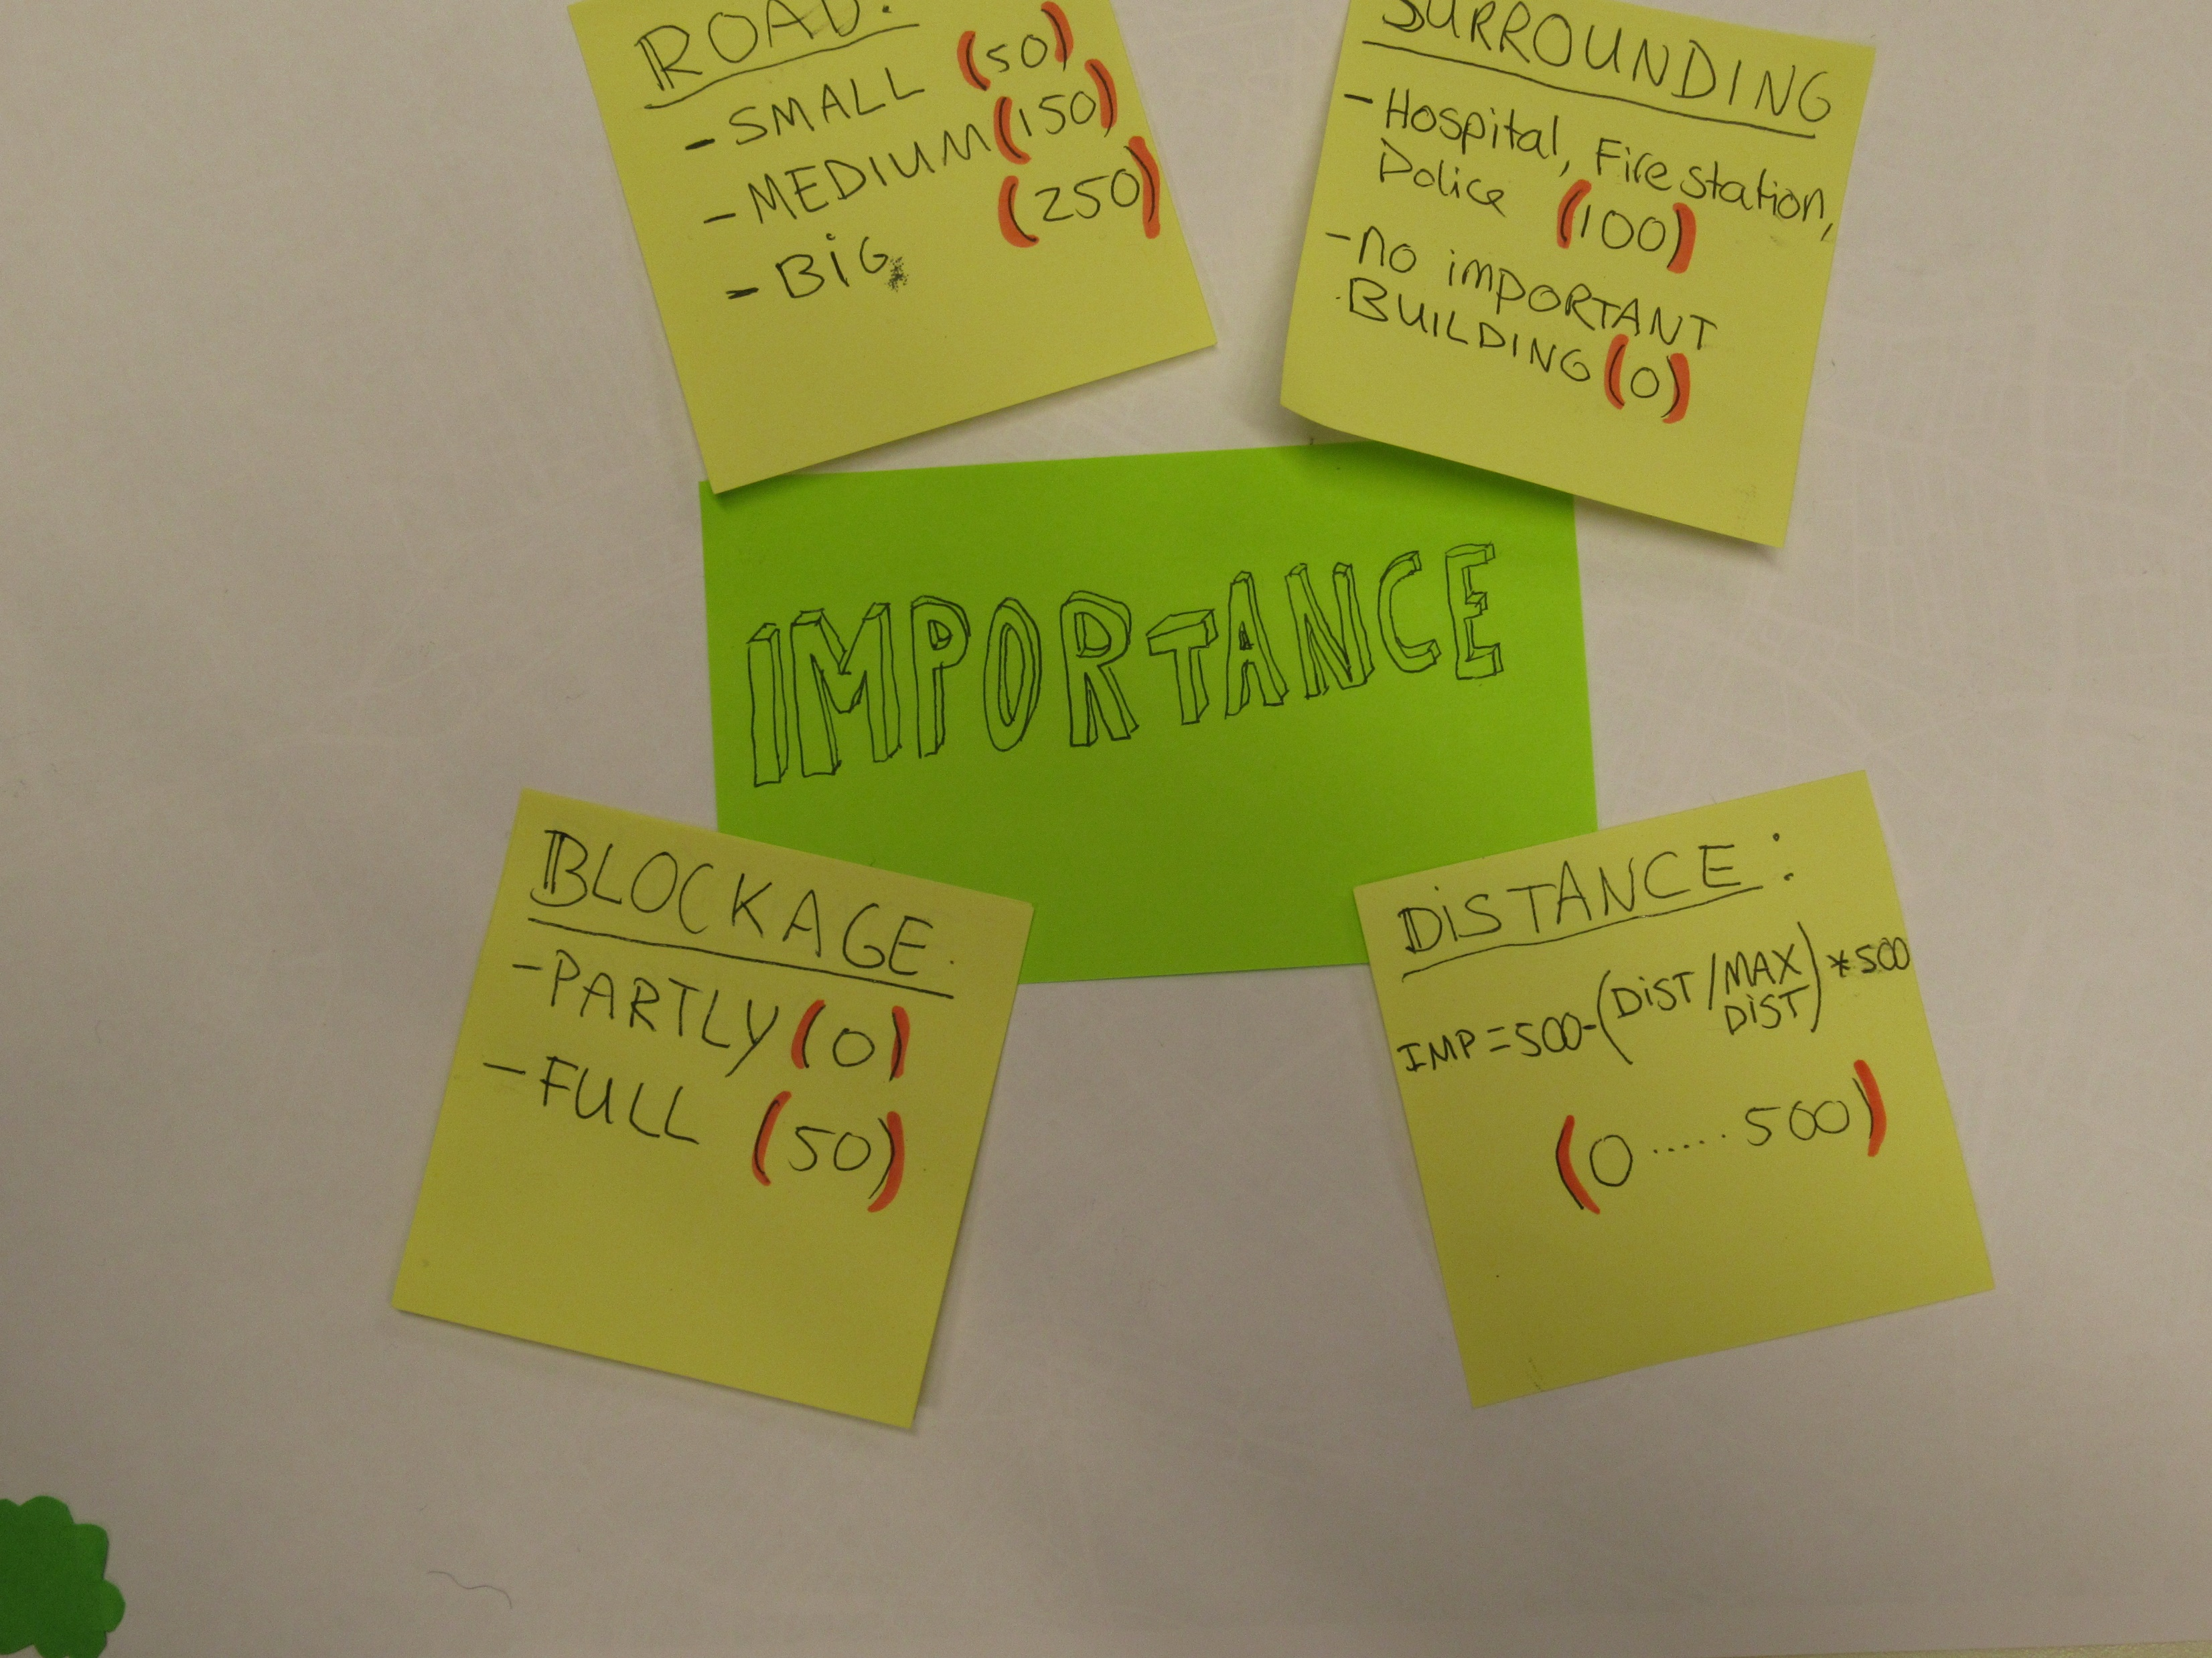

Slide 31
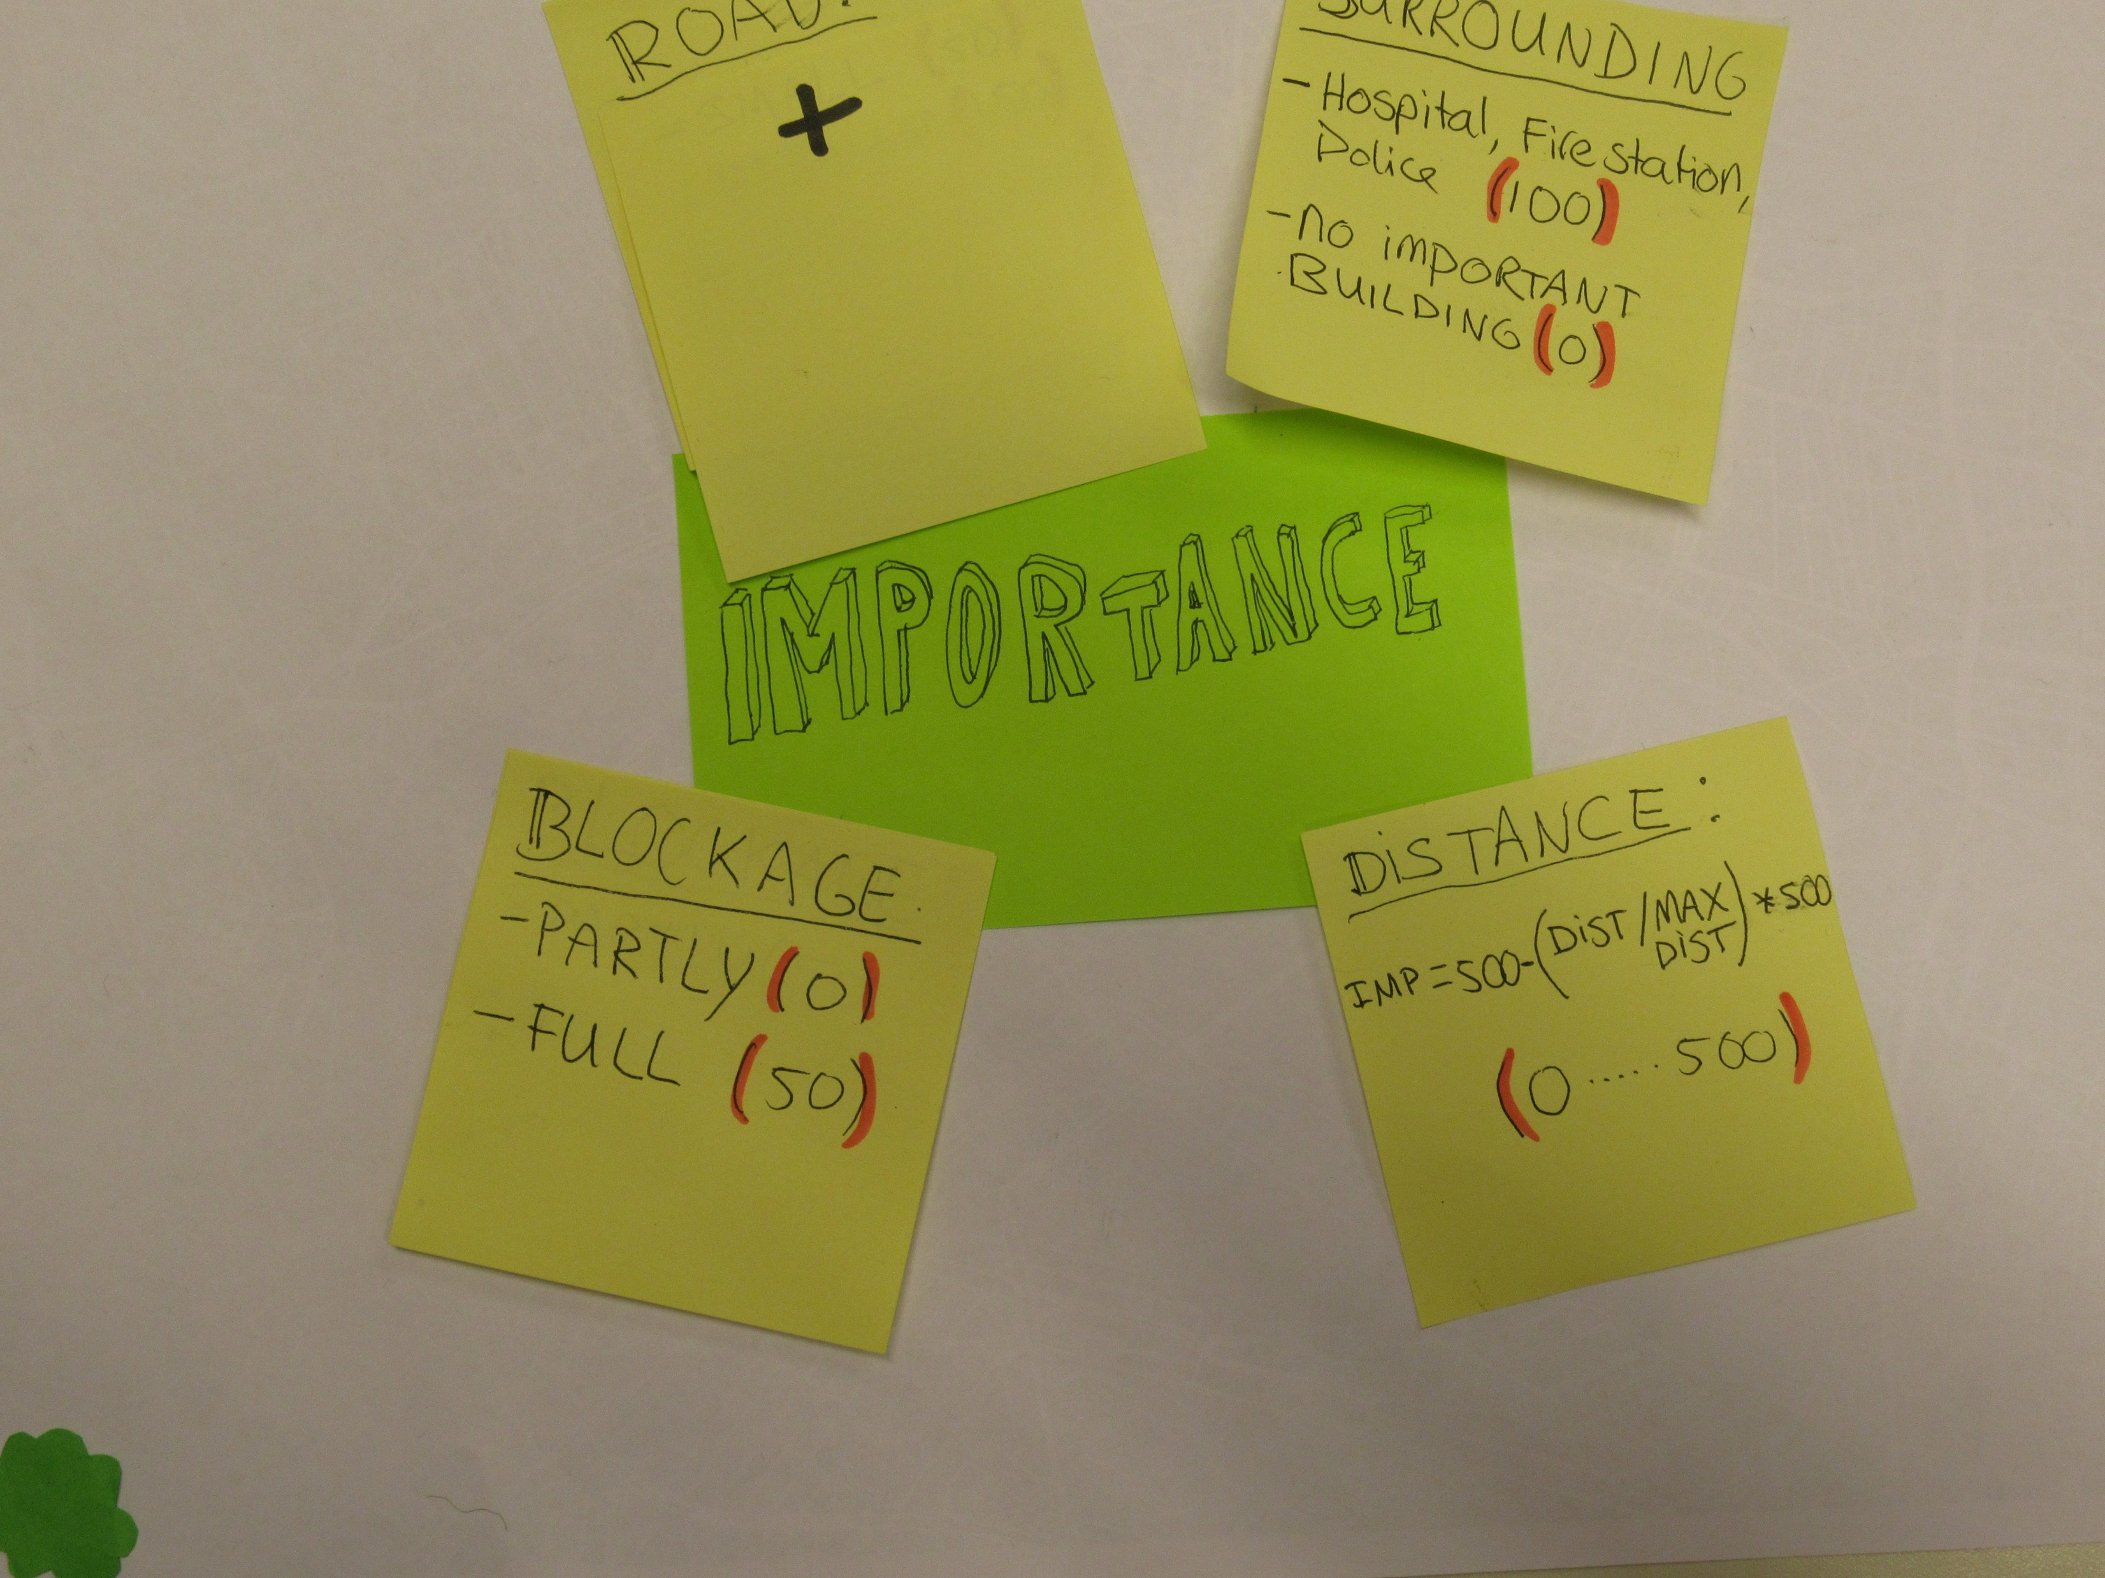

Slide 32
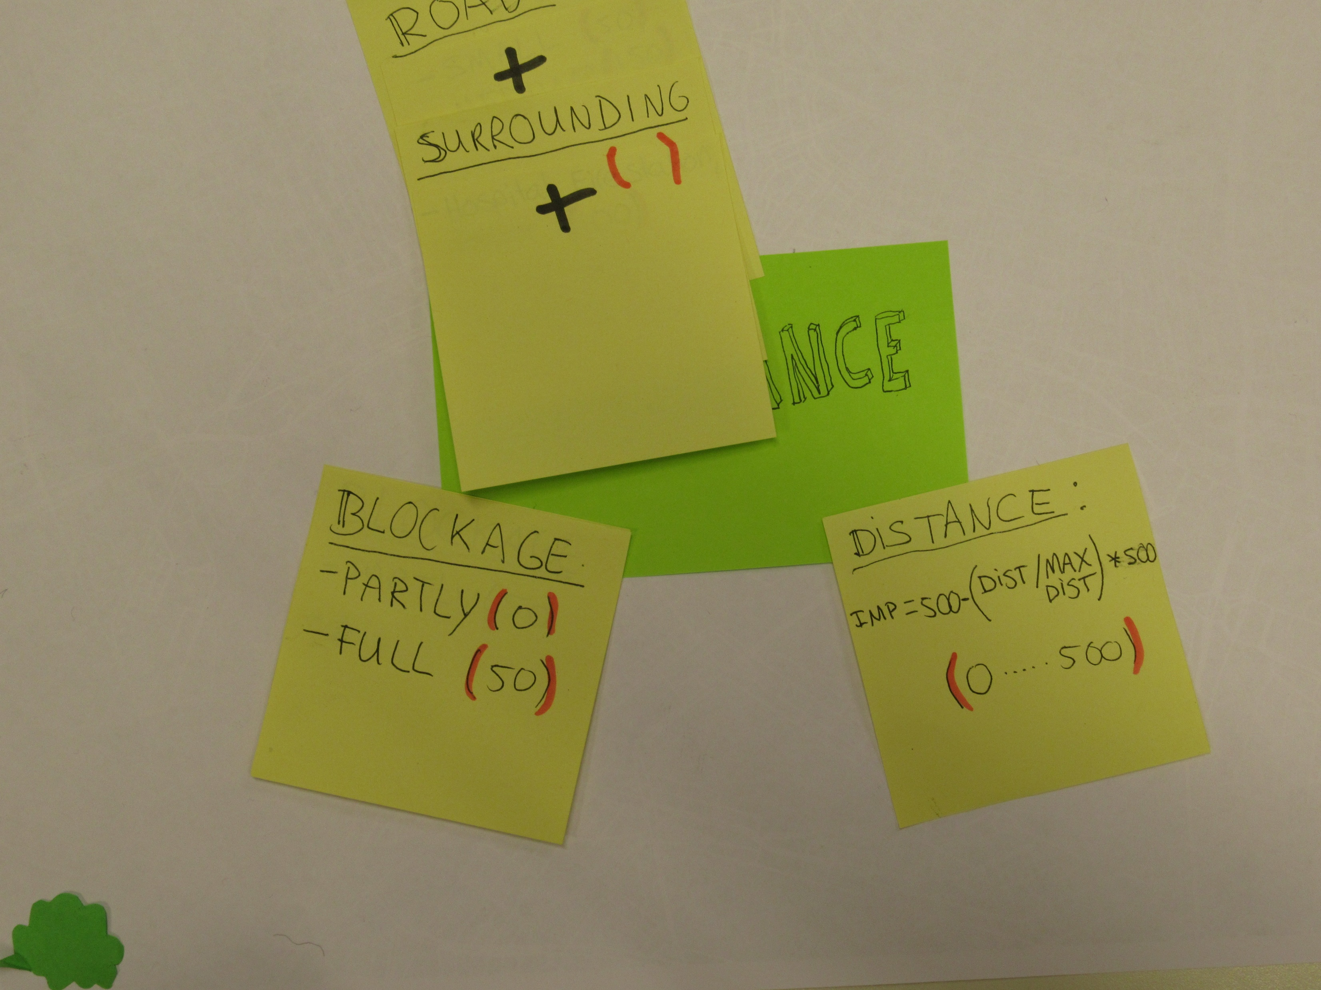

Slide 33
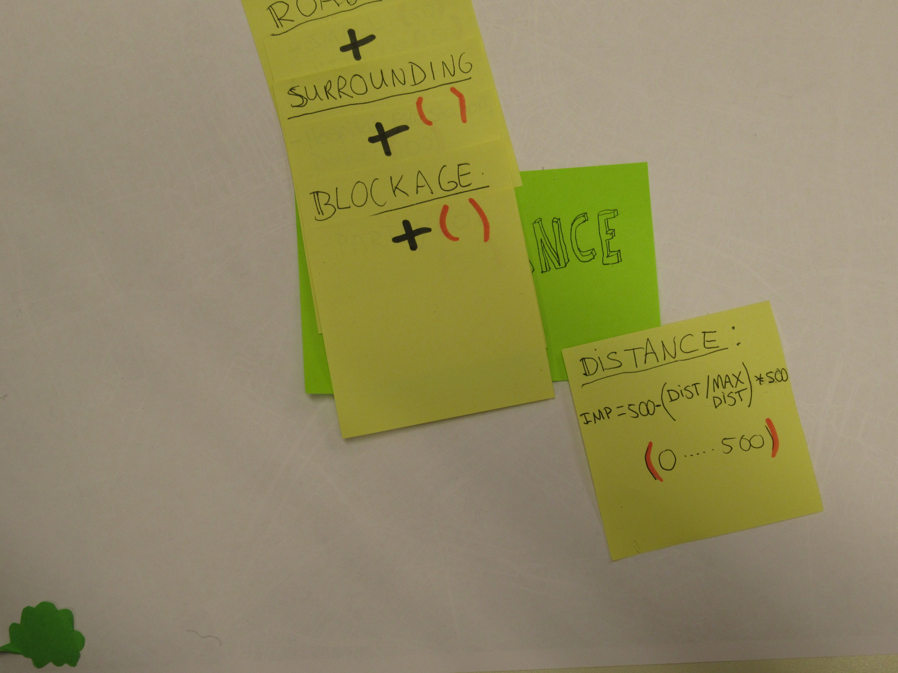

Slide 34
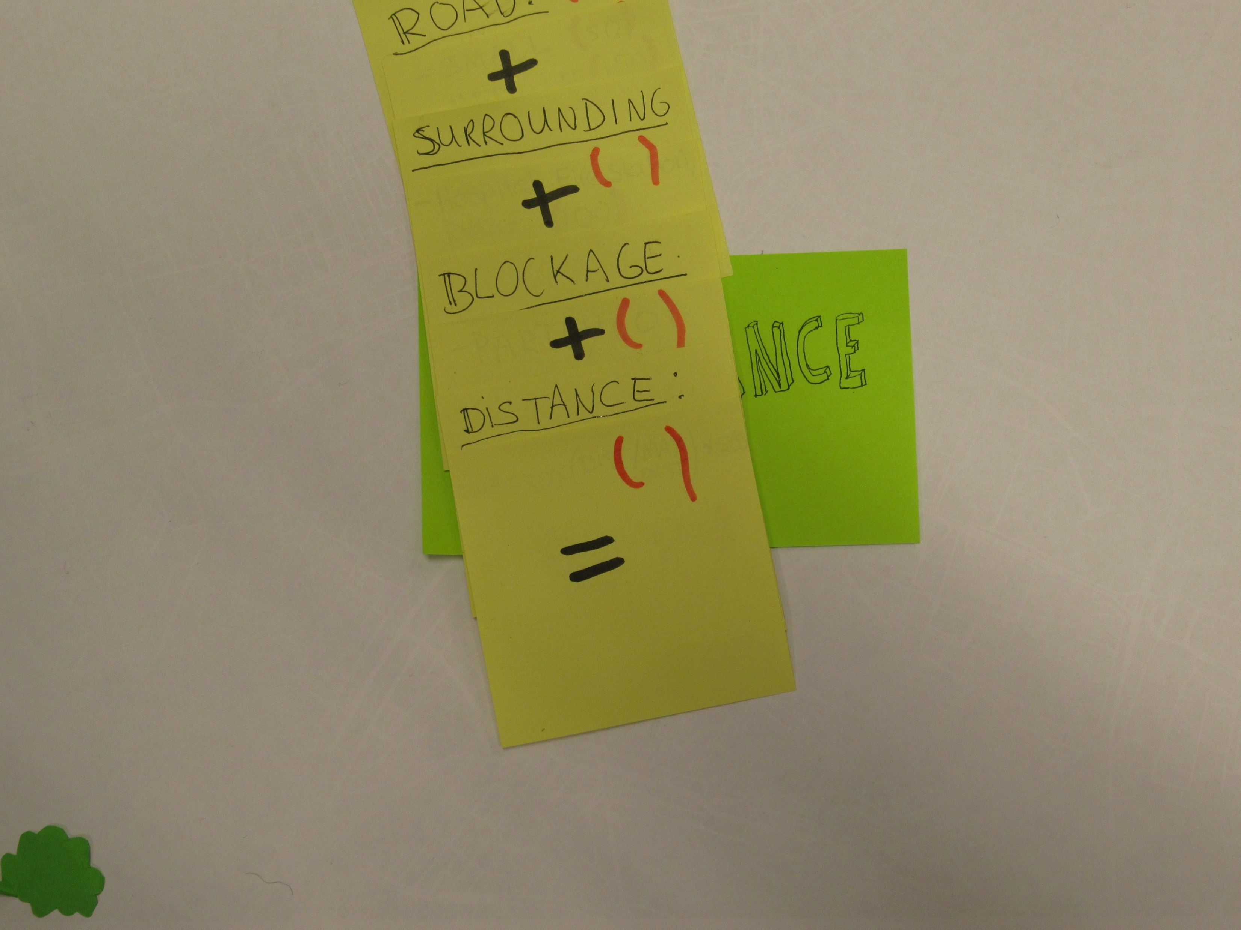

Slide 35
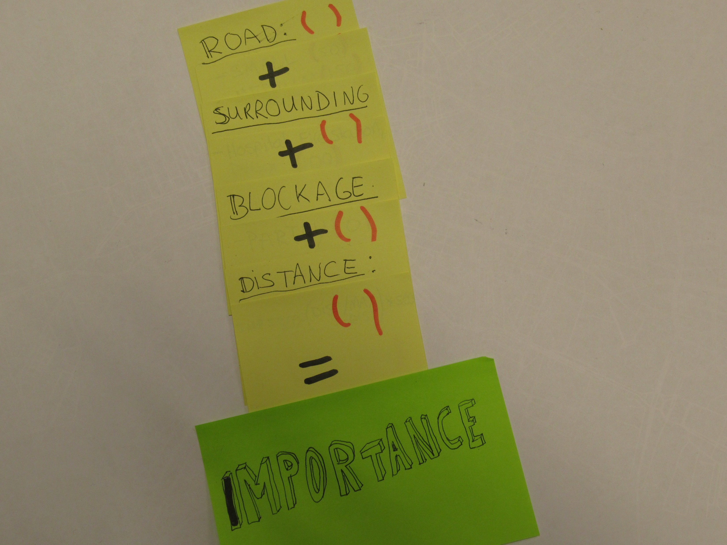

Slide 36
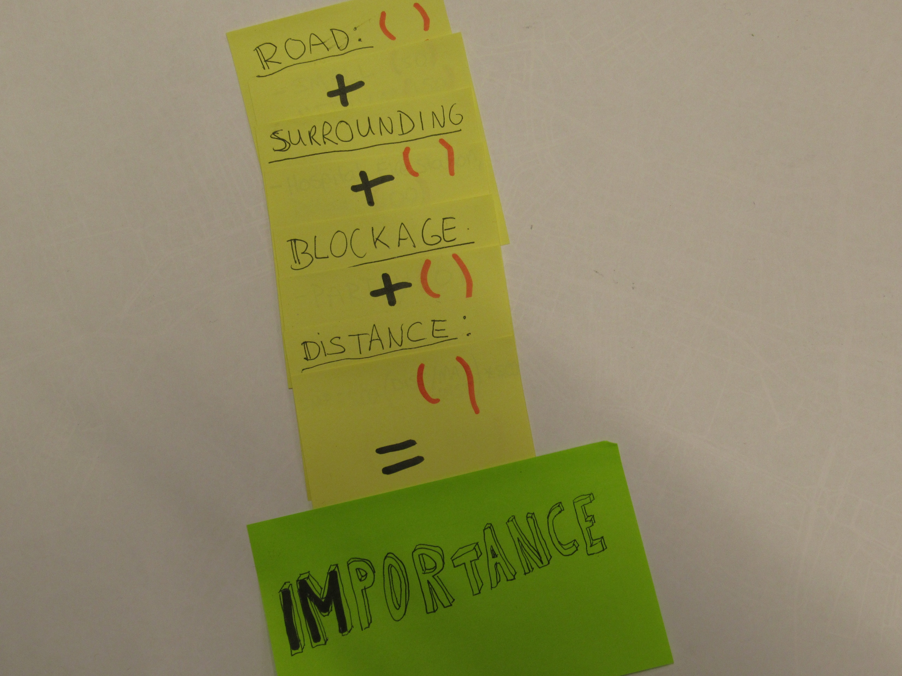

Slide 37
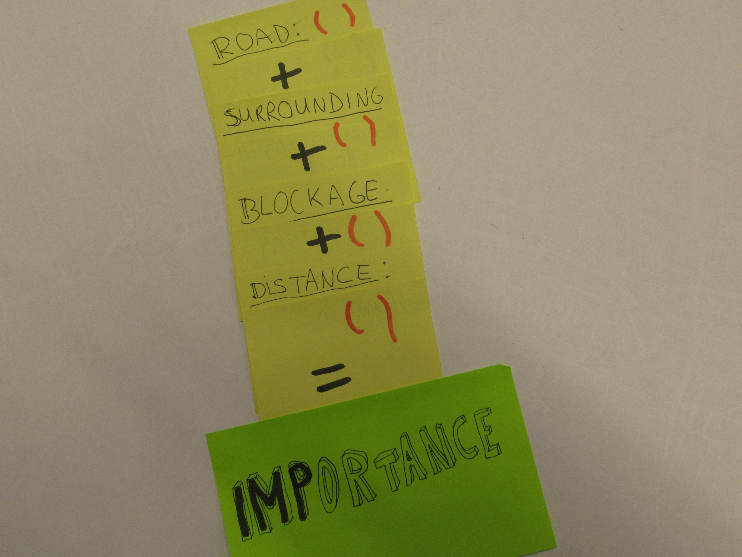

Slide 38
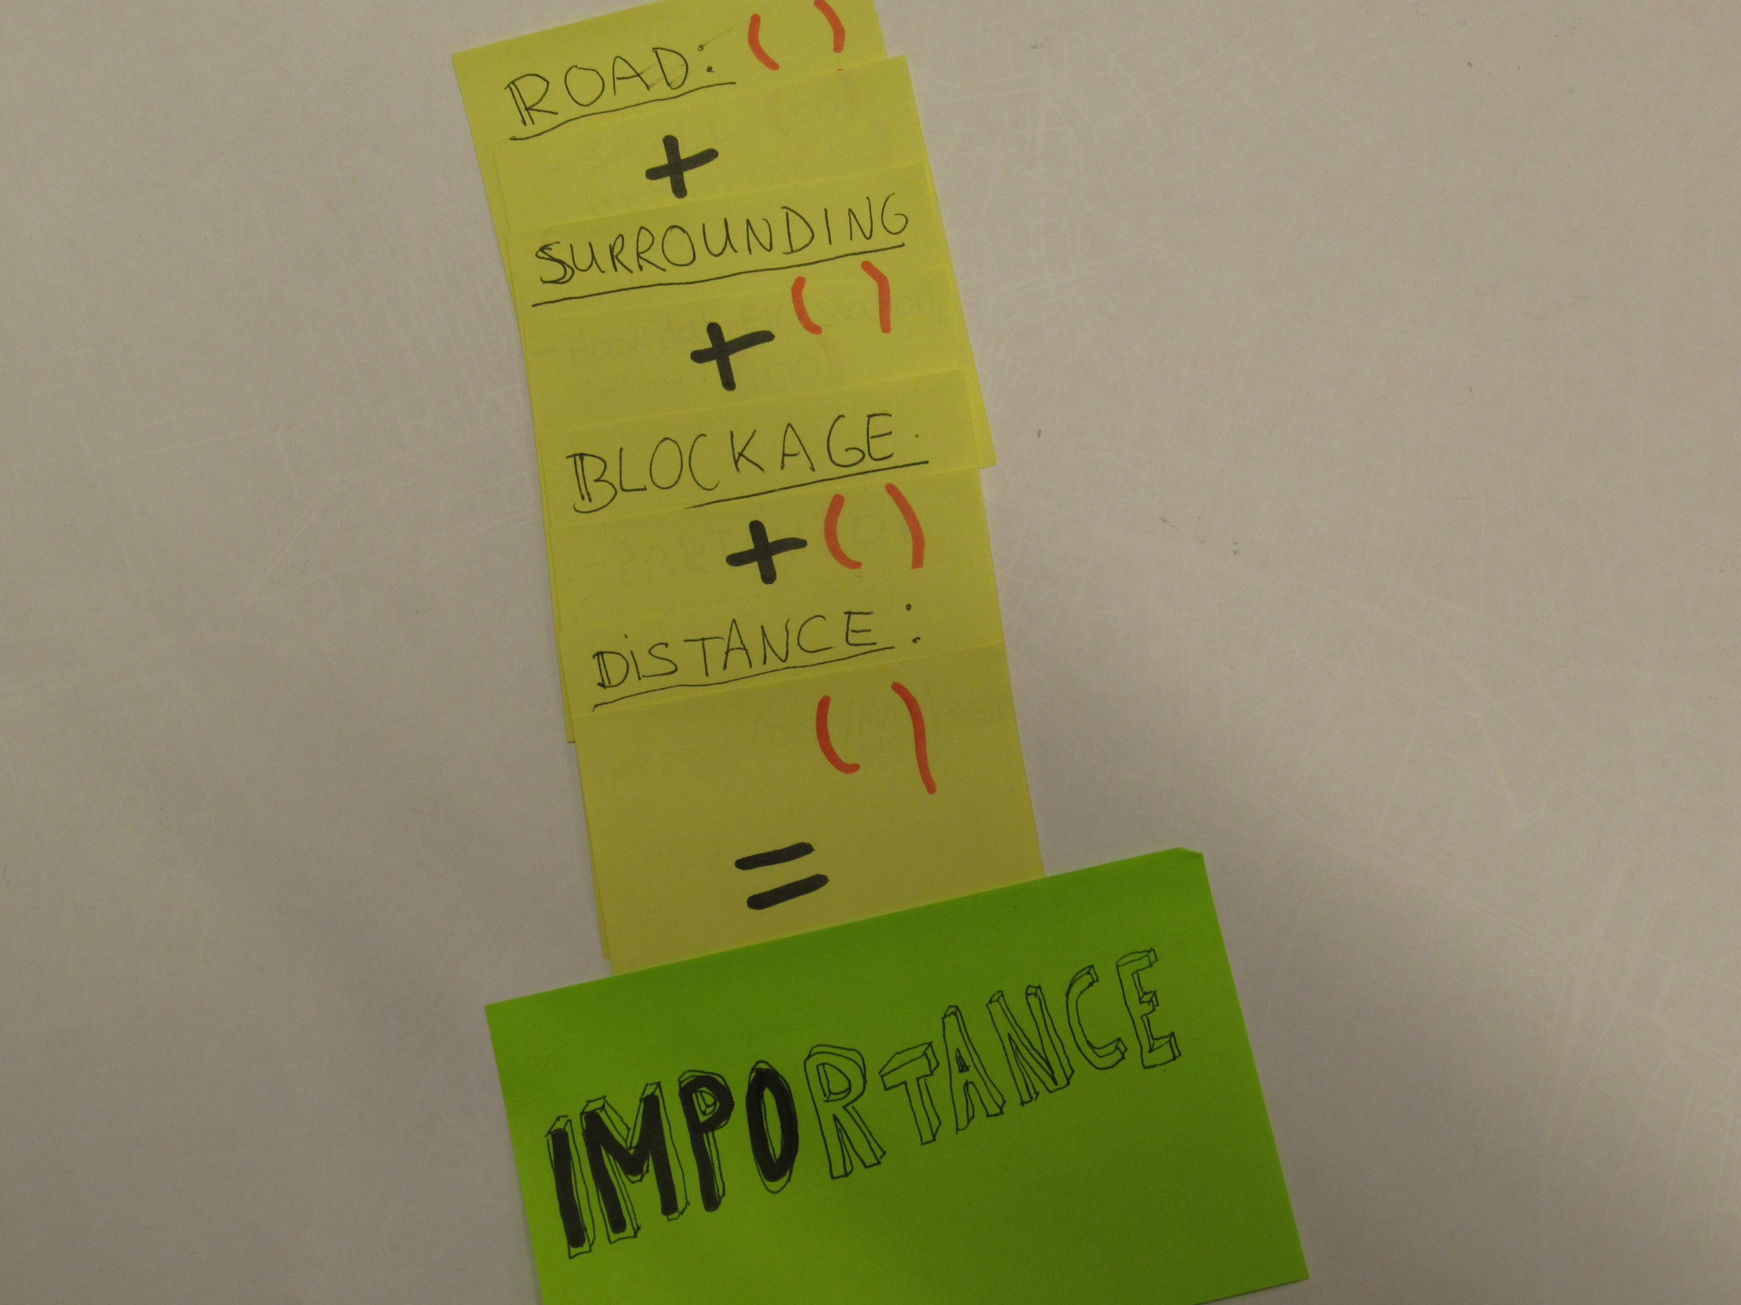

Slide 39
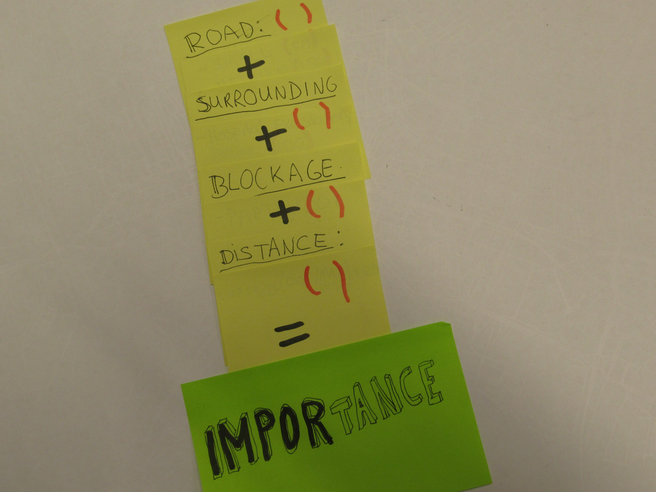

Slide 40
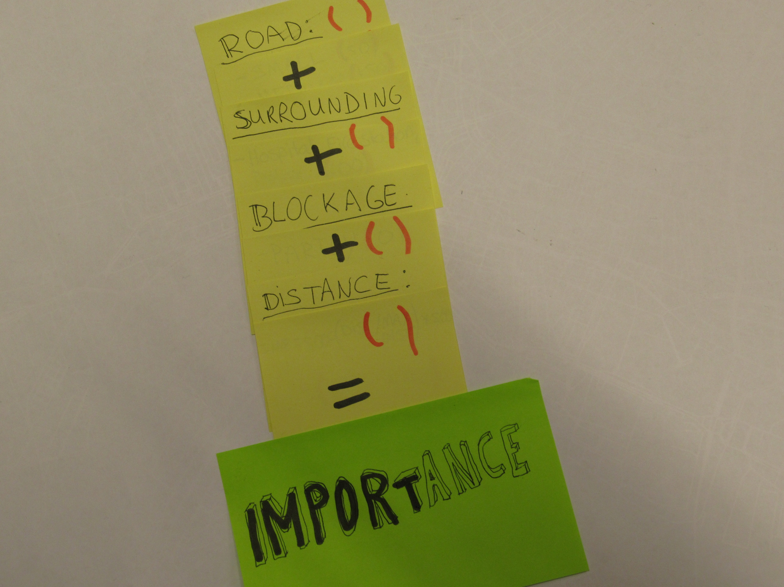

Slide 41
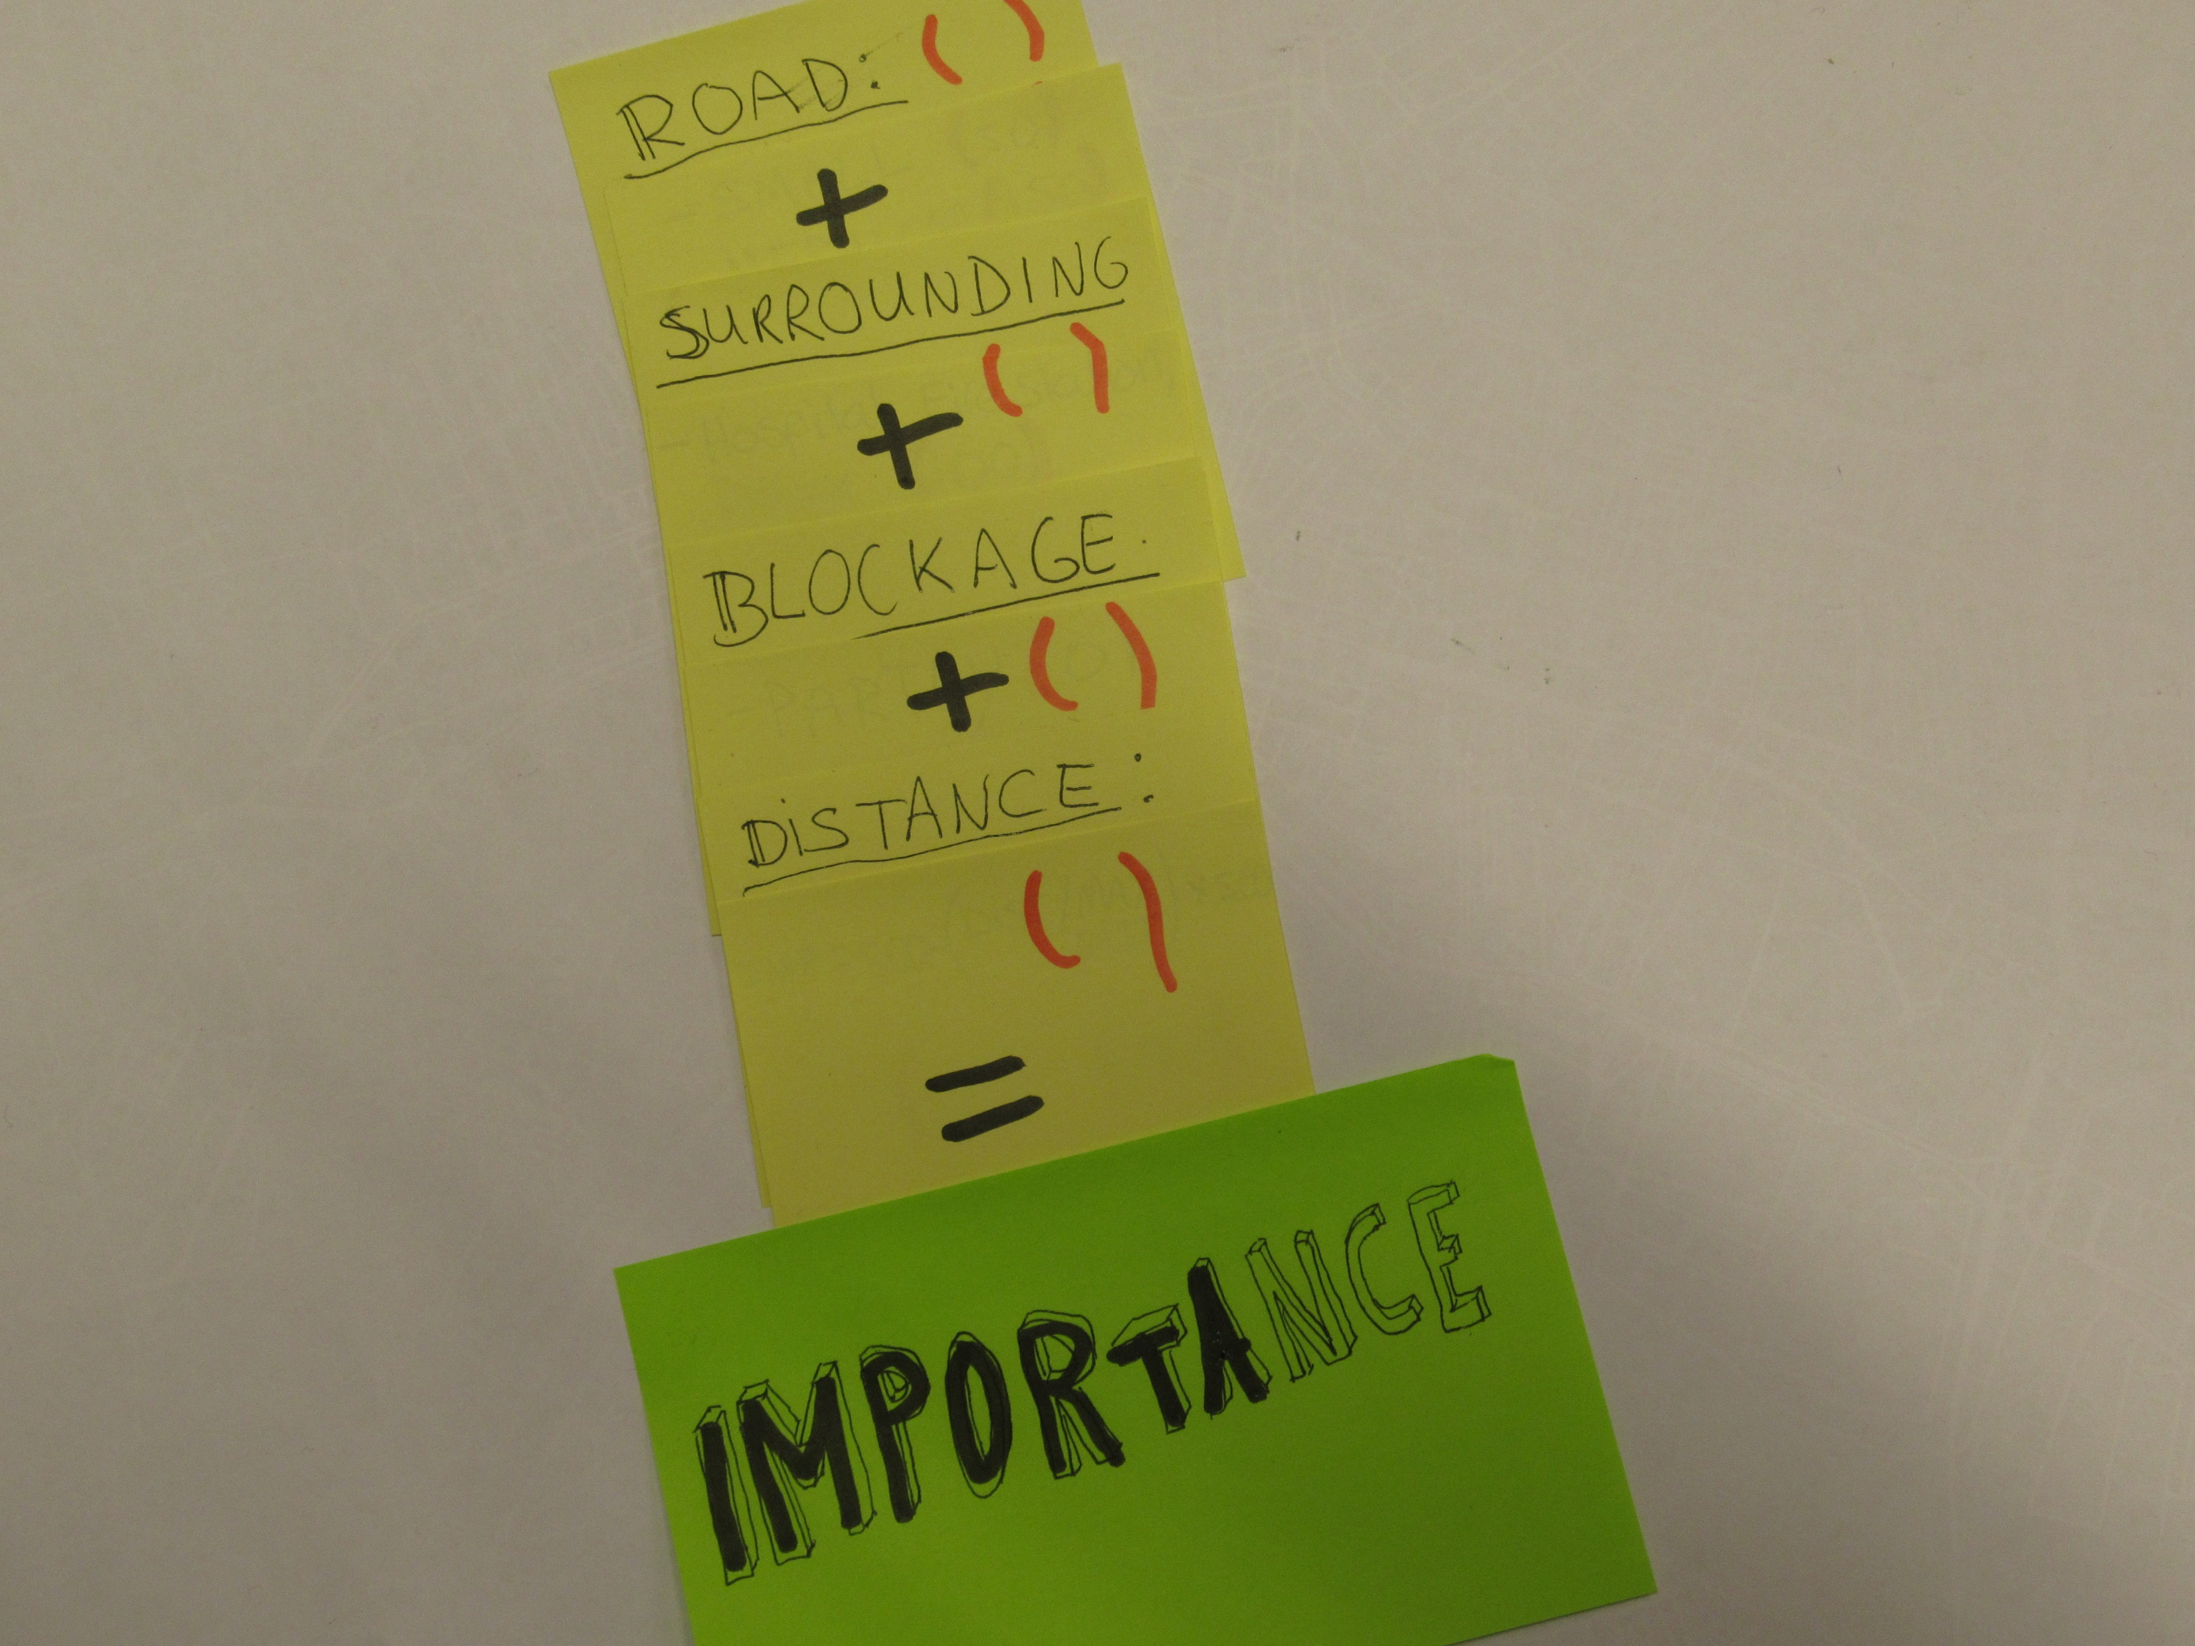

Slide 42
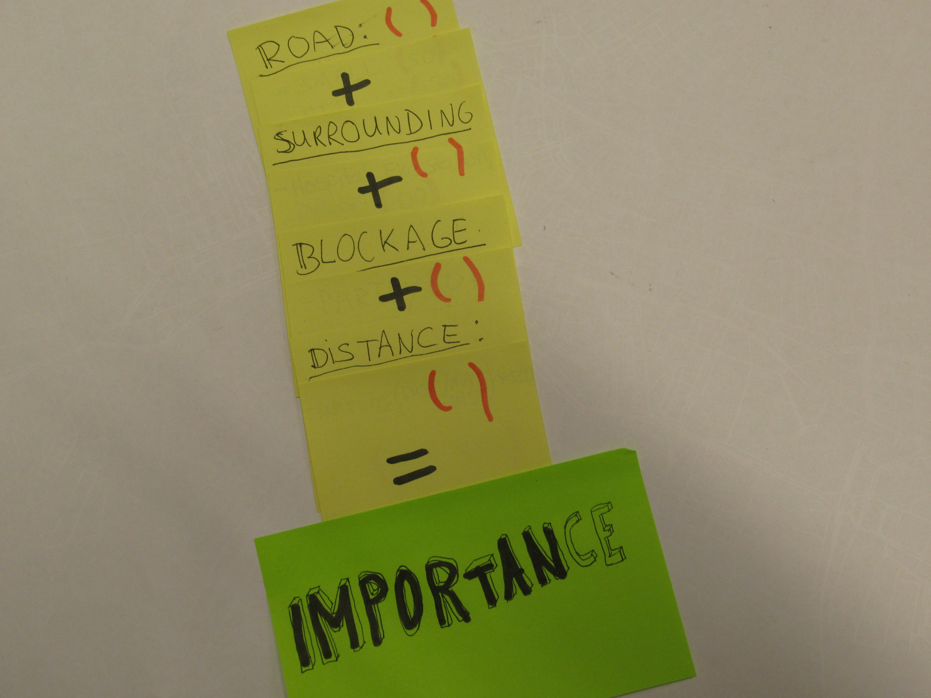

Slide 43
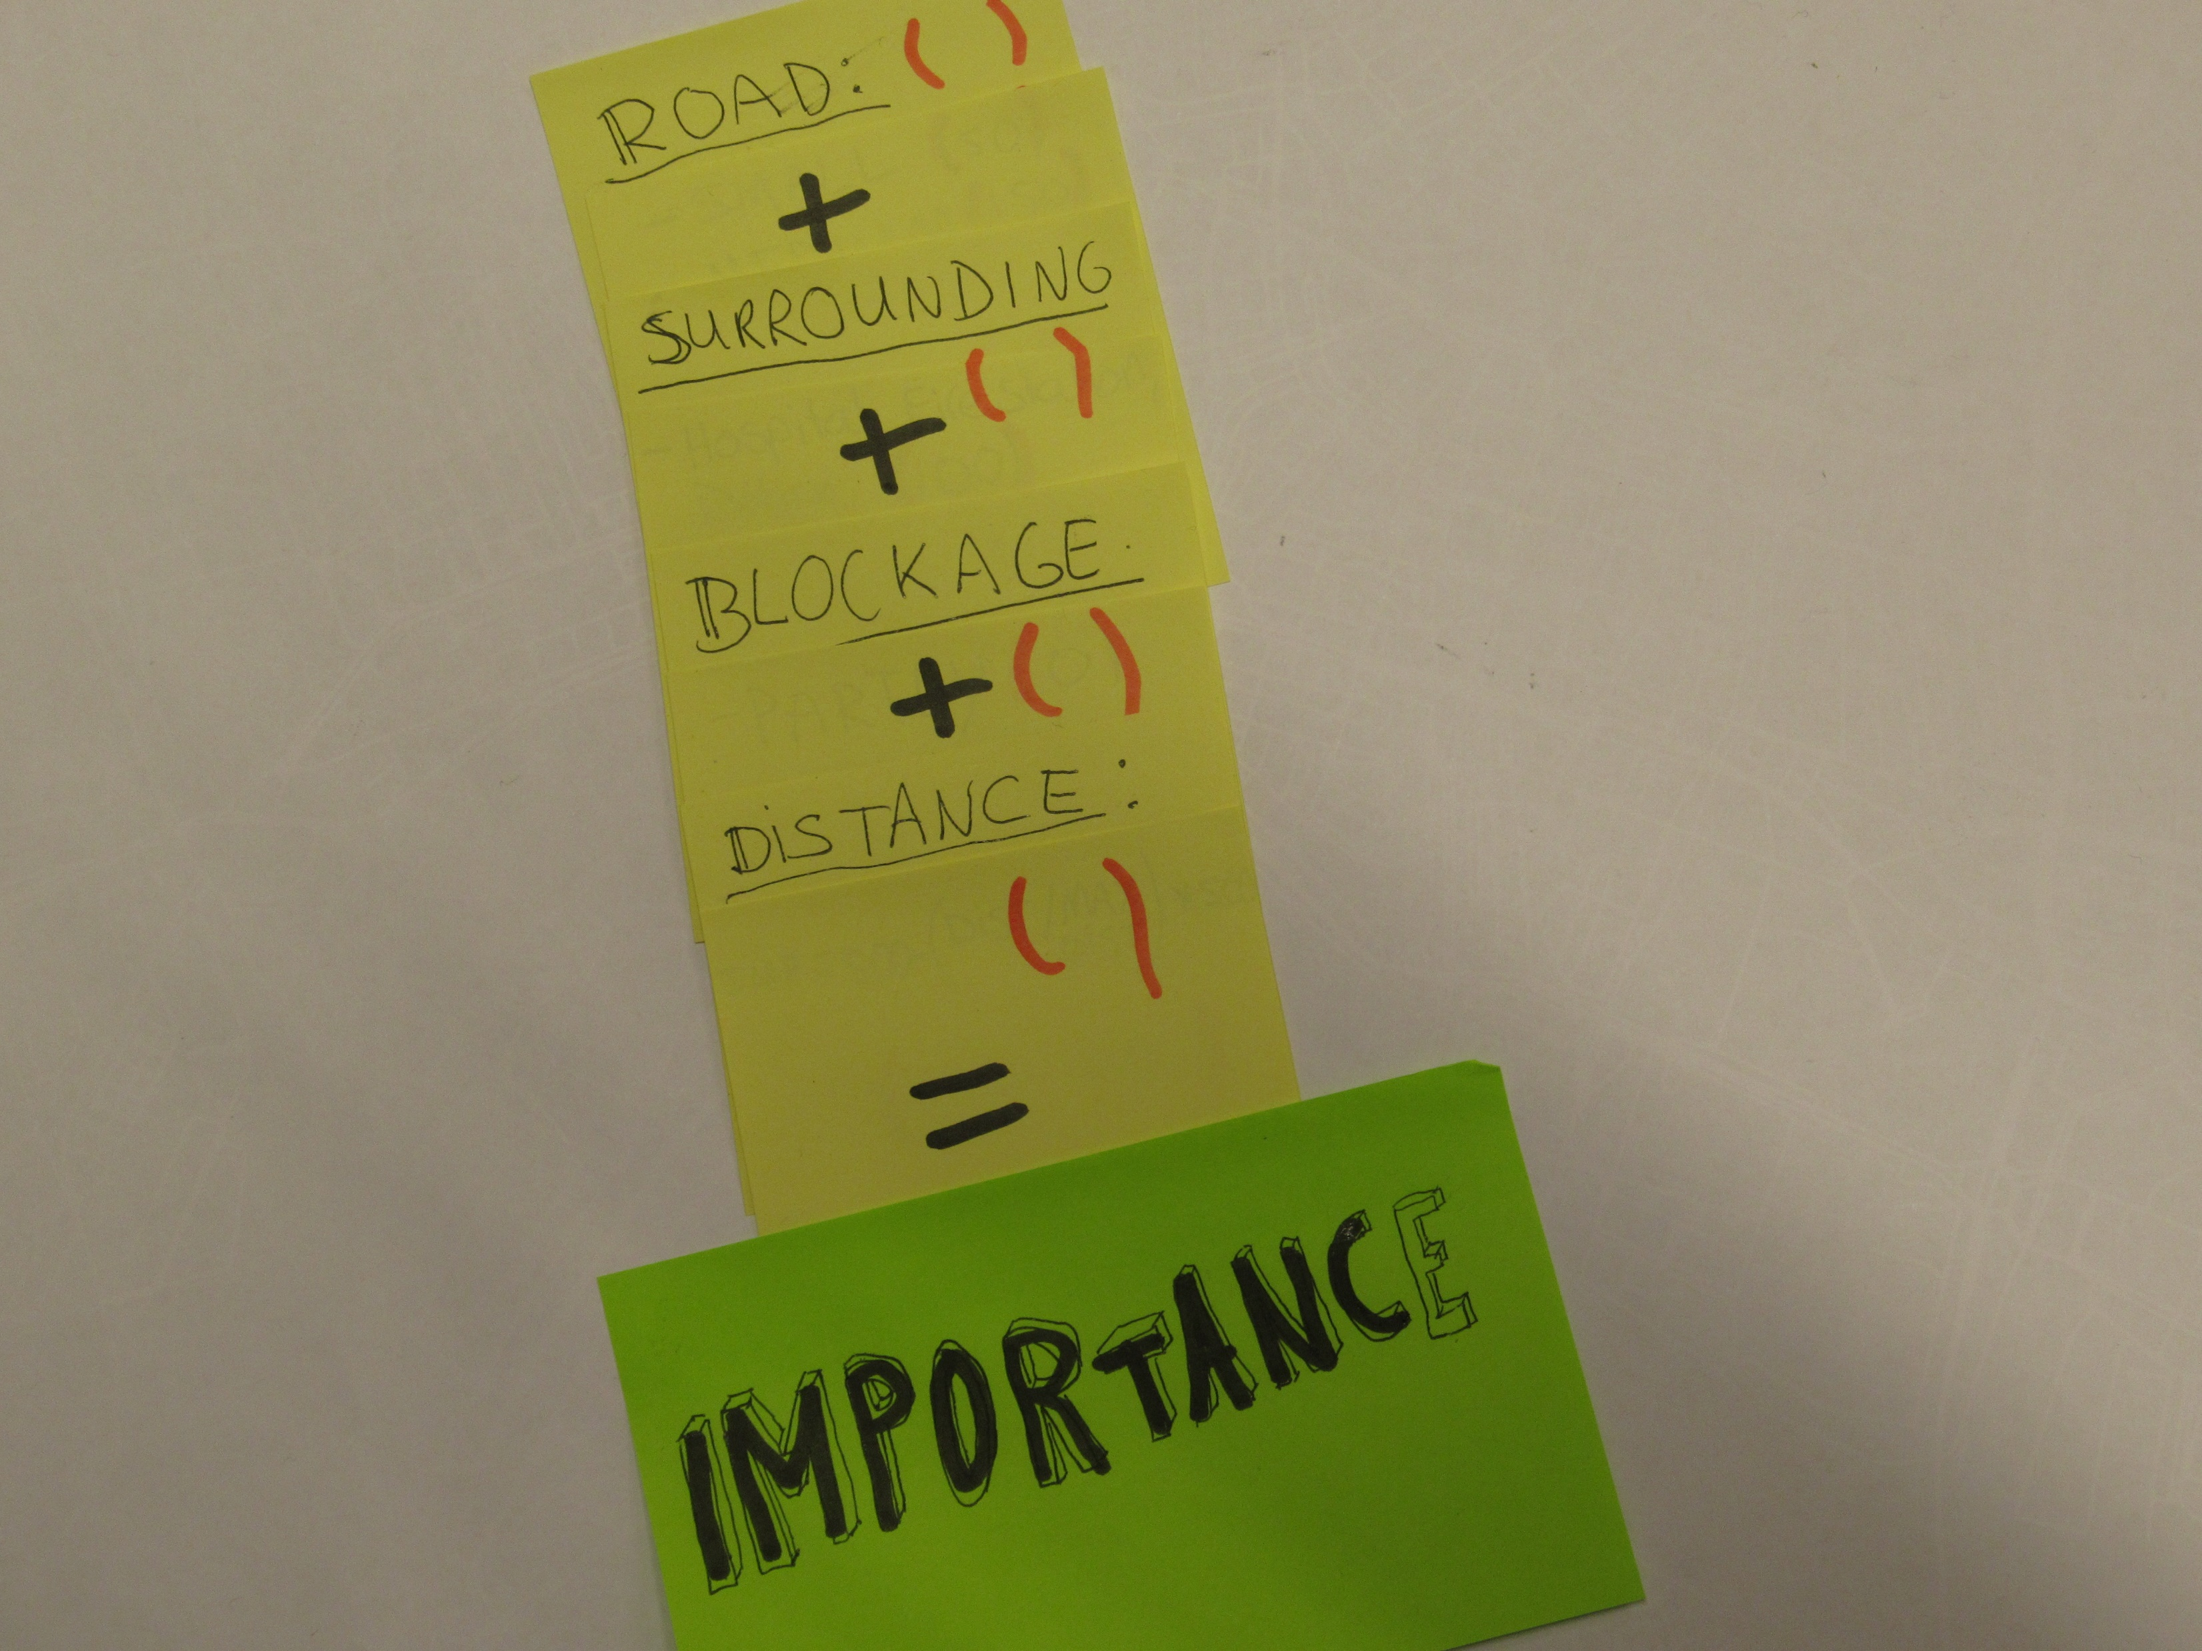

Slide 44
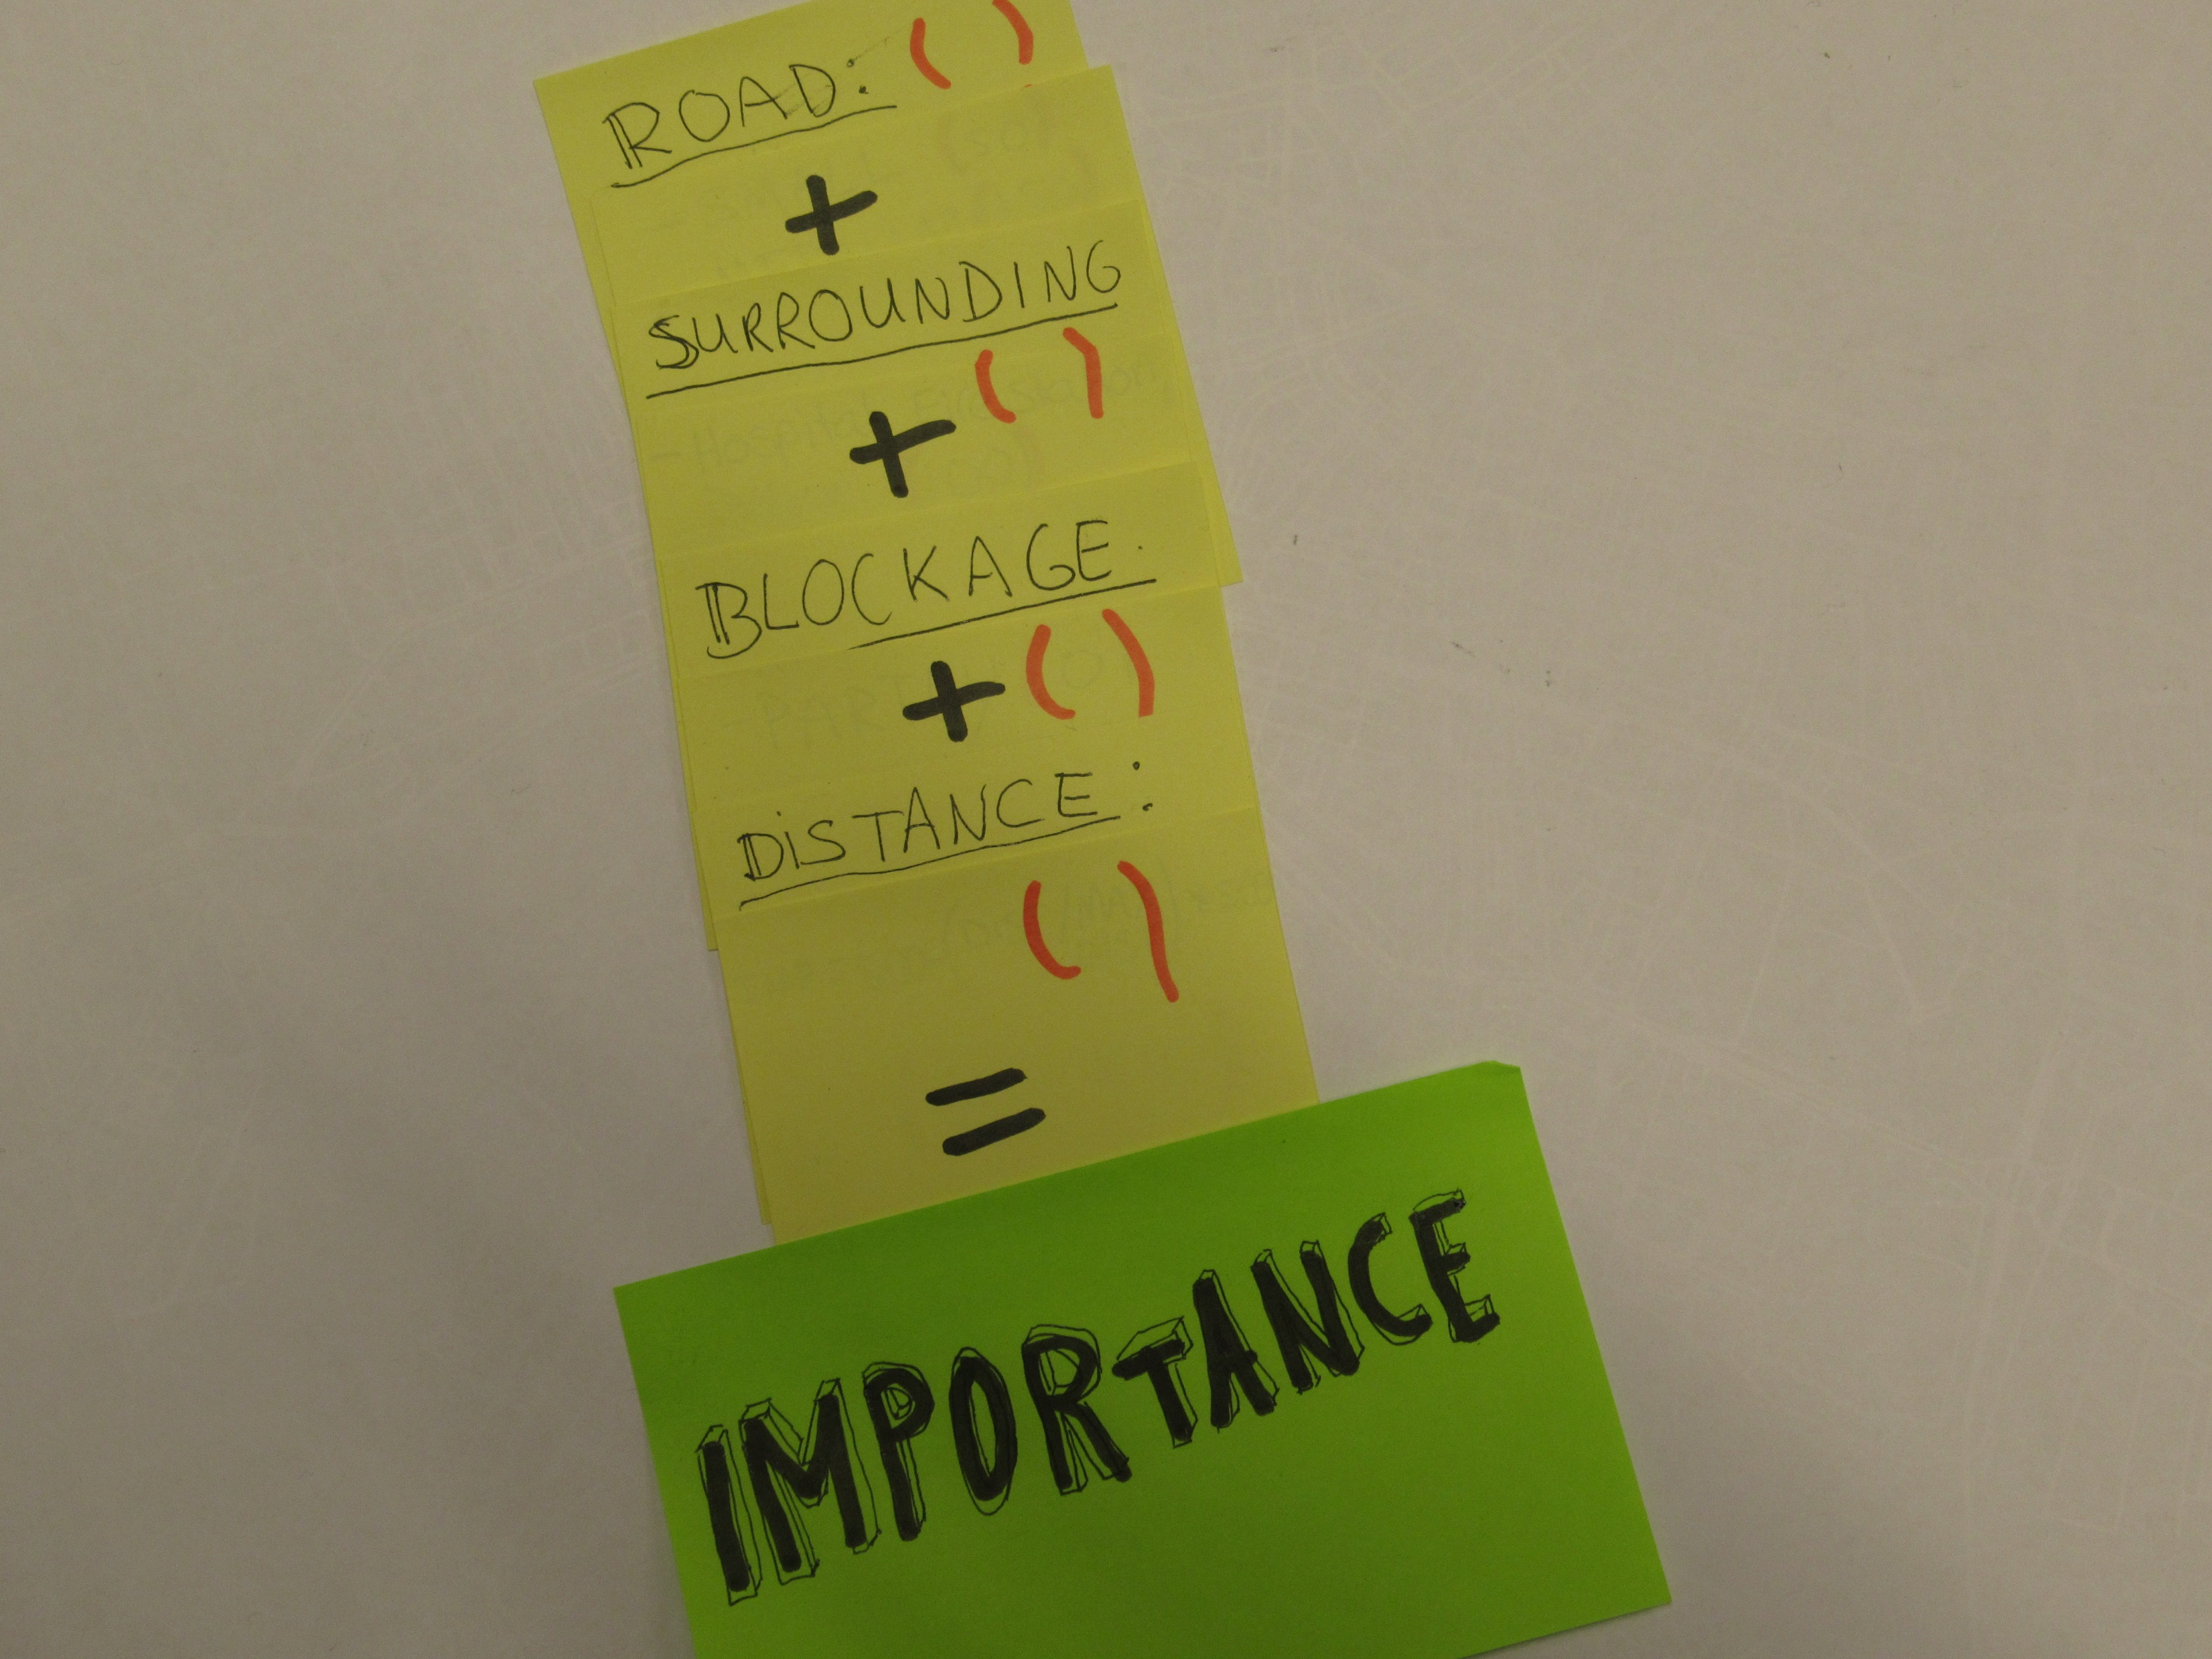

Slide 45
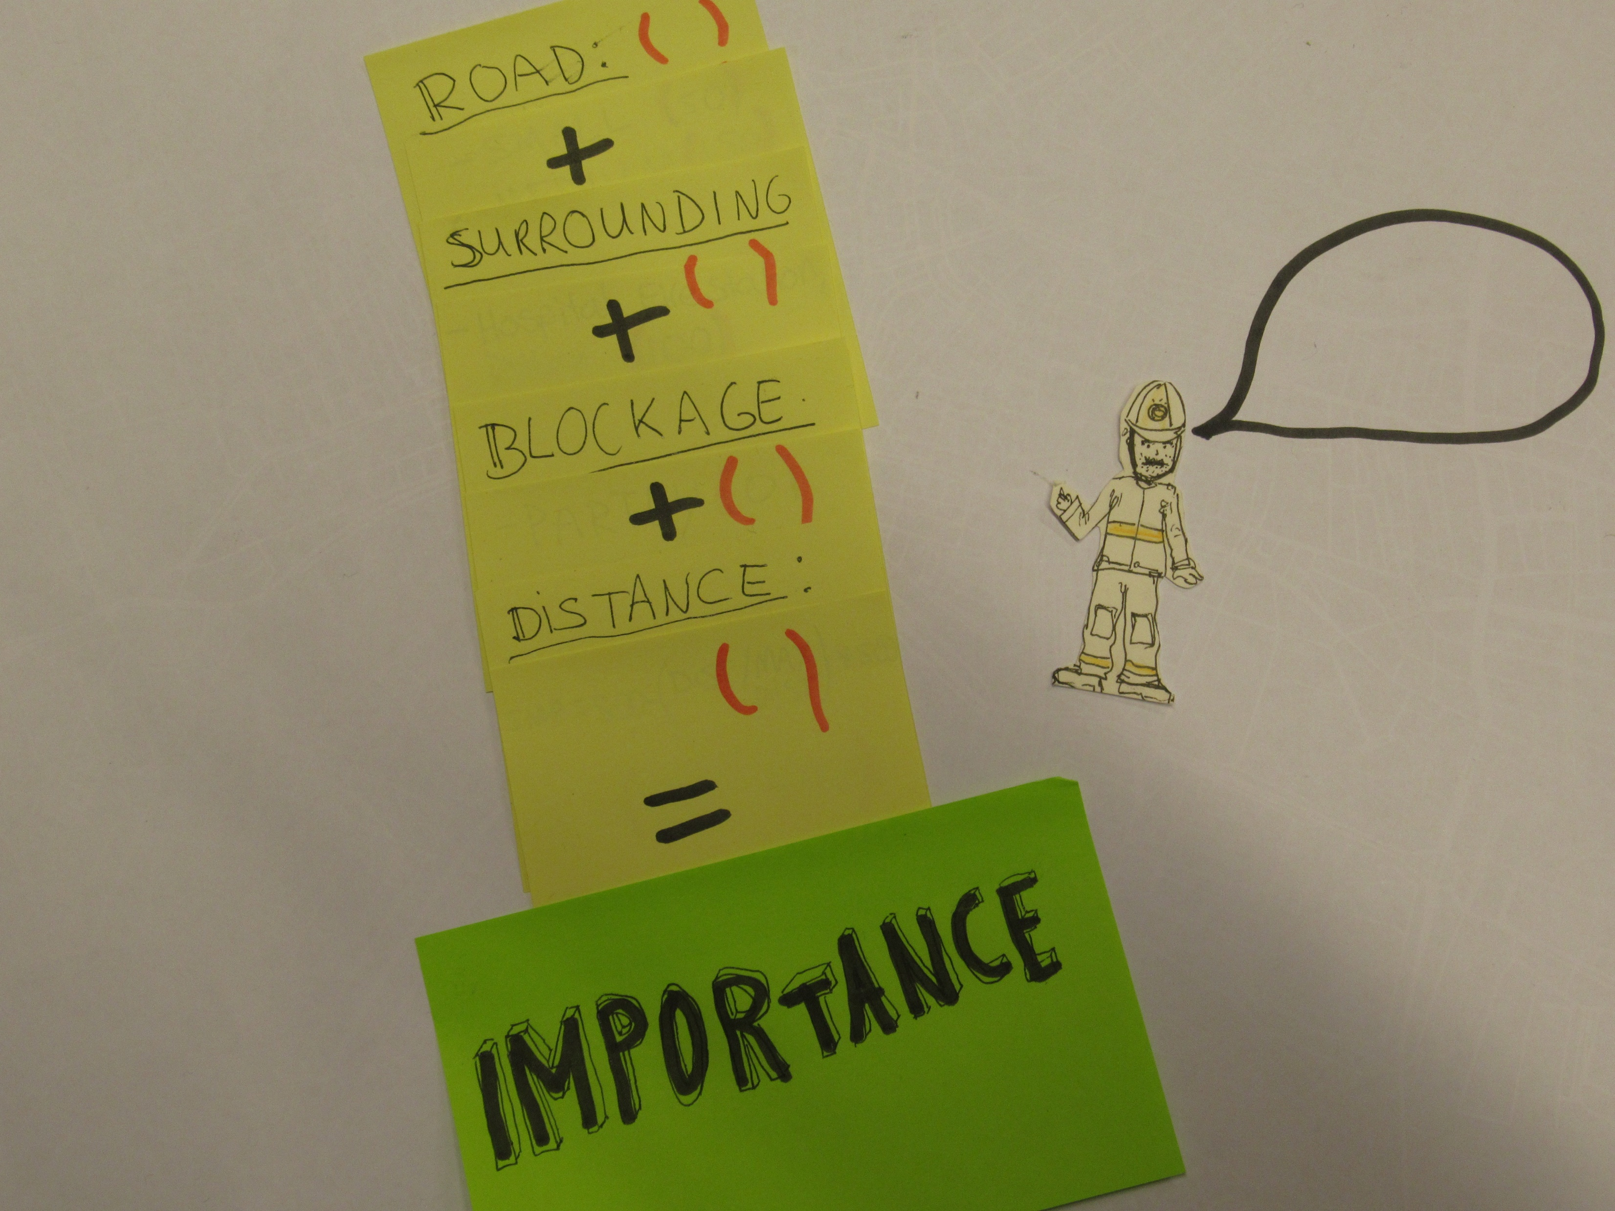

Slide 46
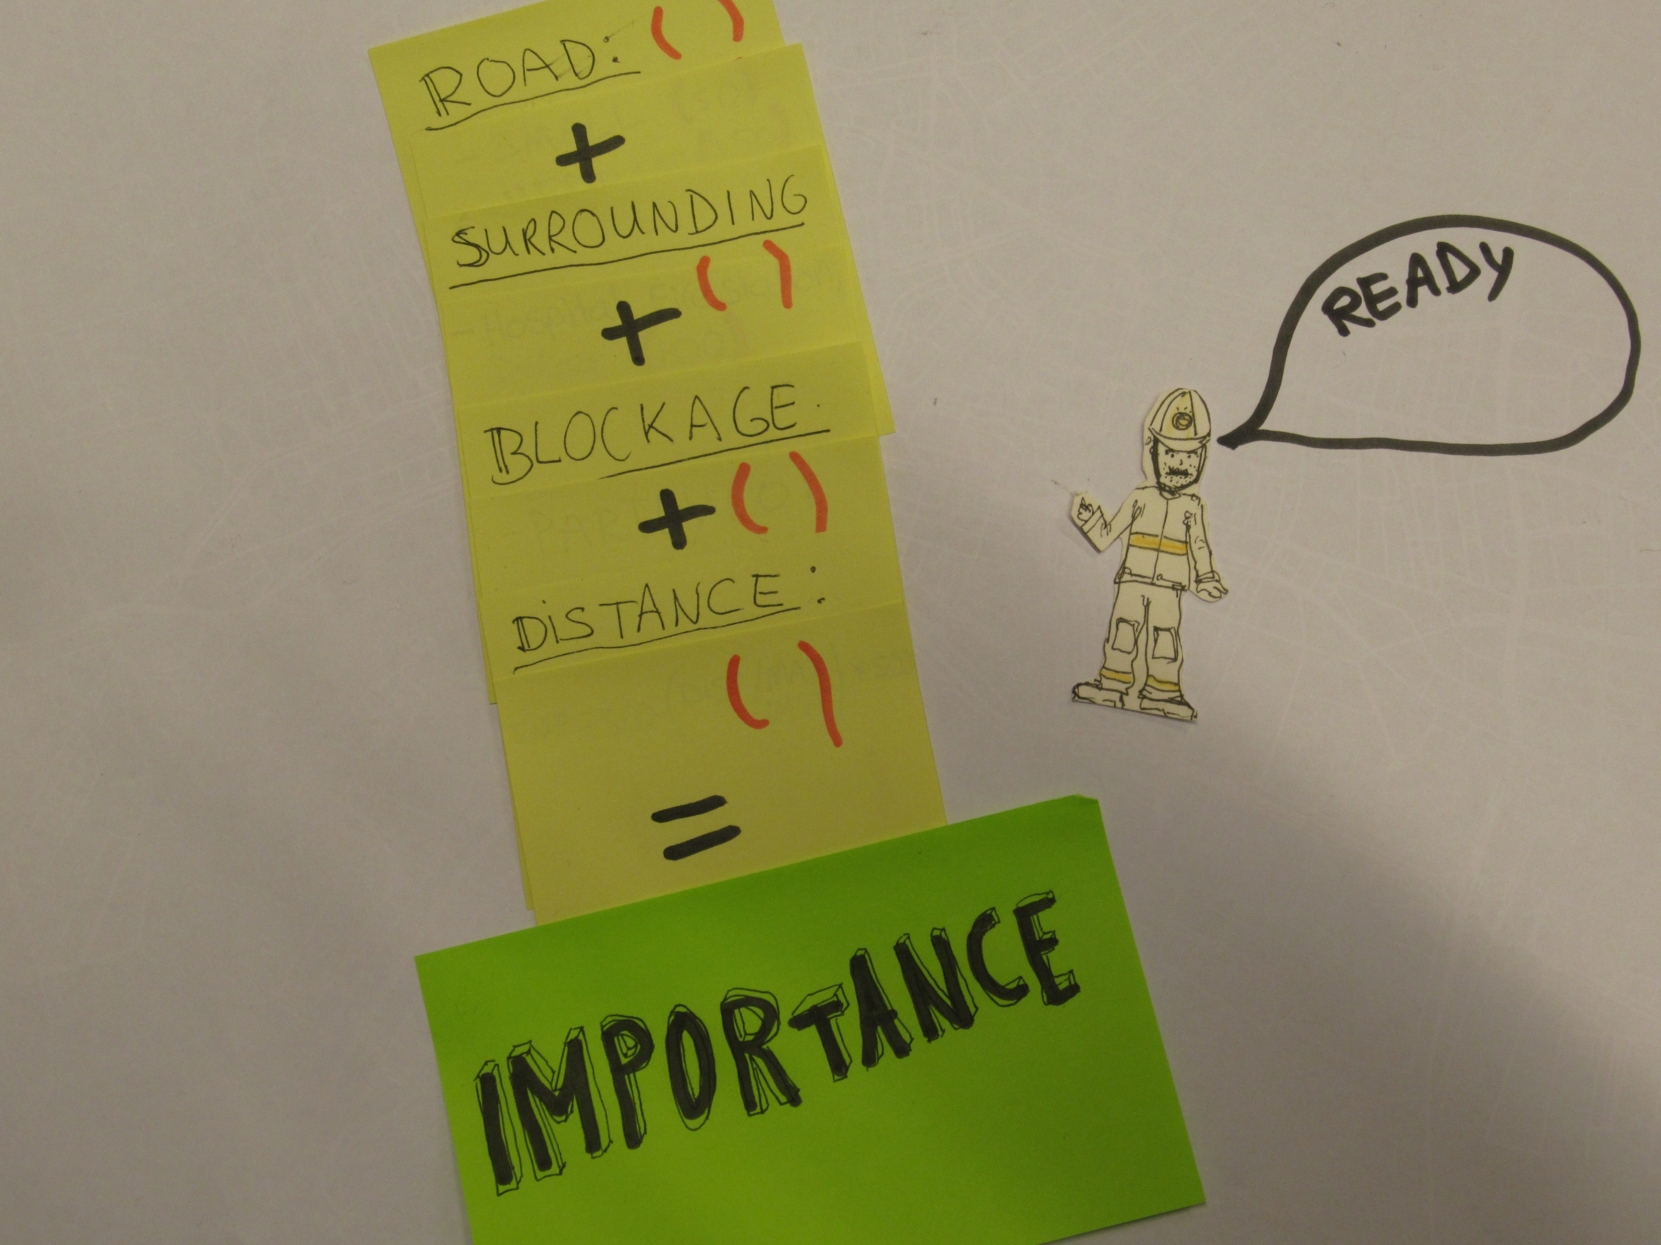
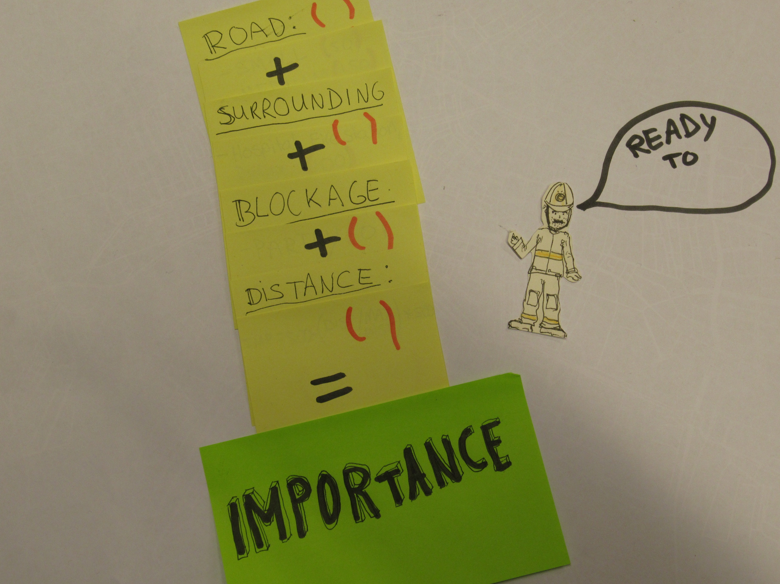

Slide 47
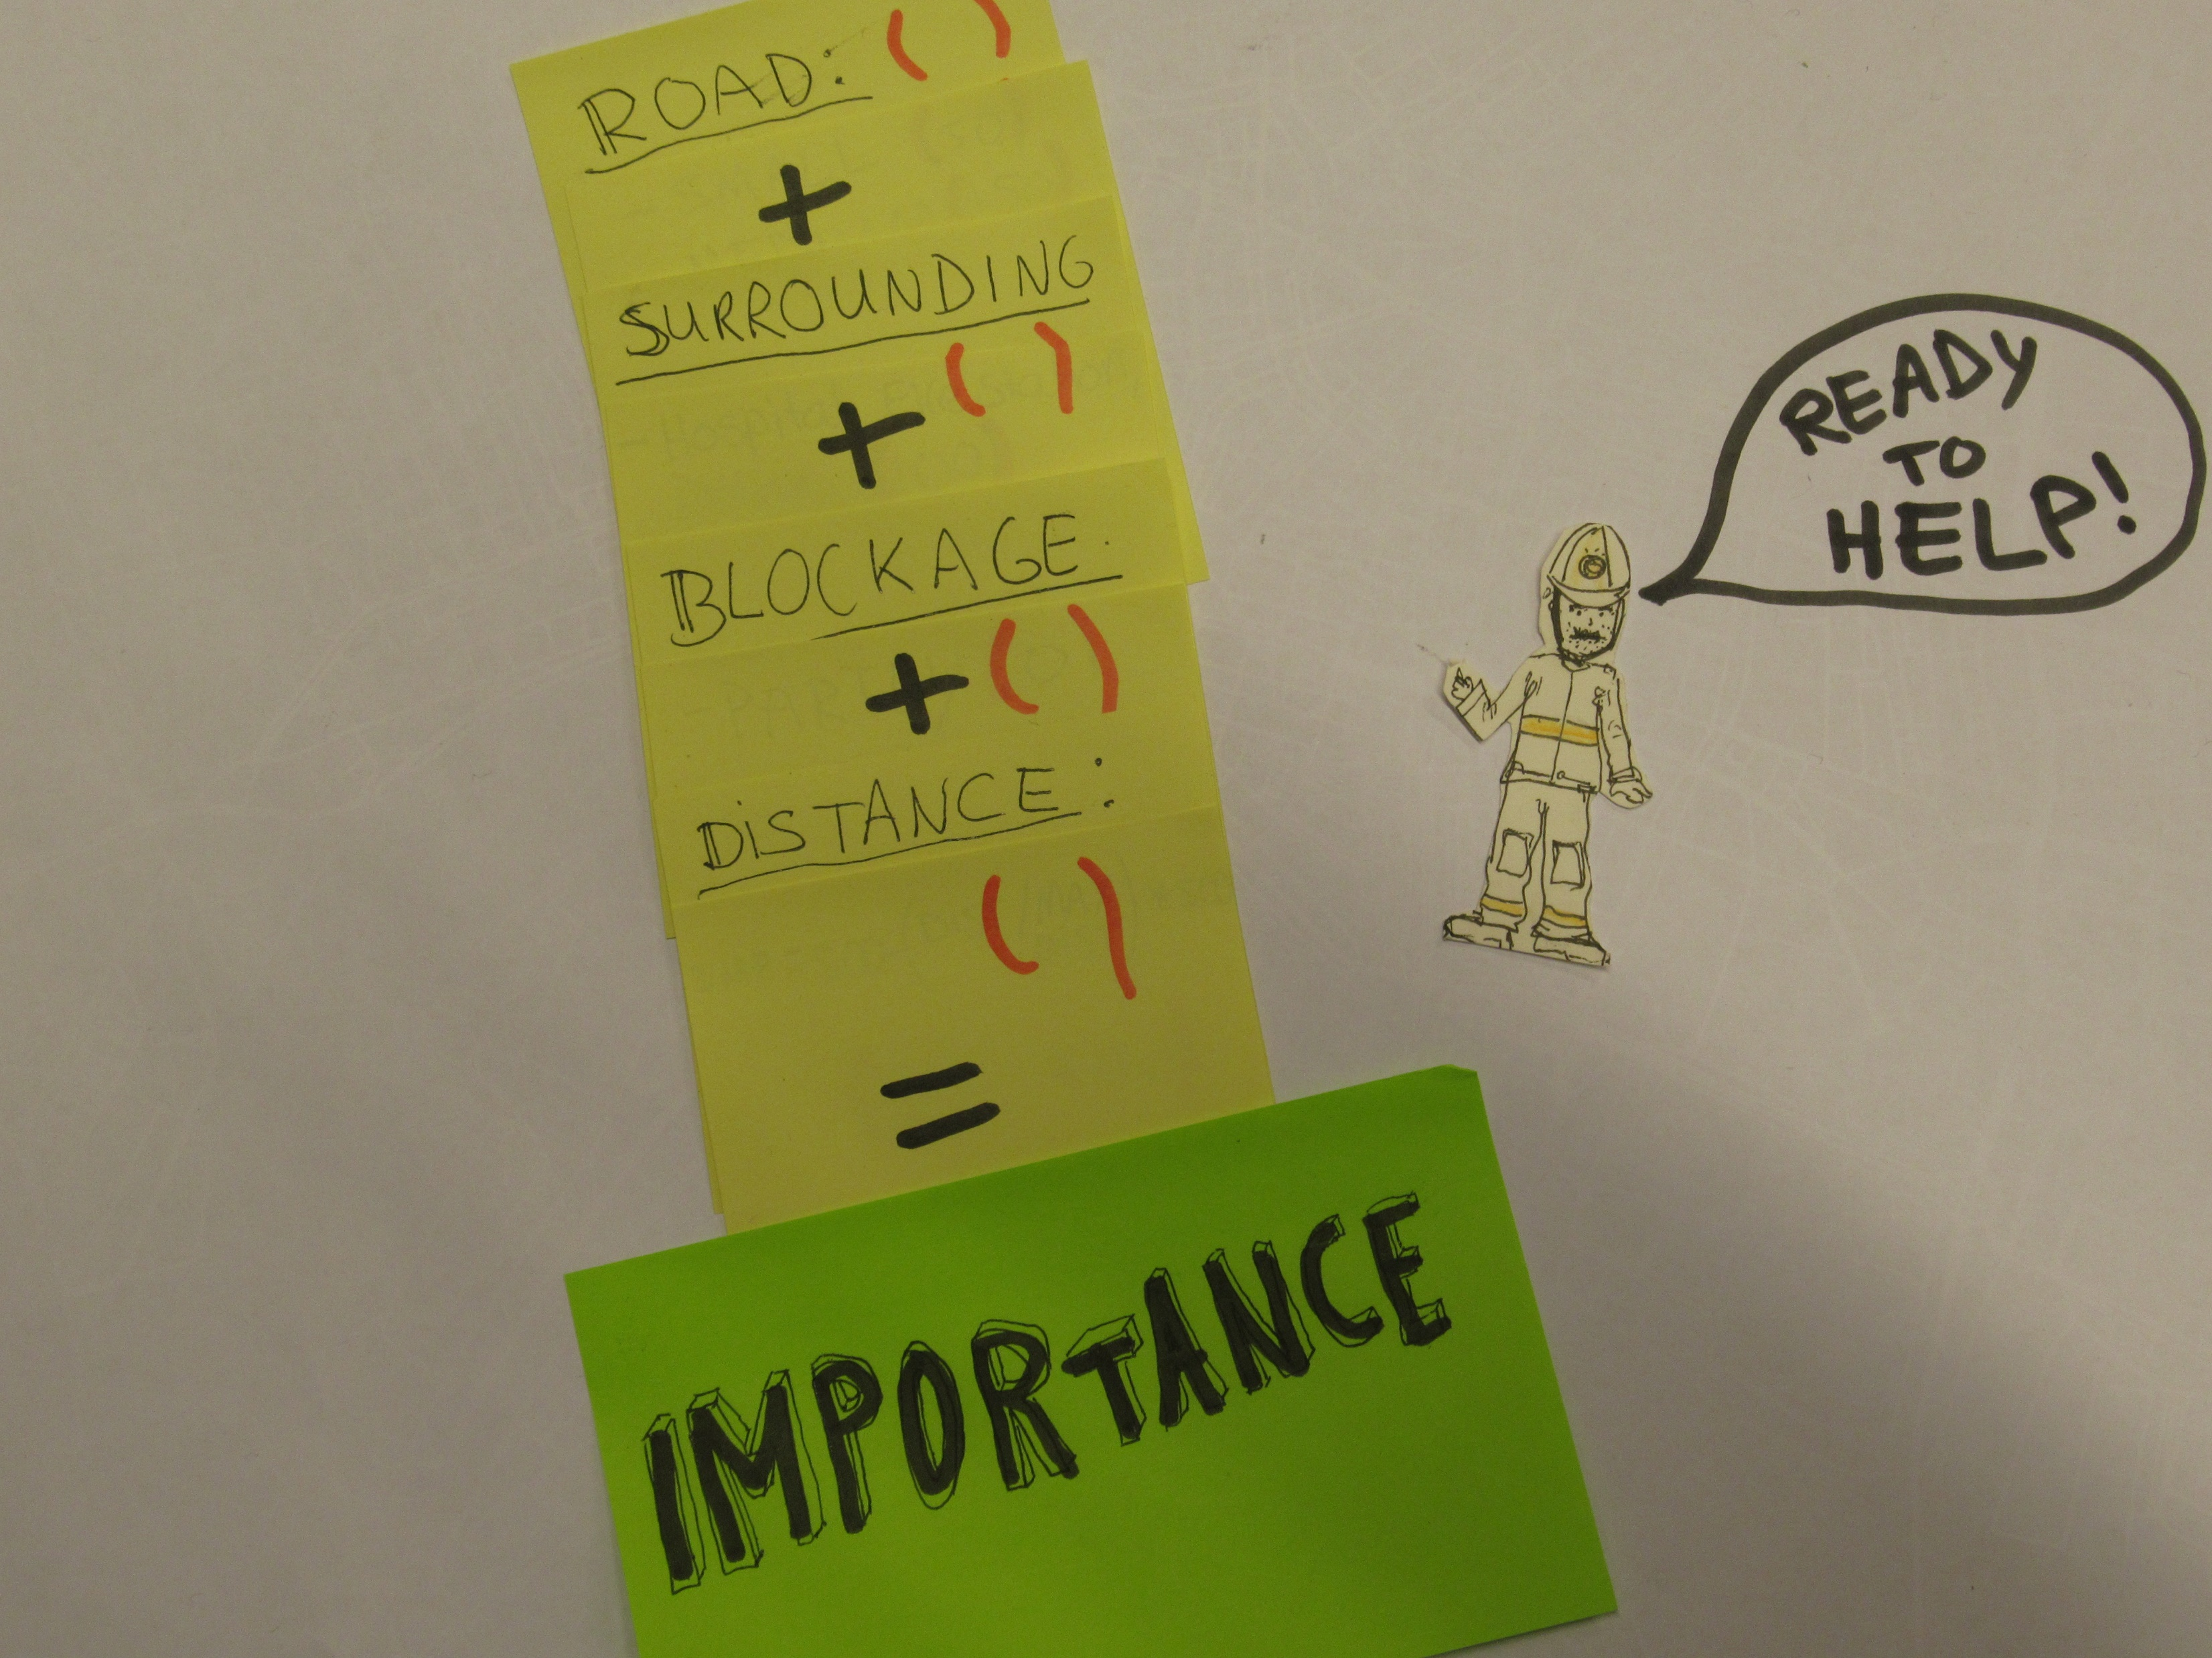

Slide 49
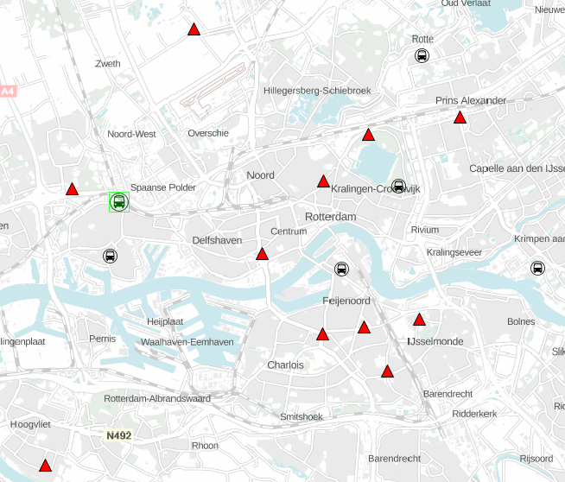
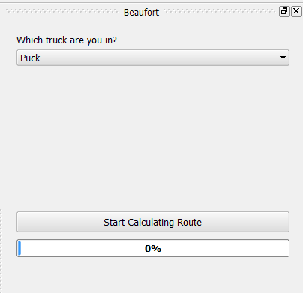
Visualisation
1. Why Beaufort?
2. User requirements
3. How does it work?
4. Visualisation
5. Future improvements

Slide 50
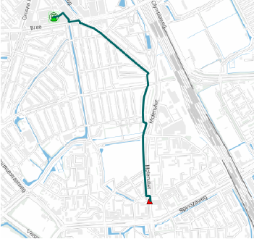
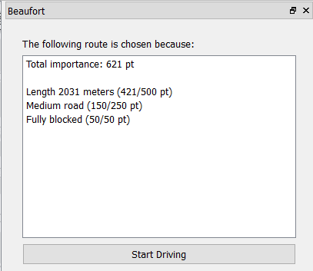
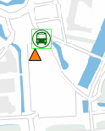
1. Why Beaufort?
2. User requirements
3. How does it work?
4. Visualisation
5. Future improvements
The moment you start driving, the roadblock status will change to ‘busy’ (orange)

Slide 51
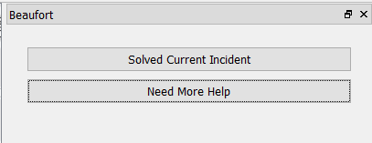
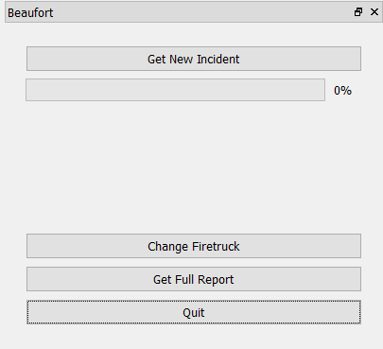
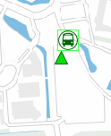
1. Why Beaufort?
2. User requirements
3. How does it work?
4. Visualisation
5. Future improvements
Doesn’t do much yet

Slide 52
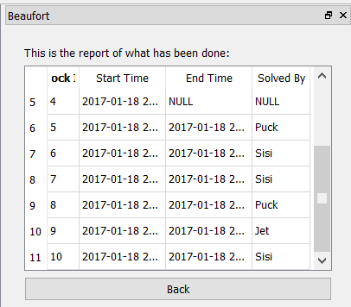
Get full report
1. Why Beaufort?
2. User requirements
3. How does it work?
4. Visualisation
5. Future improvements
For logging and comparison purposes

Slide 53
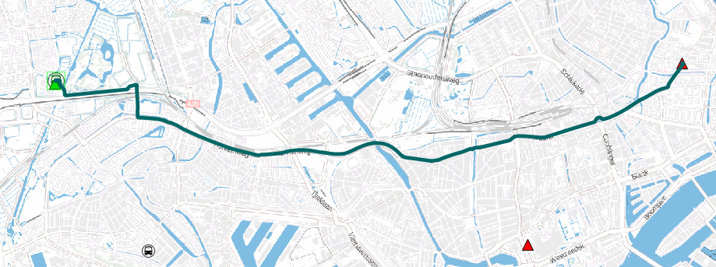
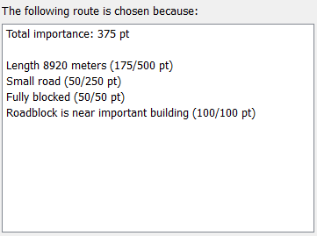
1. Why Beaufort?
2. User requirements
3. How does it work?
4. Visualisation
5. Future improvements

Slide 54
Future improvements
1. Why Beaufort?
2. User requirements
3. How does it work?
4. Visualisation
5. Future improvements
Finetune algorithm of importance
Add roadblocks on the way
Don’t drive on blocked roads
Focus on more than only roadblocks?
Real Time:
Position trucks with GPS
Real time roadblock additions by dispatch

Slide 55
Conclusion
A firetruck will always solve the most important obstacle in his area

Slide 56

Insert a picture

Slide 57

Insert a picture

